Slide 1
ILC
Accelerator Technology
Flavor Physics Workshop 2021, 30 Sept. 2021
Masao KURIKI
Graduate School of advanced science and technology, Hiroshima U.

Slide 2
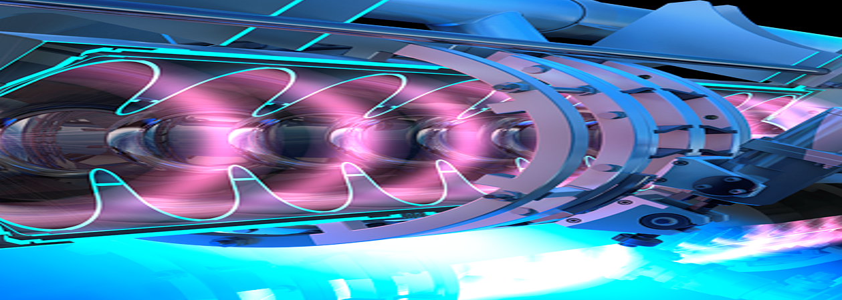
Contents
1
ACCELERATOR EVOLUTION
2
LINEAR COLLIDER DESIGN COCEPT
3
ILC ACCELERATOR TECHNOLOGY
4
SUMMARY

Slide 3
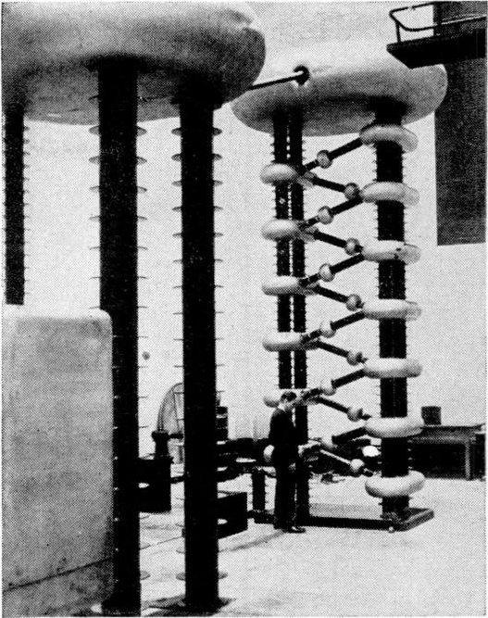
ACCELERATOR
EVOLUTION

Slide 4
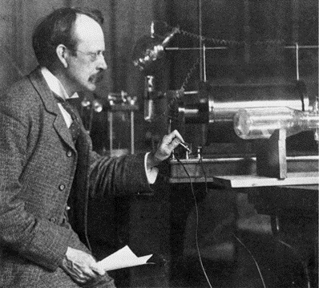
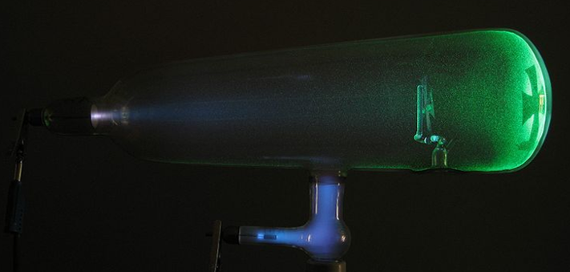
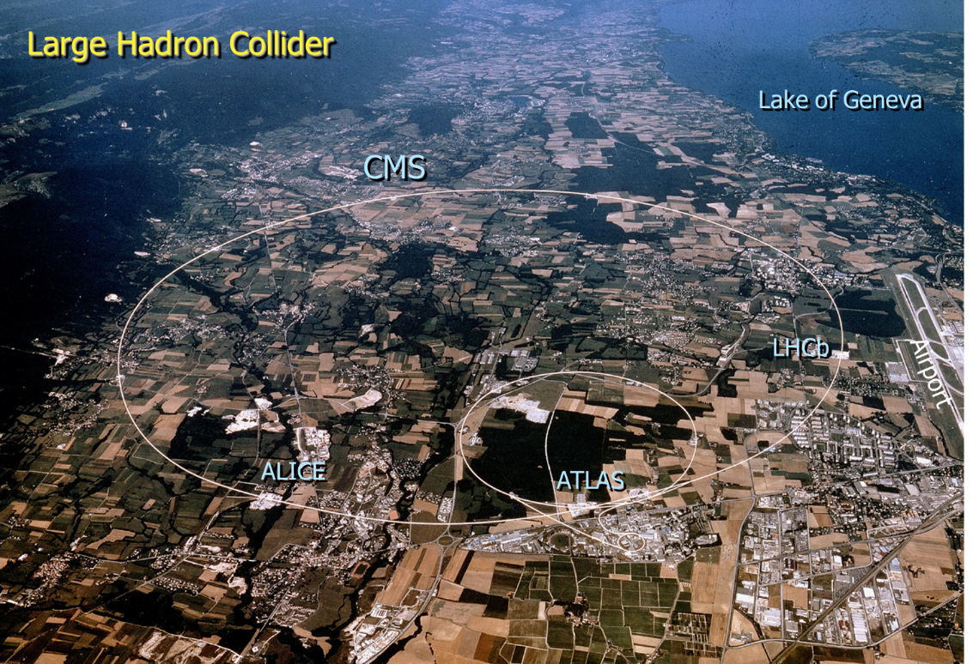
J. J. Thomson
1897 Discovery of electron by crookes tube.
Length 20 cm
Energy 100 keV
The first contact to elementary particles
2008 LHC starts at CERN
110 years
Length x 140000
Energy x 70,000,000
Circ. 27 km
Energy 7 x 7TeV

Slide 5
ACCELERATOR PERFORMANCE
LUMINOSITY
CME
KINEMATICS
EVENT RATE
REACH
ACCURACY
GIVING A LARGE NUMBER OF EVENTS FOR GOOD STATISTICS
ABILITY TO PRODUCE HEAVY PARTICLES FOR NEW PHYSICS
DEFIEN INITIAL STATE ACCURATELY FOR THE FULL EVENT RECONSTRUCTION.

Slide 6


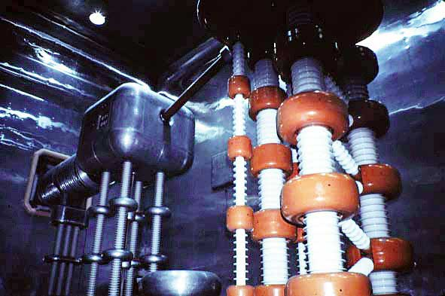

DC Accelerator : Cockcroft-Walton
Acceleration by static field.
Acceleration voltage is limited by discharge.
Acceleration is only once.
The highest energy is limited by vacuum discharge.

Slide 7
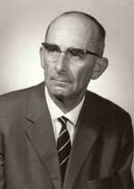
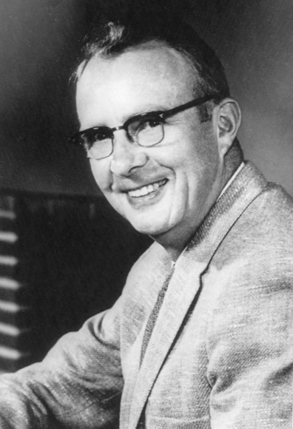
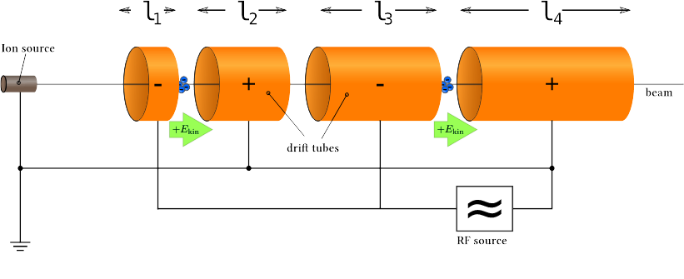
AC（RF） Accelerator
Acceleration by temporary varying field.
Acceleration can be repeatable.
The energy is unlimited principally.
This is dawn of HIGH ENERGY ACCELERATOR.
G. Ising
R. Wideroe
L. Alvarez

Slide 8
Power of Collider
Don’t move !
Beam energy for Higgs
(e+e- -> Zh)
Collider
125GeV + 125 GeV
（250GeV ILC ）
Fixed target
62,500,000 GeV
（ 250,000 ILC ）
If the particles move after collision, less effective.

Slide 9
Energy Frontier
Many Ring Colliders, but only one Linear collider
EUROPE
ASIA
US
DORIS
SPEAR
PETRA
TRISTAN→KEKB
HERA
SLC
PEP
TEVATRON
SSC
International Linear Collider
ISR
SppS
LEP→LHC
Why we built linear colliders?
Notes:
TRISTAN 3km; LEP 27km; SppS 6.9km; ISR 0.942km; HERA 6.336km; PETRA 2.3km; DORIS 0.3km; SLC (linac) 3.2km; PEP 2.199km; SPEAR 0.234km; TEVATRON 6.3km; SSC 87.1km; ILC 50km (1 TeV)

Slide 10
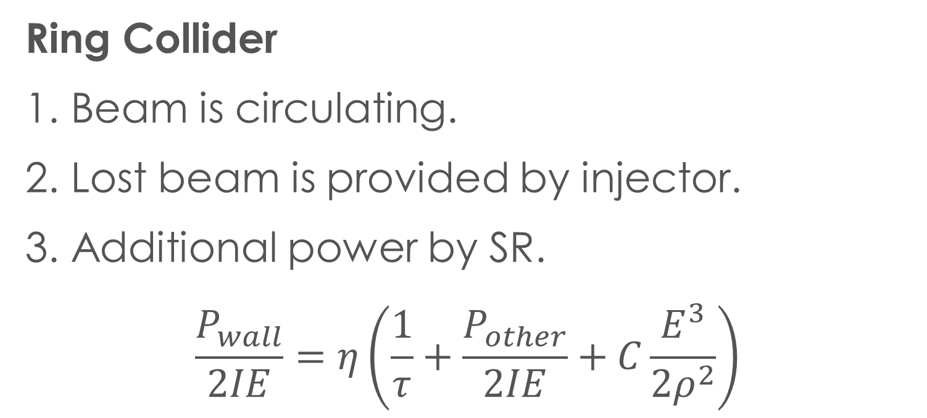
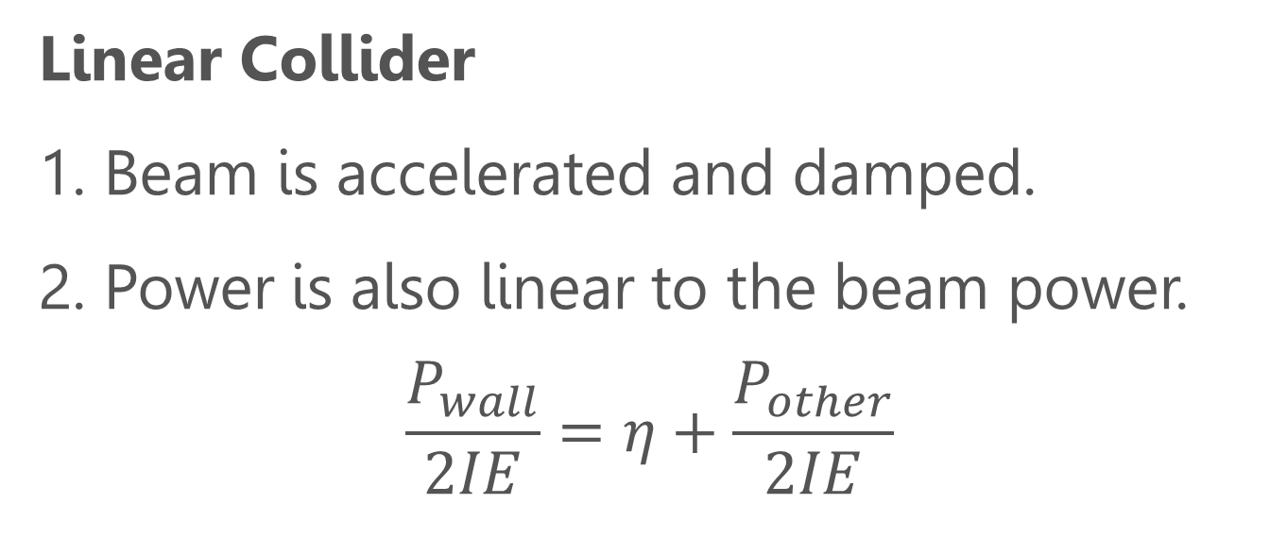
Power Consumption
Dawn of New epoch
Ring Collider
1. Beam is circulating.
2. Lost beam is provided by injector.
3. Additional power by SR.
$$\frac{P_{wall}}{2IE}=η\left(\frac{1}{τ}+\frac{P_{other}}{2IE}+C\frac{E^{3}}{2ρ^{2}}\right)$$
Linear Collider
1. Beam is accelerated and damped.
2. Power is also linear to the beam power.
$$\frac{P_{wall}}{2IE}=η+\frac{P_{other}}{2IE}$$

Slide 11
Energy evolution of accelerator
Obstacle and breakthrough
Invention of
RF accelerator
Invention of
Collider
DC accelerator
Invention of
Linear Collider
RF accelerator
+ Fixed Target
(*)the number is for e+e- collider.
Ring Collider
Linear Collider
20MeV
600MeV
200GeV*

Slide 12
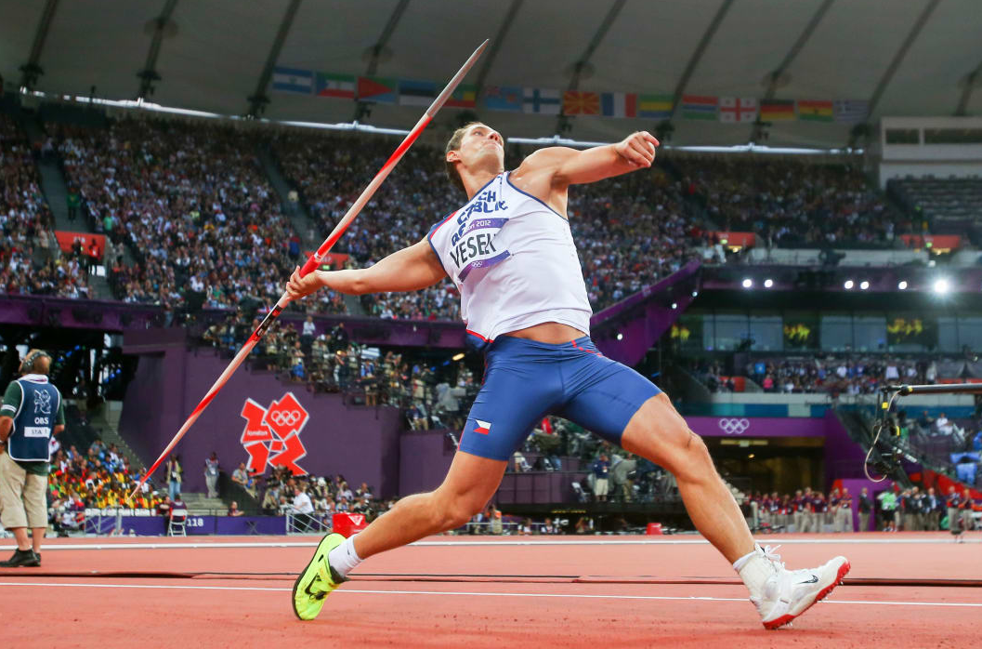
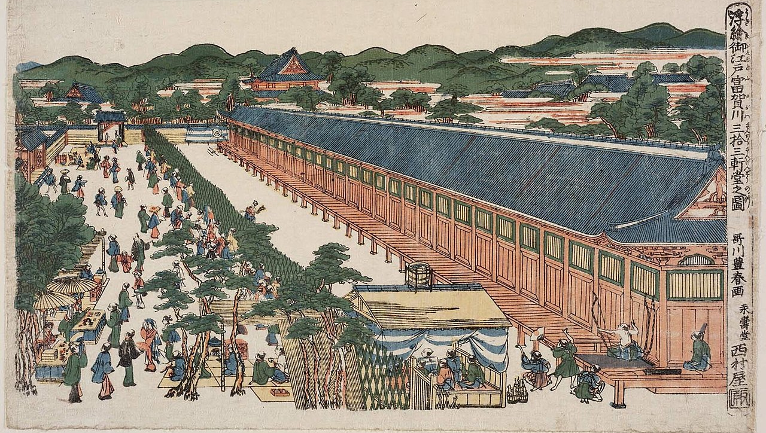

Linear Collider
Design Concept
Linear Collider character is quite different from that of ring colliders.

Slide 13
Pros and Cons of linear collider
Pros
No energy loss by synchrotron radiation.
The beam can be polarized.
Strong against the beam-beam effect, because we don’t care about the beam after collision.
Cons
The beam power can’t be high, otherwise the electricity could be huge.
Need a high gradient, otherwise the length could be humongous.

Slide 14

Luminosity Gain for LC
A high luminosity with a limited beam power is a key of LC.
Suppress for
saving electricity
$$ℒ=\frac{fn_{b}N^{2}}{4πσ_{x}σ_{y}}$$
Minimize for
larger luminosity.
Ring Collider
Linear Collider

Slide 15
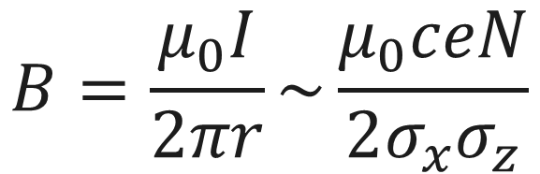
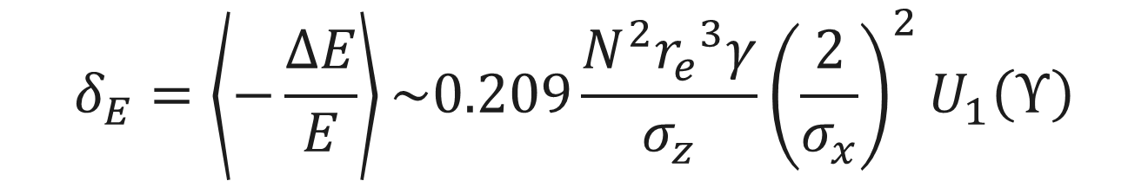



Beamstrahlung
$$σ_{x}≫σ_{x}$$
Synchrotron radiation with magnetic field generated by the collision partner.
It causes the energy tail of the beam resulting a worse energy resolution.
$$σ_{y}$$
$$σ_{x}$$
$$B=\frac{μ_{0}I}{2πr}\sim \frac{μ_{0}ceN}{2σ_{x}σ_{z}}$$
Ampere’s law
$$δ_{E}=\left\langle −\frac{ΔE}{E}\right\rangle \sim 0.209\frac{N^{2}{r_{e}}^{3}γ}{σ_{z}}{\left(\frac{2}{σ_{x}}\right)}^{2}U_{1}\left(Υ\right)$$

Slide 16
Luminosity Gain for LC
A high luminosity with a limited beam power is a key of LC.
To keep BS, only s_{y} is minimized.
Suppress for
saving electricity
To keep BS, it should not be too small.
$$ℒ=\frac{fn_{b}N^{2}}{4πσ_{x}σ_{y}}$$
Minimize for
large luminosity
Ring Collider
Linear Collider
Solar car
Collider with a limited beam power = E-Collider

Slide 17
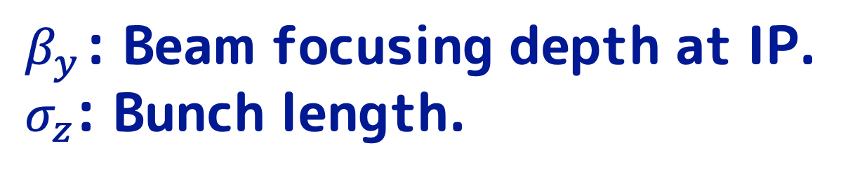


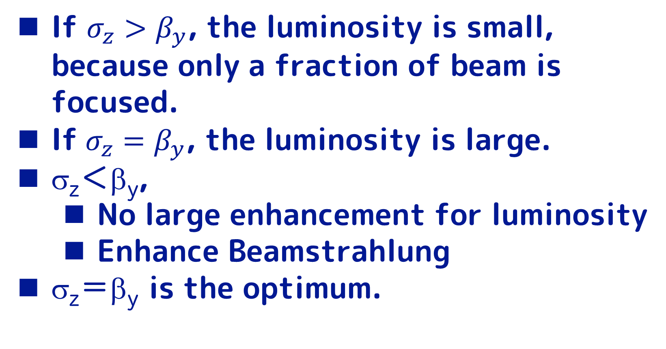
Beam Focusing (Hour glass effect)
If ${σ_{z}>β}_{y}$, the luminosity is small, because only a fraction of beam is focused.
If ${σ_{z}=β}_{y}$, the luminosity is large.
σ_{z}＜β_{y},
  No large enhancement for luminosity
  Enhance Beamstrahlung
σ_{z}＝β_{y} is the optimum.
$β_{y}$: Beam focusing depth at IP.
$σ_{z}$: Bunch length.
$$σ_{z}$$
Focusing Depth
$$β_{y}$$

Slide 18
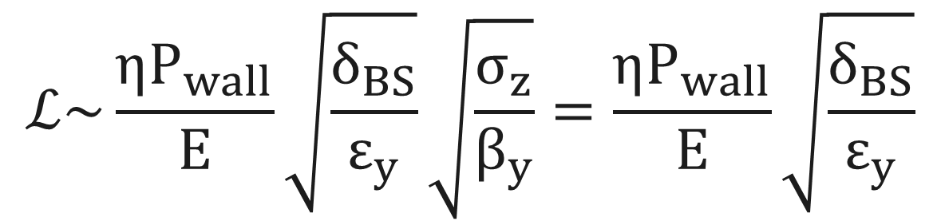

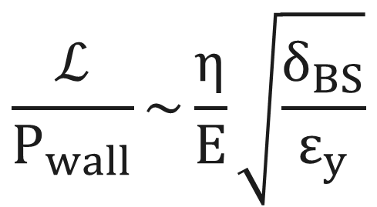
Luminosity Scaling
Beam power and electricity：$P_{beam}=eE{fn}_{b}N=ηP_{wall}$
Beam size at IP: $σ_{x,y}=\sqrt{\frac{ε_{x,y}β_{x,y}}{γ}}$
Energy spread by BS : $δ_{BS}=\frac{N^{2}E}{{σ_{x}}^{2}σ_{z}}$
$$ℒ\sim \frac{ηP_{wall}}{E}\sqrt{\frac{δ_{BS}}{ε_{y}}}\sqrt{\frac{σ_{z}}{β_{y}}}=\frac{ηP_{wall}}{E}\sqrt{\frac{δ_{BS}}{ε_{y}}}$$
Luminosity
$$\frac{ℒ}{P_{wall}}\sim \frac{η}{E}\sqrt{\frac{δ_{BS}}{ε_{y}}}$$
Normalized
Luminosity

Slide 19
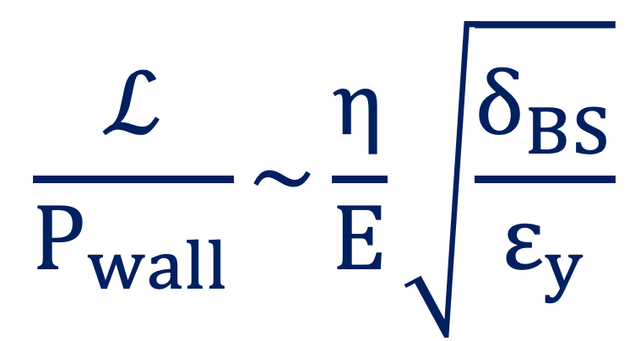
Luminosity Scaling
Experimental Design
Physics
$$\frac{ℒ}{P_{wall}}\sim \frac{η}{E}\sqrt{\frac{δ_{BS}}{ε_{y}}}$$
Normalized
Luminosity
System
Optimization
Accelerator

Slide 20
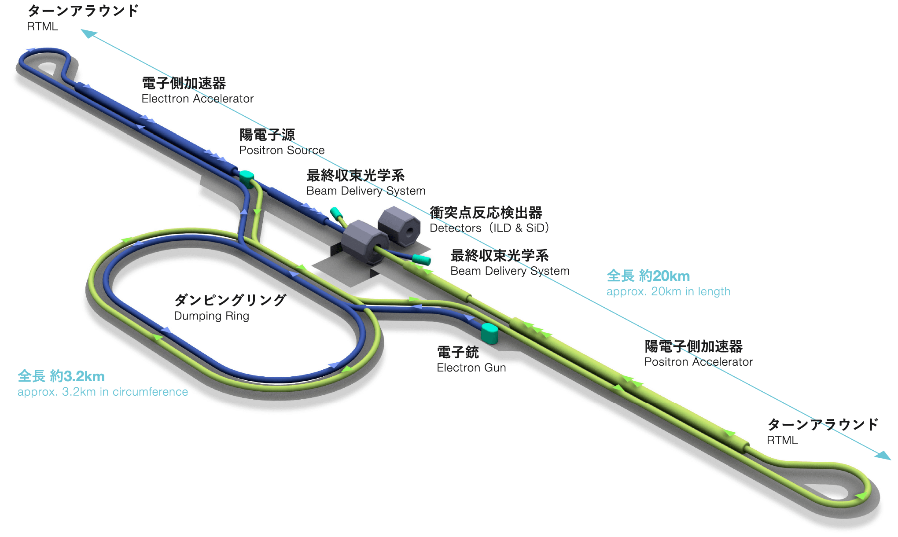
ILC Accelerator Technology

Slide 21
ILC Functions
1. (Polarized) Electron and Positron
2. Radiation Damping
3. Superconducting Accelerator
4. Final Focus

Slide 22
GaAs photocathode
GaAs crystal for polarized electron generation.
By breaking the degeneration of the valence band, spin of excited electron depends on the helicity of photon (circular polarization).
Degeneration is broken by strained super-lattice crystal giving 90% polarization.

Slide 23
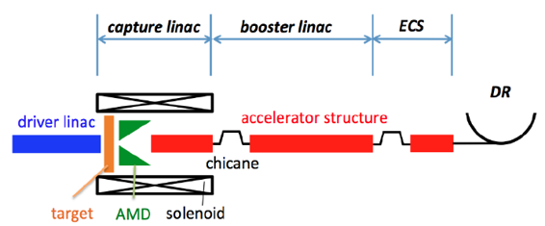
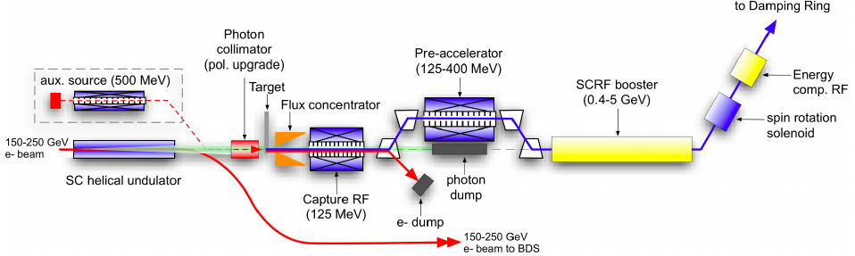
ILC Positron Source
Two concepts of positron source : Electron Driven (conventional) and Undulator.
E-Driven : Brems+pair-creation. Technically established, but unpolarized.
Undulator : Gamma from undulator radiation driven by >100 GeV driver. Technically new, but polarization is useful for physics.

Slide 24
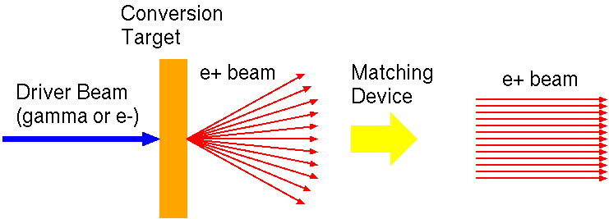
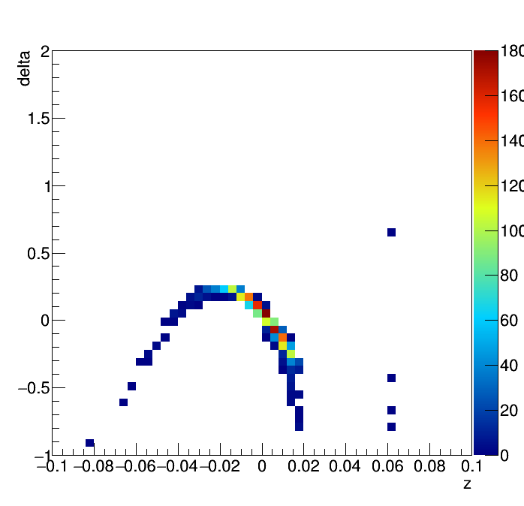
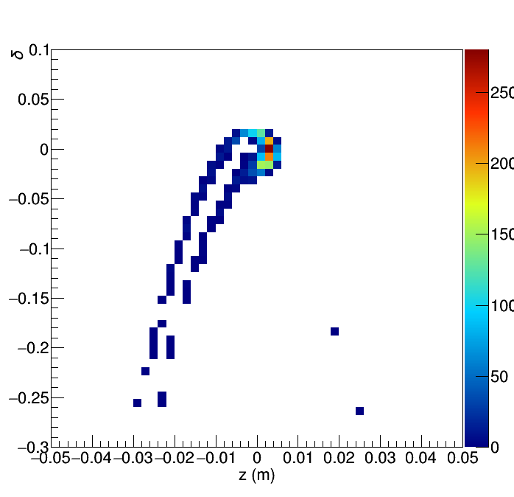
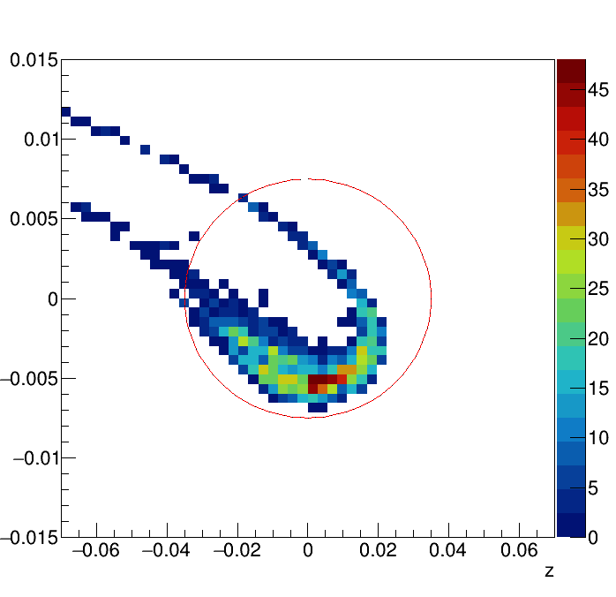
Positron Capture
Positron capture is a key issue for both scheme.
  Matching device
  RF capture
  Energy Compressor
RF capture
Booster
ECS

Slide 25
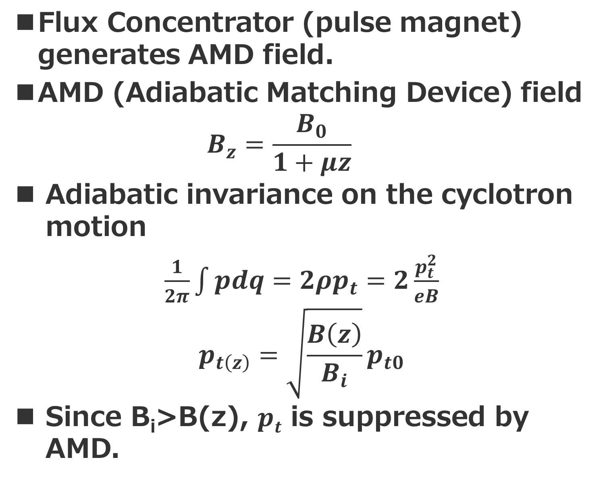
Flux Concentrator as AMD
Flux Concentrator (pulse magnet) generates AMD field.
AMD (Adiabatic Matching Device) field
  $$B_{z}=\frac{B_{0}}{1+μz}$$
Adiabatic invariance on the cyclotron motion
$\frac{1}{2π}\int{pdq=2ρp_{t}=2\frac{p_{t}^{2}}{eB}}$
$$p_{t\left(z\right)}=\sqrt{\frac{B\left(z\right)}{B_{i}}}p_{t0}$$
Since B_{i}>B(z), $pt$ is suppressed by AMD.
100mm
target
16mm
  170 mm

Slide 26
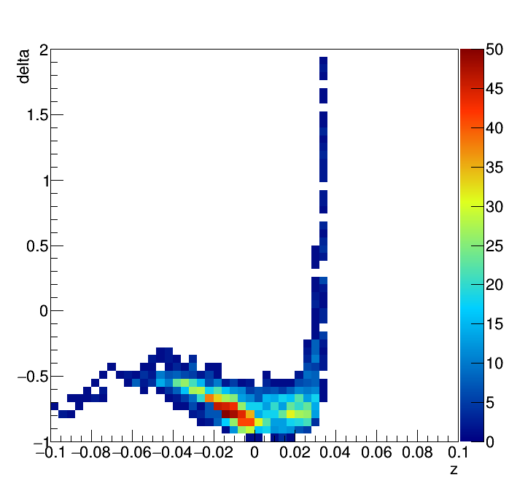
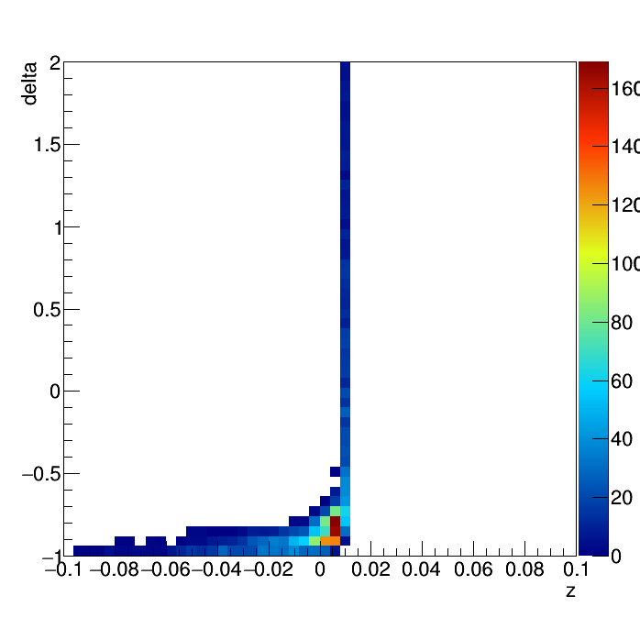
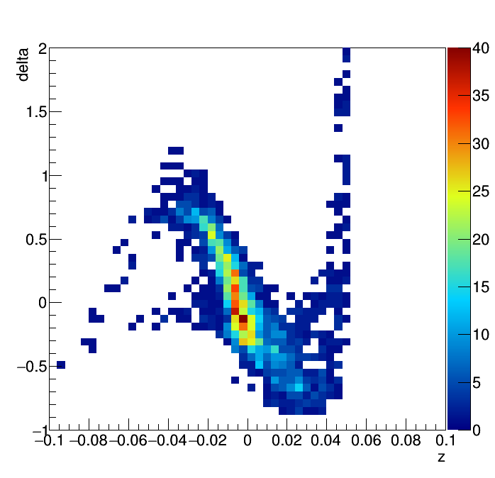
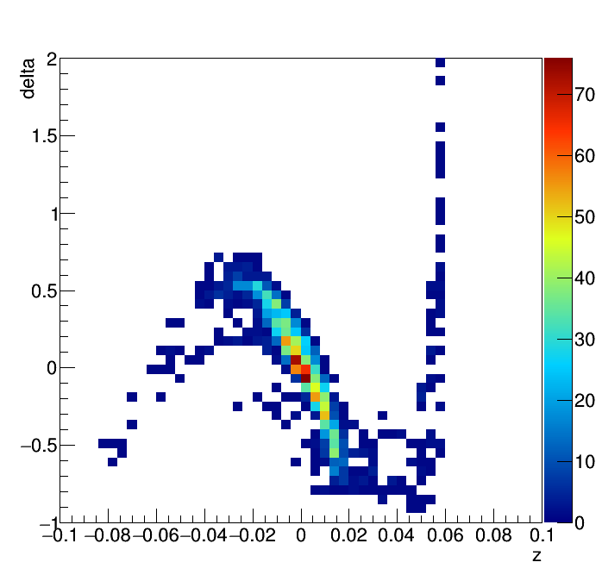
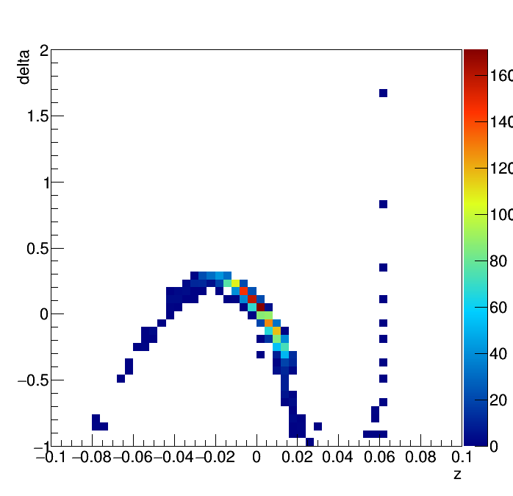

RF capture
Generated positron is widely distributed in energy and $pt$.
Positron is decelerated initially. Due to the large $pt$, positron cause phase slip.
Positron is moved to acceleration phase by the phase slip.
Acceleration suppress the phase slip. The positron is swept up at the phase.

Slide 27
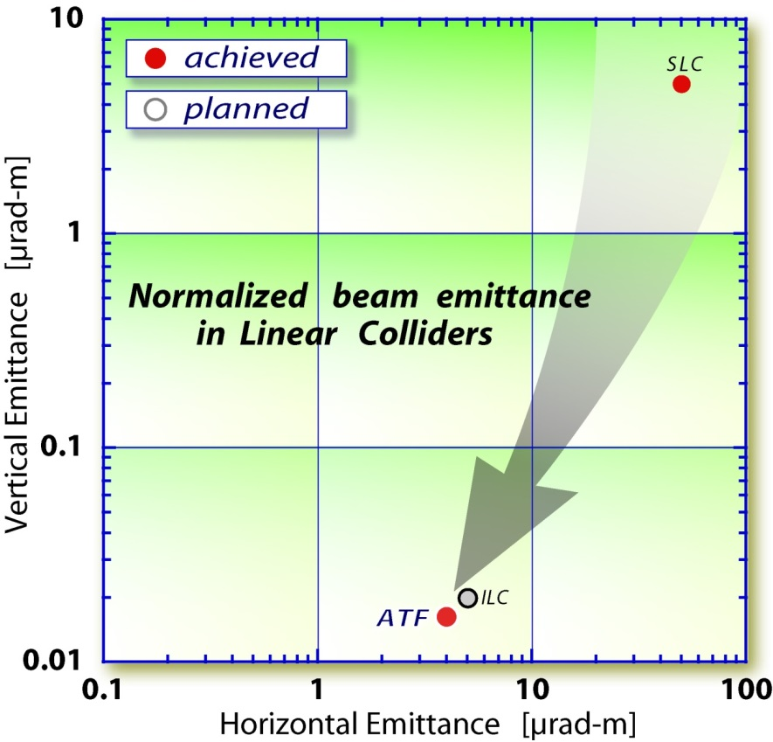
Damping Ring
Cool down the beam
Radiation
Damping
1. Beam loose their energy by SR.
2. The energy is recovered by re-acceleration .
3. SR decreases the momentum in x, y, and z, but cavity provide only p_{z}. The beam is aligned and cooled.

Slide 28
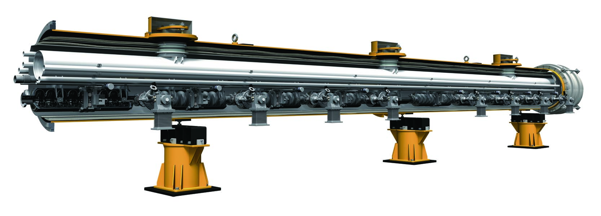
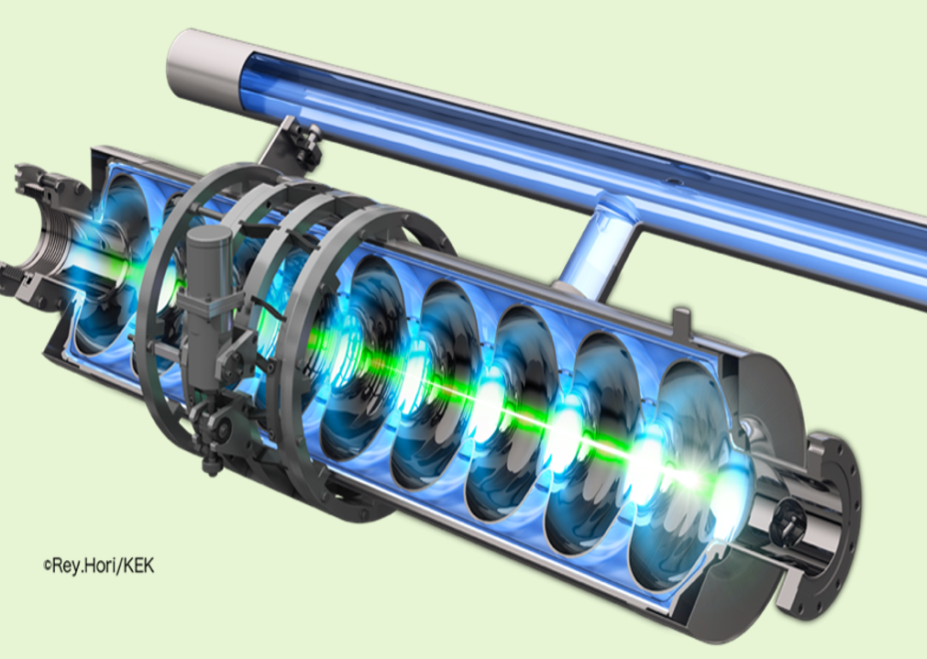
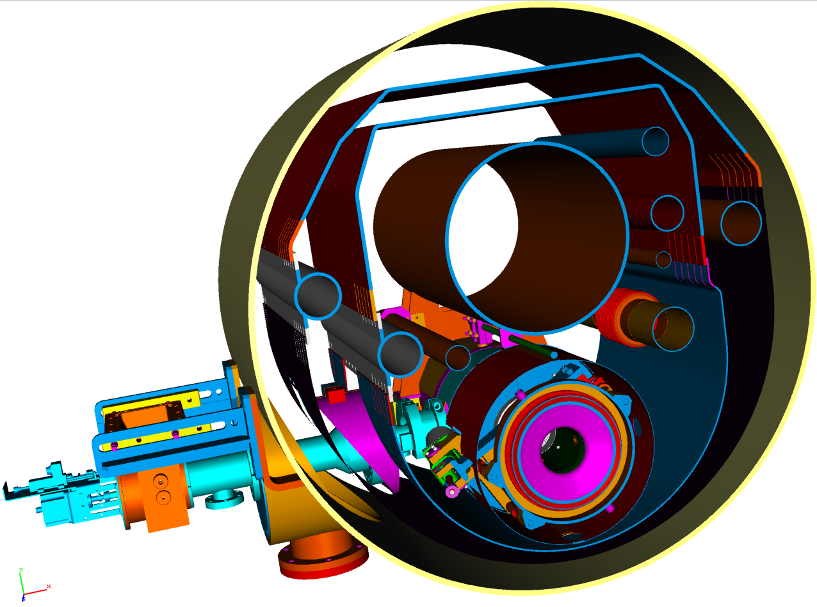
Superconducting Accelerator
Cryomodule
(8 or 9 cavities)
Gas He
return
Thermal shields
(80K, 5K)
Liq. He
SC Cavity
Super-coducting Cavity

Slide 29
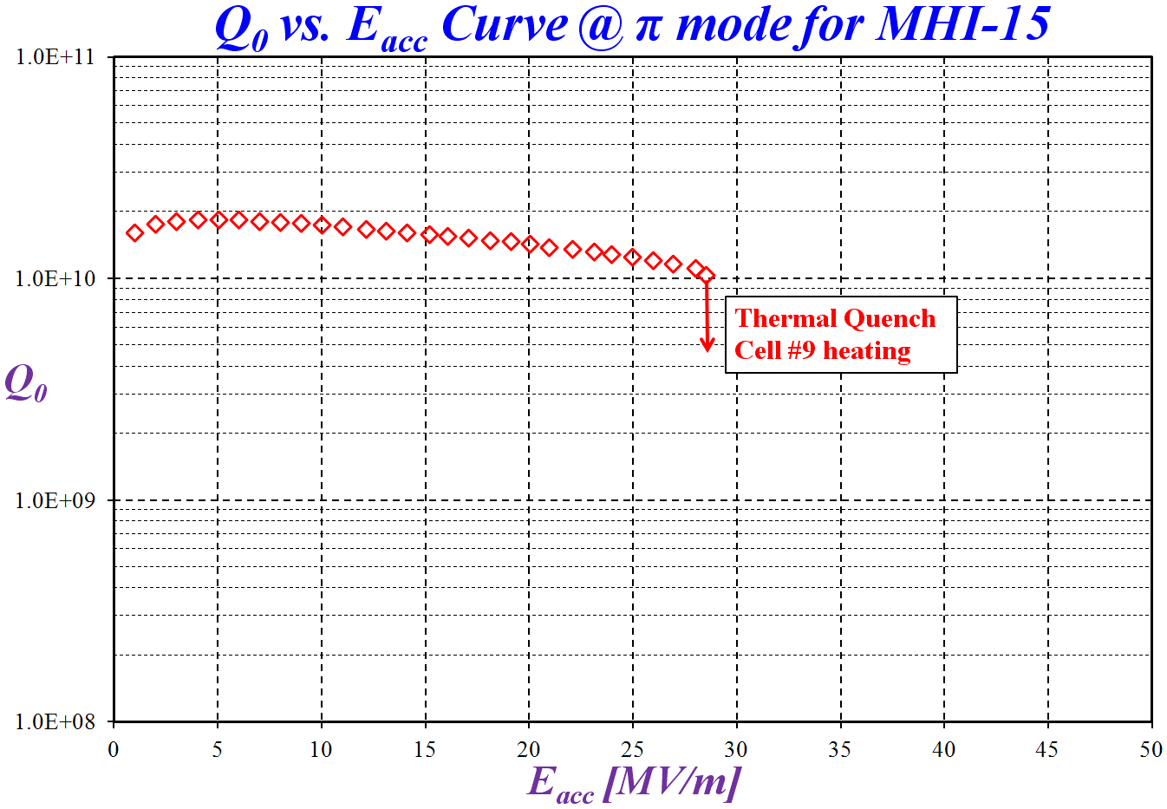
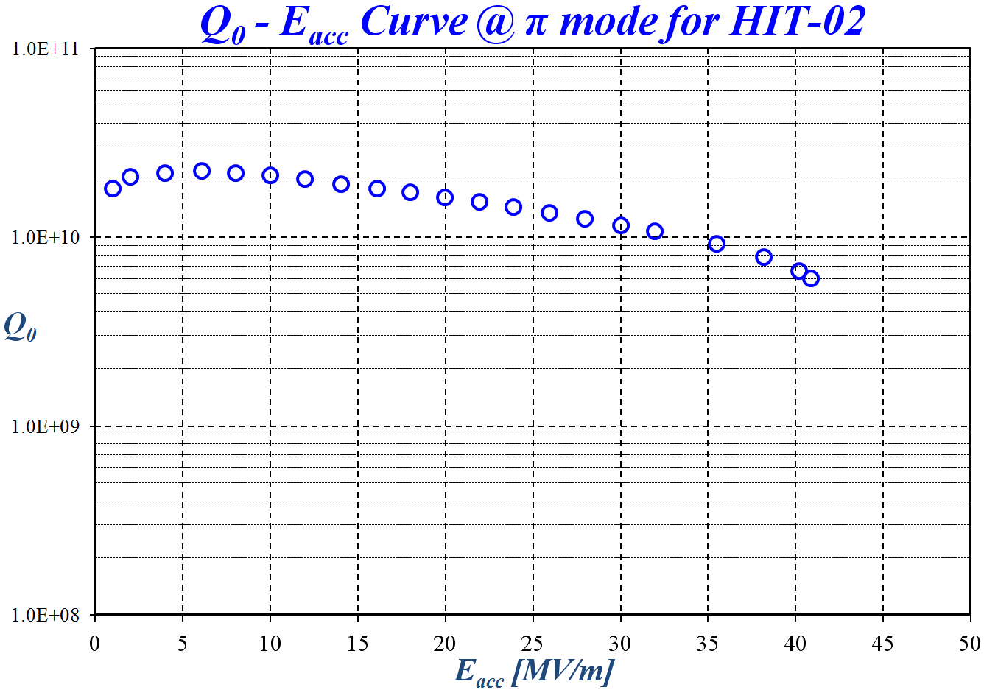
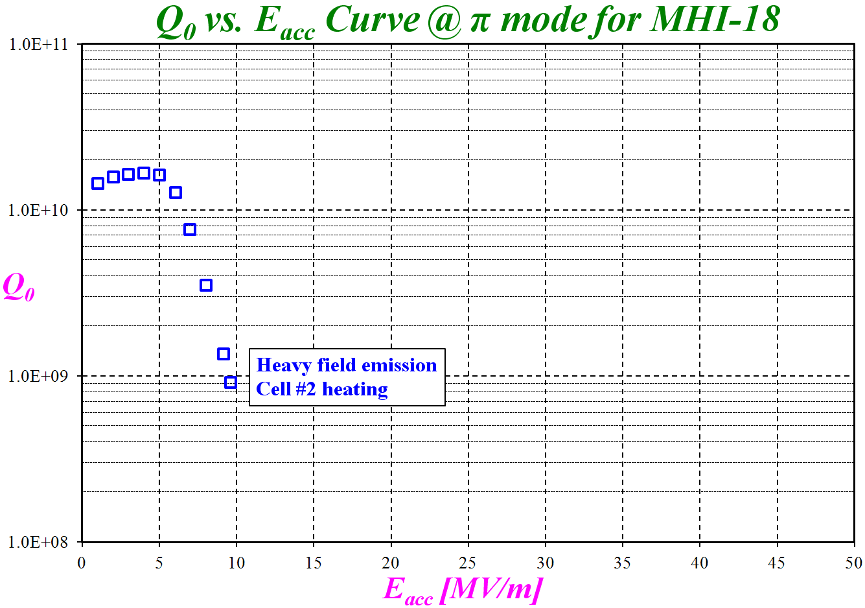
SC cavity performance
40.9 MV/m
RF power limit
Thermal Quench
ILC spec.
E=35MV/m
Q=0.8 x 10¹⁰
Field emission

Slide 30
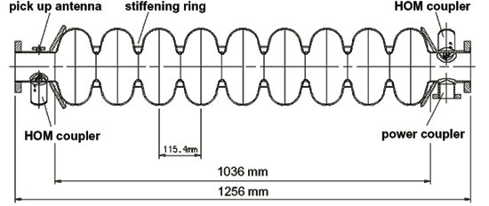
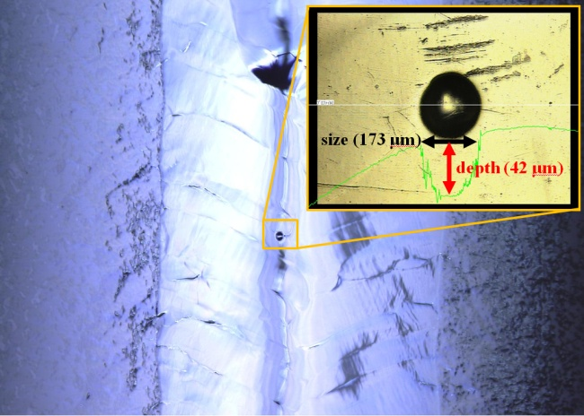
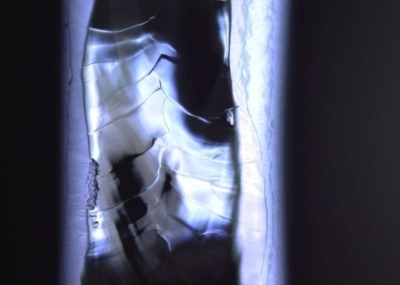
Pathology
Thermal Quench
Defects on the equator cause thermal quench because the large current.
It can be detected by temperature mapping.
Field emission
Defects on the iris causes field emission.
It leads Q-slope by the energy loss.
It can be detected by X-ray mapping.
equator
iris

Slide 31
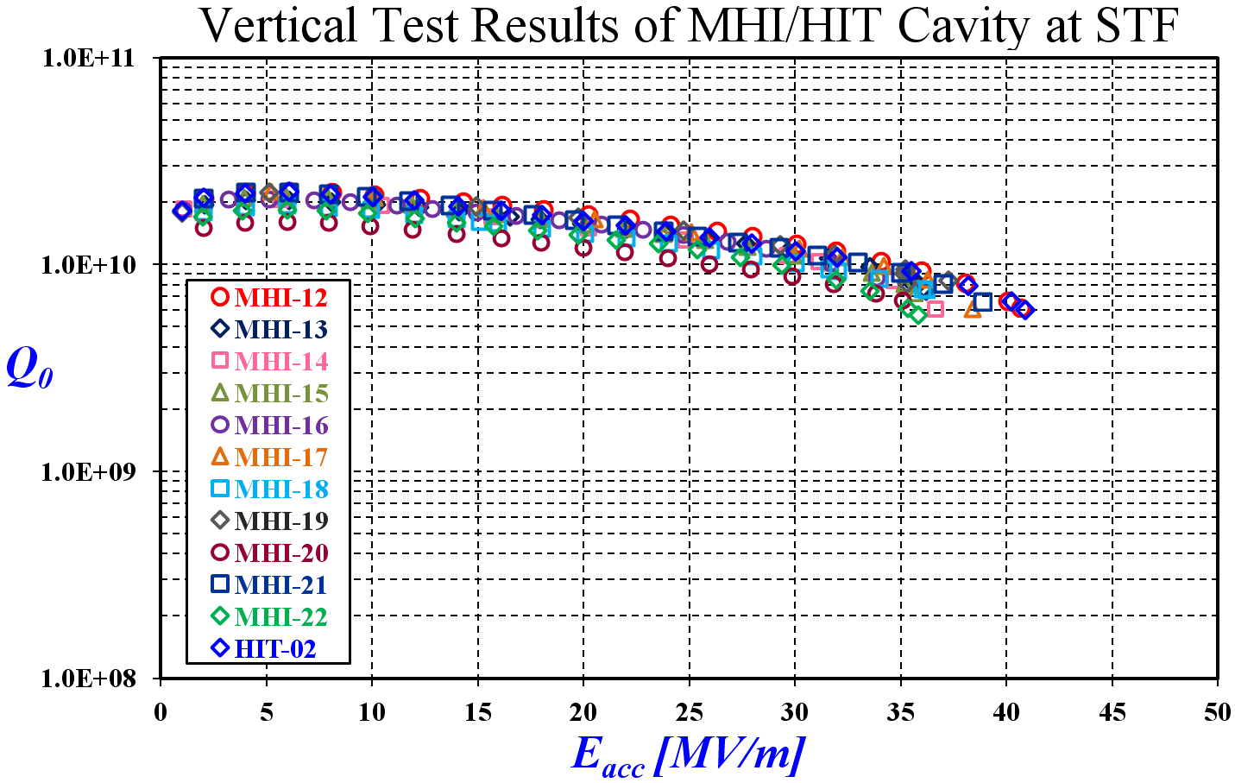
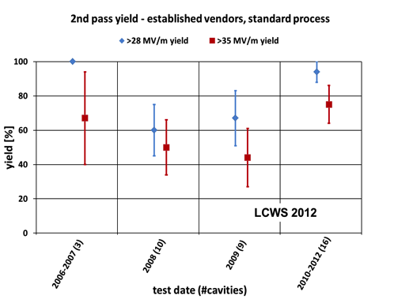
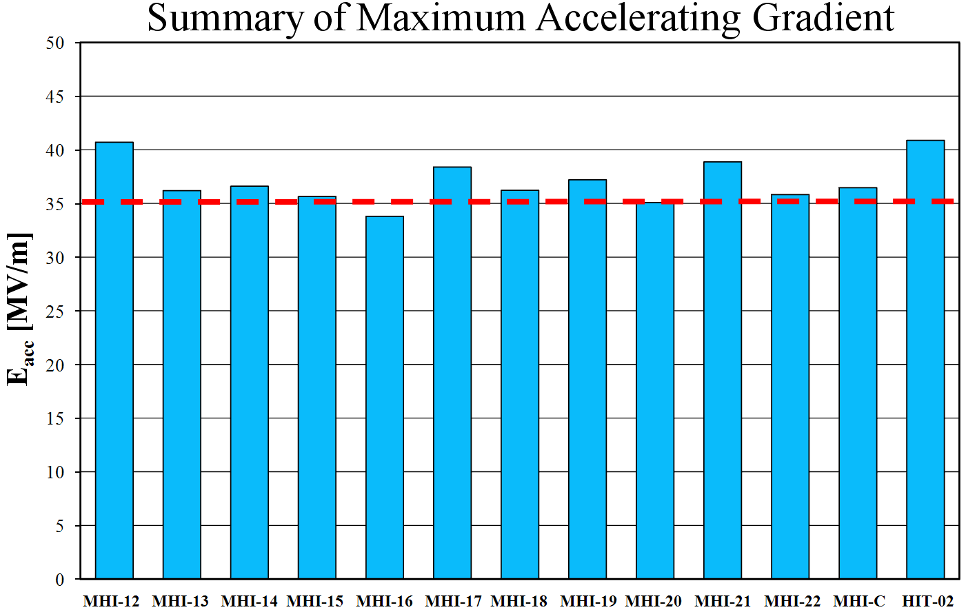
Summary STF Phase-II
All cavities satisfy the ILC specification: 35 MV/m± 20%.
Average gradient is 36.8 MV/m.
The highest is 41 MV/m which is a national record in 2013.
The field is limited by the available power (not quench).
The cavity
fabrication yield
(ratio of good
cavity) is more
than 90%.
Ready for
fabrication.

Slide 32
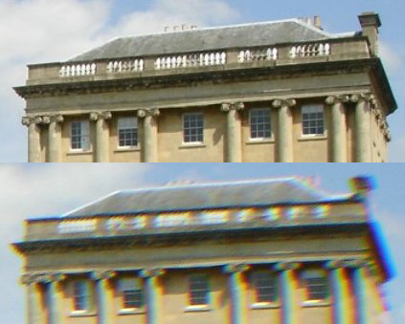
Final Focus
To improve luminosity, the beam should be focused down to 5.7nm in transverse direction.
A strong focusing is not enough. Controlling chromaticity is a key issue.
Chromaticity : Aberration by energy spread.
Chromatic aberration is corrected by achromatic lens (Sextupole + Quadrupole).
Low
energy
High
energy

Slide 33
Local Chromaticity Correction
Chromaticity by Q is corrected by sextupole with dispersion locally.
Sextupole generates non-linearity. Two pair of the lattice cancels their non-linearity to each other.
The same beam line but with lower energy has been examined at ATF2.
Sext. Quad.
Sext. Quad.
Sext. Quad.
Sext. Quad.
IP
Bending

Slide 34




Final Focus Test at ATF2
ILC FF Beam line is simulated at ATF2 experimentally.
Beam size is measured with Laser fringe monitor (AKA Shintake monitor).
41 nm beam size was confirmed. It should be compared with 37nm at ILC.

Slide 35


Traveling Focus option
By considering hour glass effect, $β^{∗}≪σ_{z}$ is not effective to obtain a large luminosity.
If we place “a lens” at IP, the beam size can be kept small.
We use the beam as the lens because the beam attracts to each other by Coulomb force.
The focal point should be moved along the bunch: traveling focus.
Traveling focus is possible with crab. Cavity + sextupole.
It is possible, but sensitive to field error, etc. That is why it is an option.

Slide 36
Summary
1. New Epoch
3．LC Technology
Linear collider is a new epoch on the high energy accelerator to extend our reach since the invention of collider.
High gradient linear accelerator and nano-beam is key technologies of LC.
2. LC is an E-collider
4. ILC Accelerator is ready
LC concept is realizing a large luminosity with a limited beam current.
Accelerator technology to construct ILC is ready.

