Slide 1

高エネルギー加速器入門
Masao KURIKI
Graduate School of Advanced Science and Engineering
Hiroshima University
ALLPPT.com _ Free PowerPoint Templates, Diagrams and Charts

Slide 2
講義の目的
加速器は基礎研究、応用、実用など幅広く使われている。
加速器の性能向上は研究成果に直結する。
加速器の原理を理解することで、研究者としての幅が広がる。
特に最先端の研究を行おうとすれば、その目的に最適化した加速器を設計しなくてはならない。
加速器の原理を理解することで、全体としての研究の最適化が可能となる。

Slide 3
講義の概要
現代における加速器とその役割(1.5)
ビーム力学(1.5)
線形加速器の構成(1.5)
高周波加速の基礎(1.5)
加速器応用ー医療用加速器(1)
巨大科学プロジェクトの意義 (1)

Slide 4
現代における加速器とその役割

Slide 5
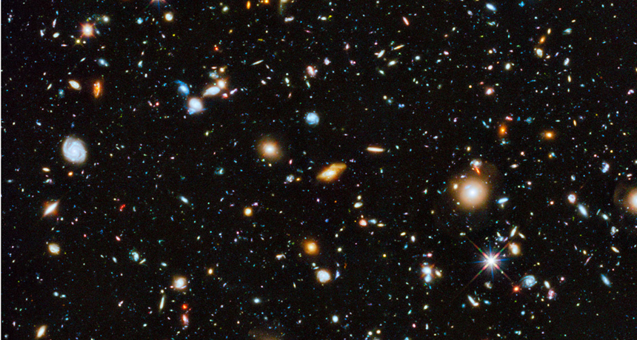
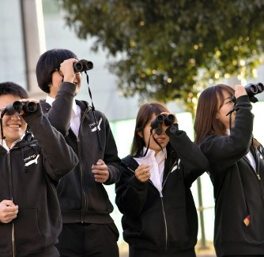
Mystery of Universe
Hubble Space Telescope
Only 4% of “matter” is visible.

Slide 6
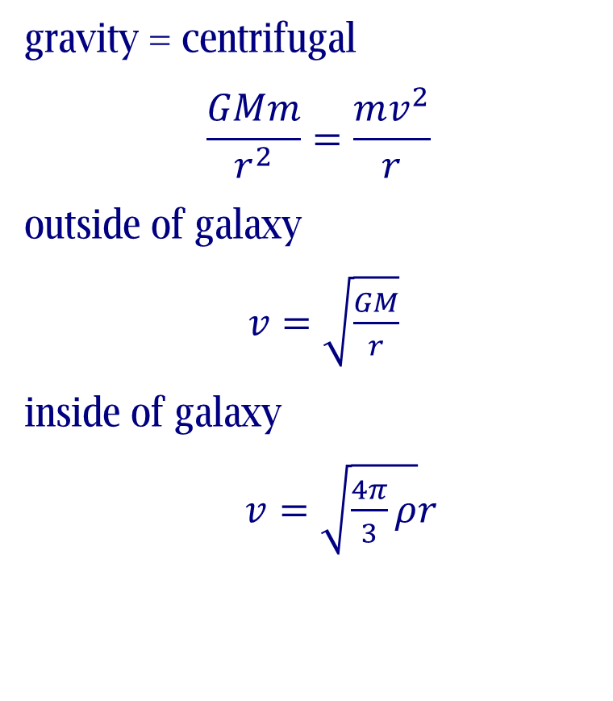

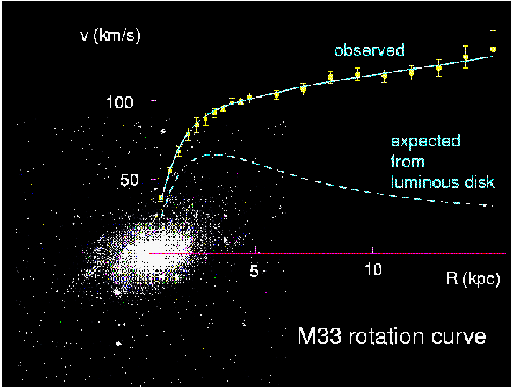
Dark Matter
Invisible（no electro-magnetic interaction),
No interaction to each other at all,
Only gravitational interaction to matter.
Corbelli & Salucci (2000); Bergstrom (2000)

Slide 7

宇宙の成分
time
Accelerated
expansion
Cosmological Fraction
Inflation
Big Bang

Slide 8


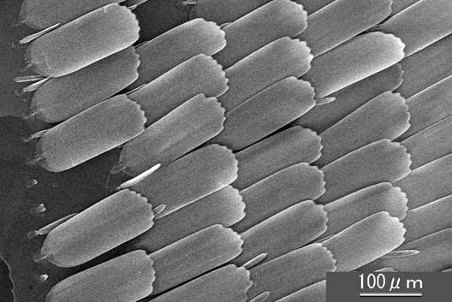
Approach to New Frontier
Discovery a new object.
Discovery a new fine structure of known objects.
http://www.technex.co.jp/tinycafe/discovery02.html

Slide 9
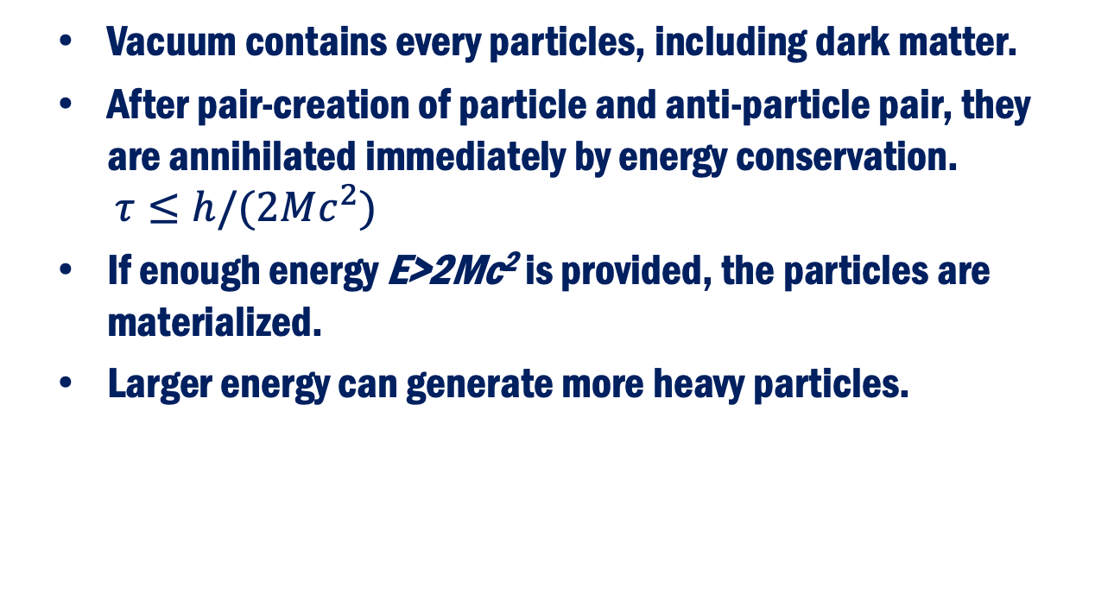
How to Approach New Particles?
Vacuum contains every particles, including dark matter.
After pair-creation of particle and anti-particle pair, they are annihilated immediately by energy conservation.
$τ≤h/(2Mc^{2})$
If enough energy E>2Mc² is provided, the particles are materialized.
Larger energy can generate more heavy particles.
Energy
particle
Anti-particle

Slide 10
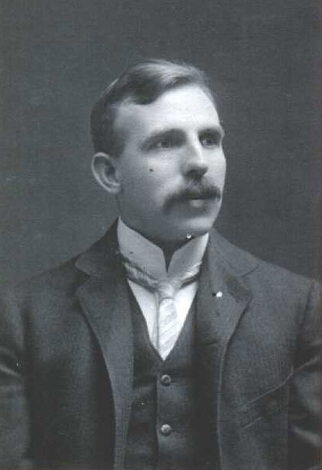
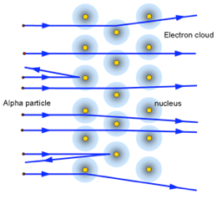
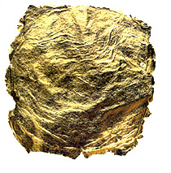
How to Approach a fine Structure?
New unknown particles might exist everywhere, but too small to observe.
How to detect a fine structure or object?
Good example is observation for nucleus.
Alpha particle is scattered by nucleus.
Light is scattered by averaged gold foil.
Resolution is wavelength ~ momentum.
Rutherford

Slide 11
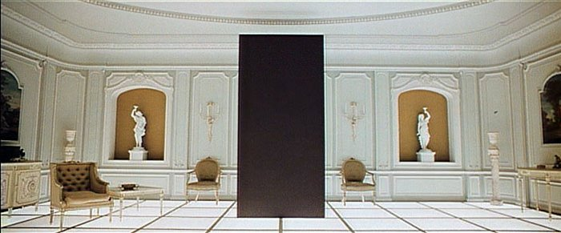

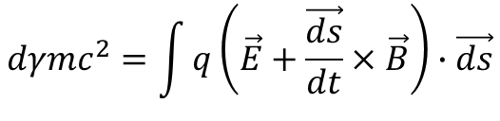
Particle Accelerator
High energy particle is a good tool to approach new particles and fine structures.
Accelerator generates the high energy particle for scientific research and applications.
$$dγmc^{2}=\int{q\left(\vec{E}+\frac{\vec{ds}}{dt}×\vec{B}\right)∙\vec{ds}}$$
Lorentz force
$$=\int{q\vec{E}∙\vec{ds}}$$
Always zero
The field integral opens new world!

Slide 12
Where is the new physics?
Need a guiding principle.
Smithonian.com

Slide 13
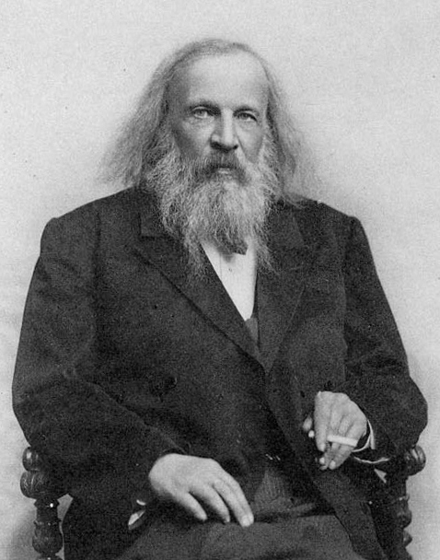
Who is this?
Dmitri Mendeleev
(1834 – 1907)
Inventor of Vodka
Determine the tax law
for Vodka
Inventor of
Periodic Table

Slide 14
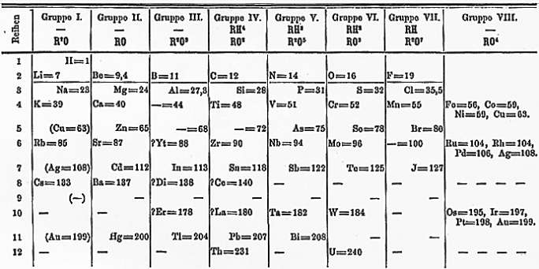
What is matter?
Periodic table is not a simple list ordering the element by mass.
Mendeleev puts many “vacant seats”.
He made many scientific predictions according to the periodicity.
He made a principle.
-> Nuclear model

Slide 15
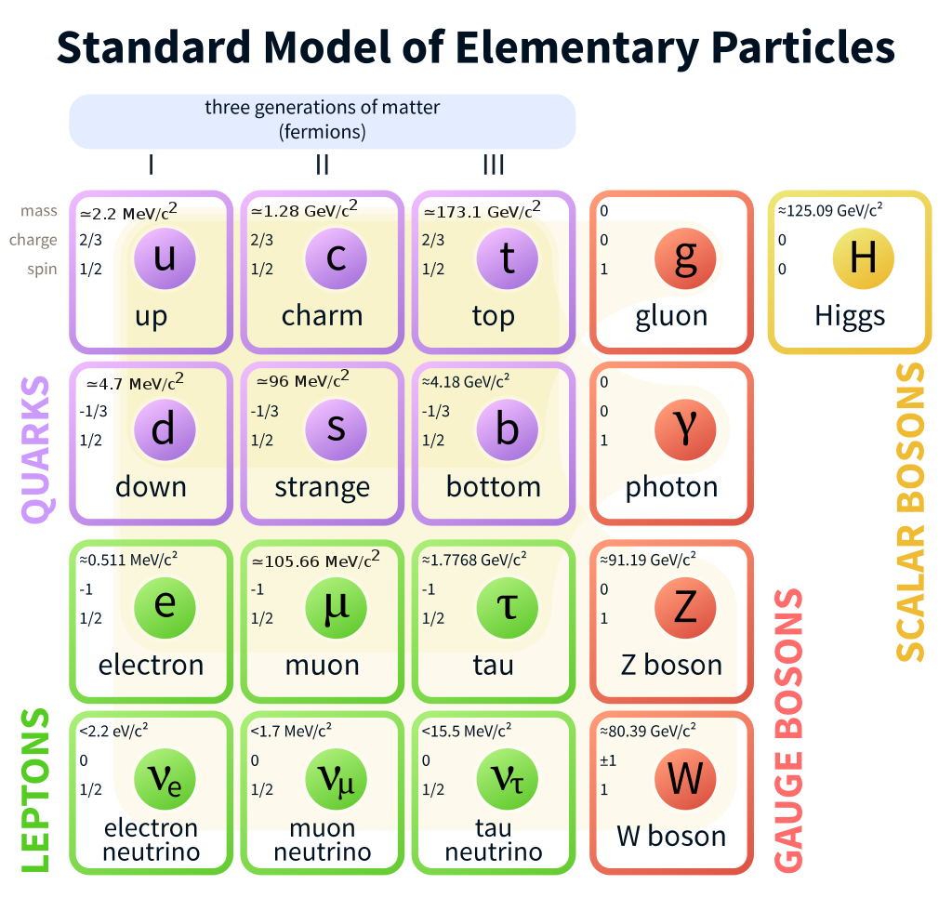
Making another periodic table for elementary particles.
Dark matter, Dark energy, Super-symmetry, Extra dimension, Multi-higgs, etc.
We approach the new physics with Accelerator.

Slide 16
Accelerator
in Modern Science
and applications

Slide 17
Accelerator in Modern Science
Starting from Nuclear and particle physics, accelerator is now used in a wide variety of fields;
  Material science,
  Life science,
  Humanities,
  Medical applications (Diagnosis and Treatment)
  Industrial applications, etc.
Various accelerator systems were developed for each purpose.

Slide 18
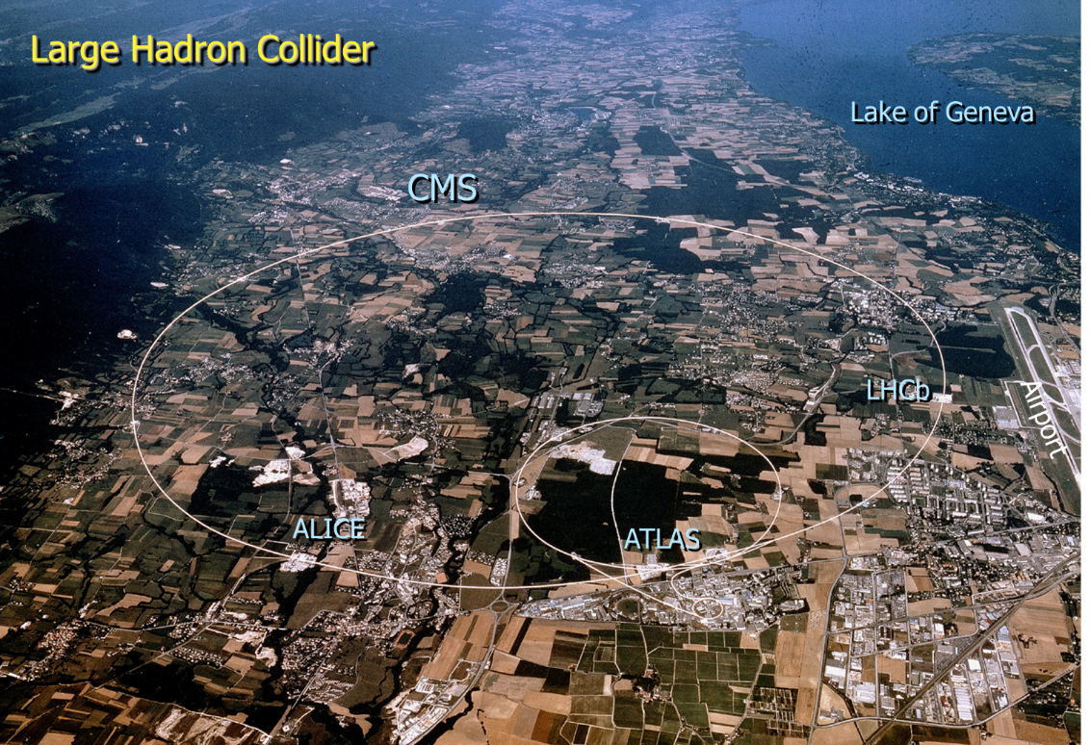
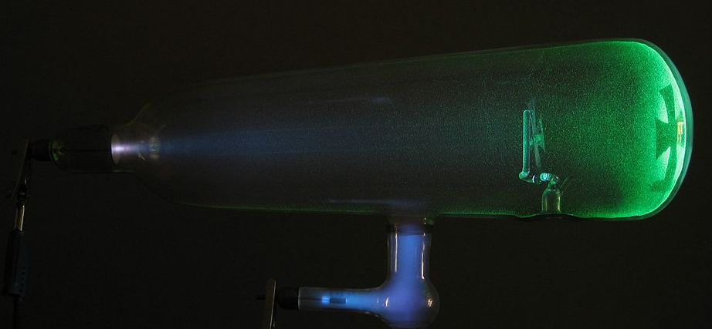
High Energy Physics
A powerful driving force for the accelerator development
High energy physics is a discipline to study the fundamental dynamics of elementary particles and interactions.
Starting from a cathode ray tube, the history of high energy physics is the history of accelerator.
Scale 40k times
(0.2m → 8.0 km)
Energy 1.3e+8 times
(100keV → 13 TeV)
2018
1890

Slide 19
Particle discovery
Year | Event | Acc. E.
1895 | X-ray produced by Wilhelm Röntgen with cathode ray tube | 100kV
1897 | 1897 Electron discovered by J. J. Thomson with cathode ray tube | 100kV
1919 | Proton discovered by Ernest Rutherford with alpha ray | -
1932 | Neutron discovered by Chadwick with alpha ray | -
1932 | Positron discovered by Anderson in cosmic ray | -
1937 | Muon discovered by Neddermeyer et al. In cosmic ray | -
1947 | Pion discovered by Powell et al. In cosmic ray | -
1947 | Kaon (strange quark) discovered by Rochester et al. In cosmic ray | -
1955 | Anti-proton discovered by Segre with Bevatron | 6 GeV
1956 | Elctron anti-nutrino in beta decay | -
1962 | Muon nutrino discovered by Lederman with AGS | 33 GeV
1969 | Partons observed in DIS | 30 GeV
1974 | J/Psi meson (charm quark) discovered by Richter and Ting with SPEARand AGS | 3/33GeV

Slide 20
After the development of particle accelerator, most of the new particles were discovered with accelerators.
Year | Event | Acc. E.
1975 | Tau discovered by Perl with SPEAR | 3 GeV
1977 | Upsilon meson (bottom quark) discovered with FNAL-PS | 400 GeV
1978 | Gluon discovered by Barber et al. with PETRA | 33 GeV
1978 | Weak nutral currents discovered by Prescott with SLAC Linac | 30 GeV
1983 | W/Z boson discovered by Rubbia and Meer with CERN-SPPS | 500 GeV
1995 | Top quark discovered with FNAL-Tevatron | 1000 GeV
2000 | Tau-nutrino discovred by FNAL-Tevatron | 1000 GeV
2012 | Higgs boson discovered by CERN-LHC | 13 TeV

Slide 21
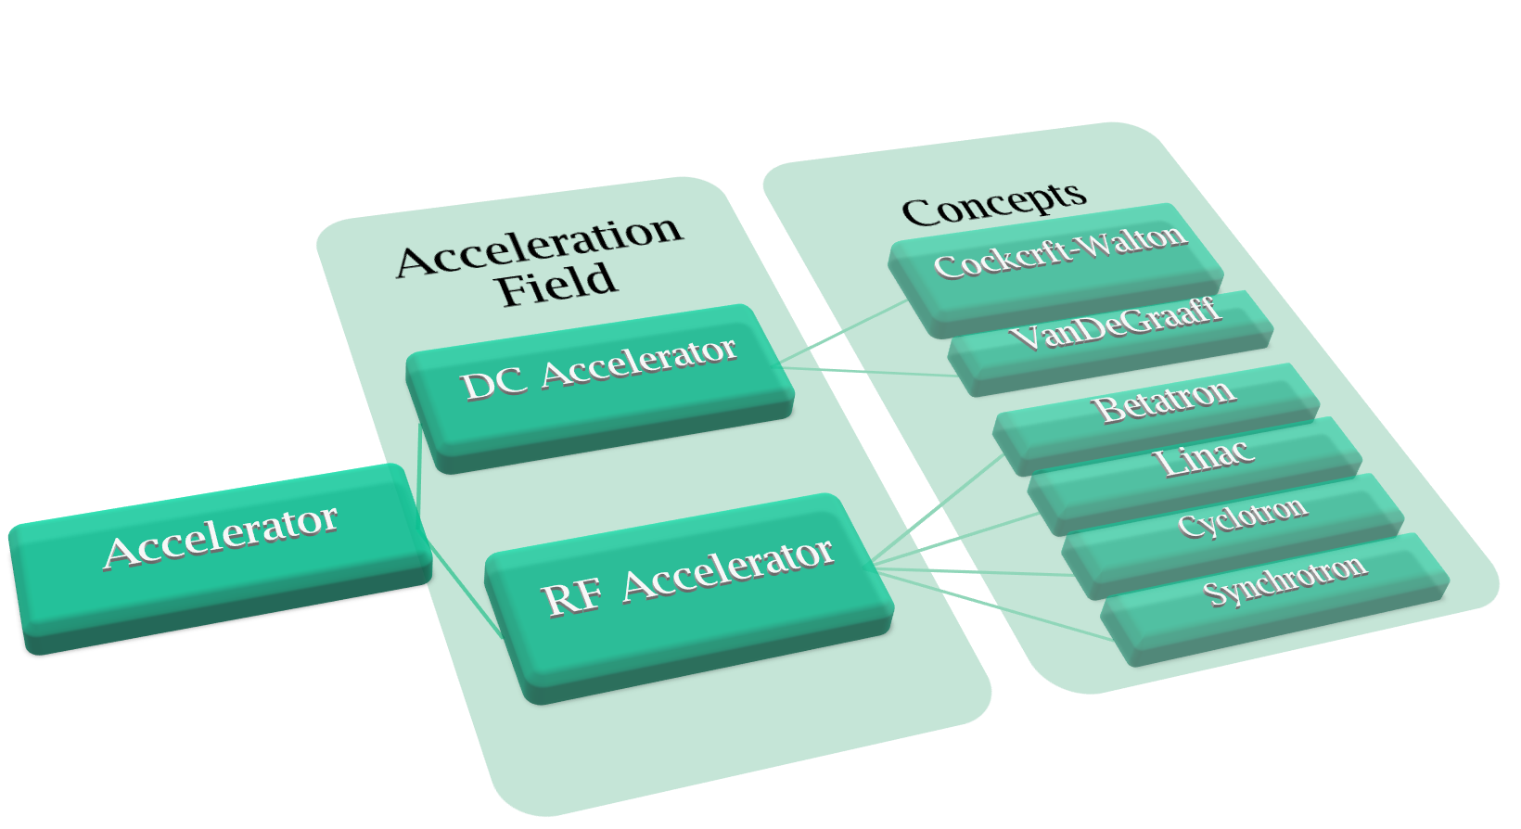
Accelerator Category

Slide 22
Energy Frontier
DC accelerator
+V
Gnd
q
Accelerating Energy is E=qV.
Not repeatable.

Slide 23
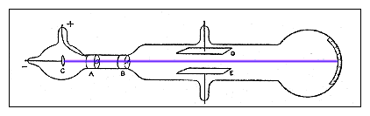
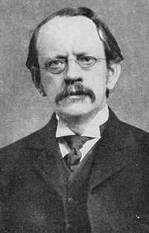
CRT: Cathode Ray Tube
Electric voltage between two metallic plates
Heat the cathode --- something emitted
Proved the existence of electron in 1897 by J.J. Thomson
J.J. Thomson
23
K. Yokoya

Slide 24





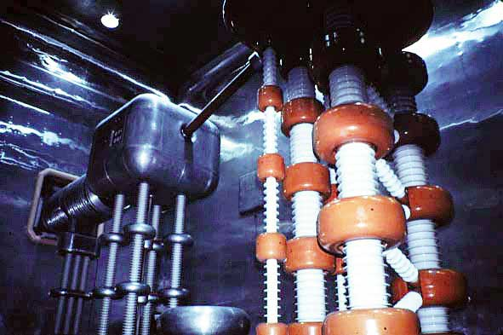

DC Accelerator : Cockcroft-Walton
Resonant charge by
circuit ladder.
Cavendish institute in UK, 1932, 800keV.
First nuclear transformation by accelerator
H + Li -> 2 He
Currently used as
initial acceleration.
KEK 750keV Cockcroft-Walton

Slide 25
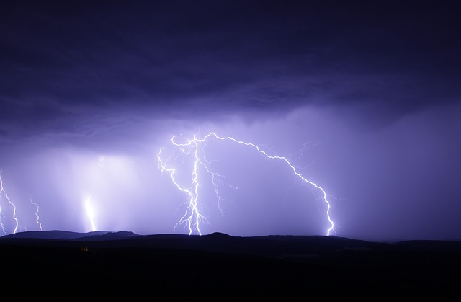
Energy limitation
Since the acceleration is not repeatable, the energy is determined as the voltage.
The voltage is limited by discharge. It is ~
10 MV.
The highest energy by DC accelerator is ~10MV.
25

Slide 26
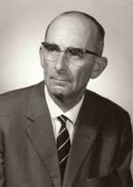
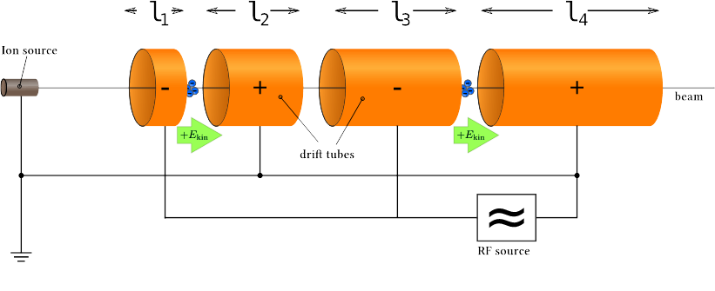
AC（RF） Accelerator
Acceleration by temporary varying field.
Acceleration can be repeatable.
The energy is unlimited in principle.
All high energy accelerators is variations of Widroe accelerator.
R. Wideroe

Slide 27
Cyclotron
B field
Energy is limited by the synchronous condition.

Slide 28
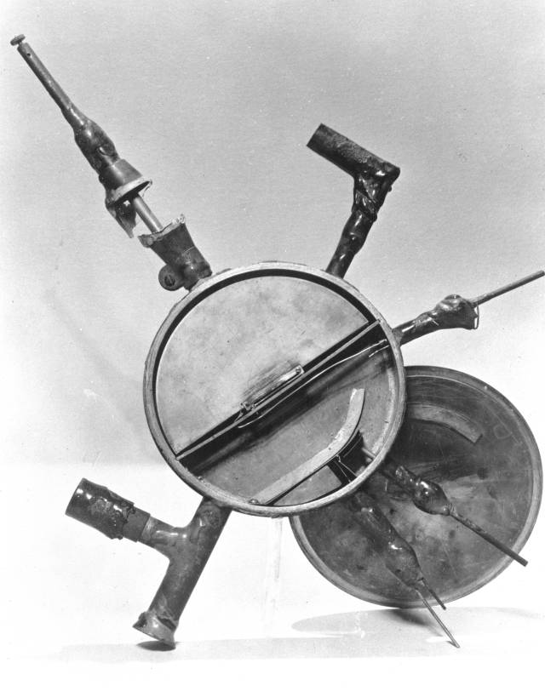
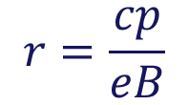
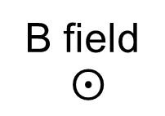
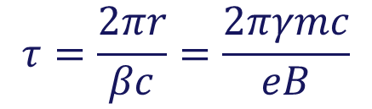


Invented by E.O.Lorence in 1931 at Berkeley, California.
Particle is circulated in magnetic
field with radius r,
The revolution period is constant for γ~1.
The particle is repeatedly
accelerated between the gap of
“Dee” electrodes with a constant
frequency voltage.
The radius is increased, and the
particle is extracted.

Slide 29
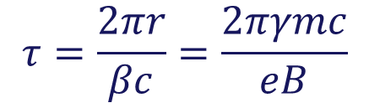
Energy Limitation
The synchronous between particle and field is not maintained for γ>1.
The energy of particle is oscillated
and not accelerated anymore.
It is suitable for heavy particles.
Maximum energy is 20 MeV for proton.

Slide 30
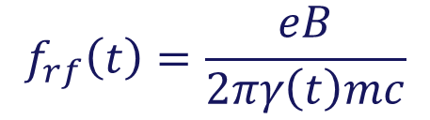
Synchro-cyclotron
In Cyclotron, if f_{rf} is adjusted to keep synchronous condition, further acceleration is
possible.
350MeV is achieved.
The energy is limited by B field.
The electrode (Dee) could be huge for high energy.

Slide 31
Synchrotron
The orbit is constant. No gigantic
magnet and electrode are necessary.
RF frequency and B filed are varied for
synchronization.

Slide 32

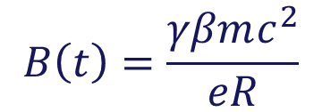
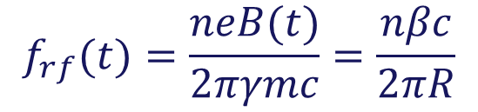

Keep a constant circulation radius, varying B(t) and f_{rf}(t). n is an integer.
Maximum energy is determined by the B-field.
RF cavity

Slide 33
Linac (Linear Accelerator)
Linac (Linear Accelerator） is composed from many accelerator cavity.
The acceleration energy is unlimited in principle.
Acceleration energy E
E = eVL
V ： accelerator gradient (V/m)
L： accelerator length (m)

Slide 34

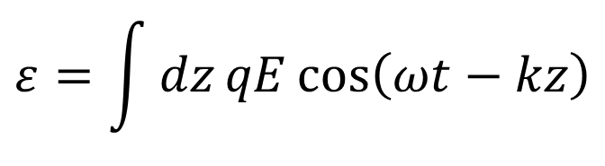


Synchronization
Particle motion (velocity) and RF phase
velocity should be matched for acceleration.
Otherwise, the particle is just oscillated and no net acceleration.
RFによる加速
$$ε=\int{dz}qE\cos\left(ωt−kz\right)$$
$$φ=ωt−kz$$
$$dφ=ω−kβc$$
位相が一定の条件
$$ω=kβc$$

Slide 35
RF Structure
Depending on β of the particle, various RF structure has been designed.
Heavy particle (p and ion) has less β, different structures are used for each acceleration stages.
Light particle (electron and positron) is accelerated easily up to β~1, the acceleration can be made with identical RF structures.
35

Slide 36
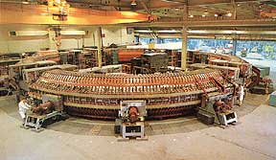
1950’s
A few GeV proton synchrotrons
  Cosmotron (BNL) 3GeV
  Bevatron (LBL) 6.2GeV
Many new particles
  anti-proton, anti-neutron
  Λ, Σ, Ξ, Ω,....
  Systematic description introducing “Quarks” by Gell-Mann in 1964
K. Yokoya
36

Slide 37
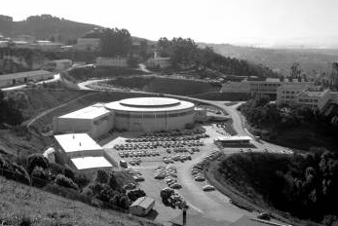
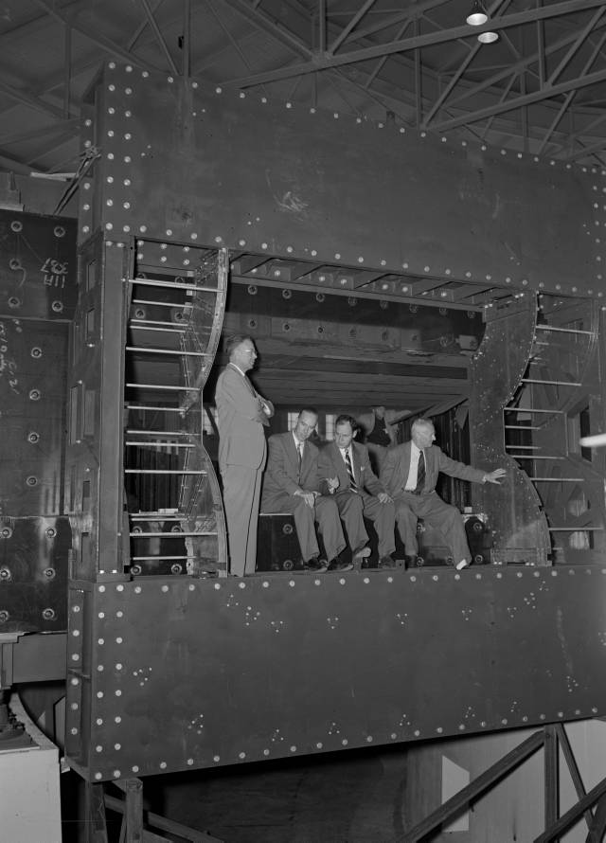
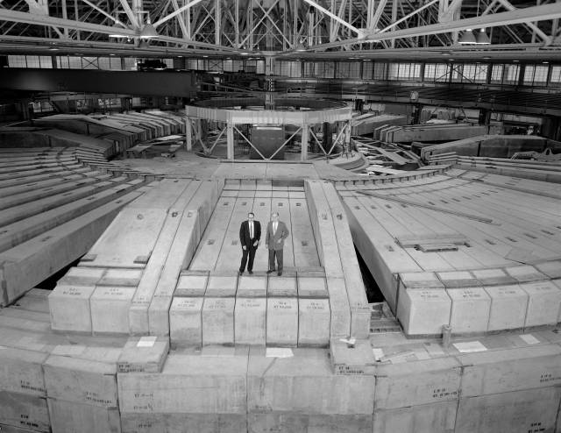
Bevatron
Weak-focusing synchrotron
Lorence Berkely Lab
Operation start in 1954
Bev.. = Billion Electron Volt
= Giga Electron Volt (GeV)
Up to 6.2 GeV
Discovered anti-proton in 1955
8th International Accelerator School for Linear Colliders
Antalya, Turkey, 4-16, December, 2013
37
http://www.lbl.gov/image-gallery/image-library.html

Slide 38
Principle of Strong Focusing
Magnet size became an issue even for synchotron of a few GeV scale
Combination of F-type magnet and D-type can reduce the beam size
Around 1957
Quadrupole magnets can also be used
New issue: accuracy of field and alignment
8th International Accelerator School for Linear Colliders
Antalya, Turkey, 4-16, December, 2013
38

Slide 39
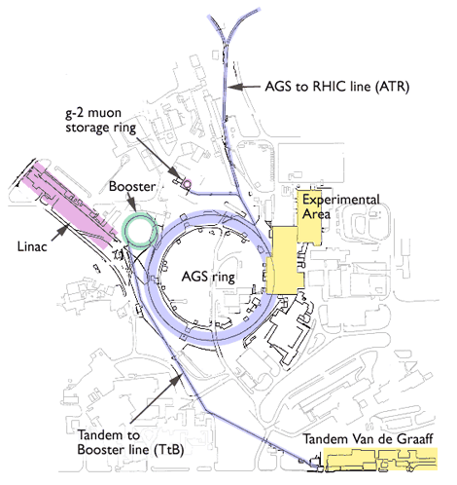
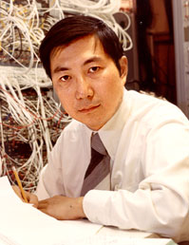
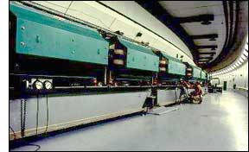
AGS: Alternating Gradient Synchrotron
Synchrotron based on strong-focusing principle
BNL in US
Operation start 1960, ~20GeV
Up to ~33GeV
Discovered
  J/ψ
  mu neutrino ν_{μ}
39
Sam Ting

Slide 40
Storage Ring
Synchrotron can be used to store beams for seconds to days
Usage
  Collider
  Synchrotron light source
Principle same as synchrotron but
  no need of rapid acceleration
  (even no acceleration)
  longer beam life (e.g., better vacuum)
  insertion structure (colliding region, undulator, etc)
40

Slide 41
SLAC: Stanford Linear Accelerator
Electron Linear Accelerator, 2 miles
Microwave frequency 2856MHz (wavelength 10.5cm)
Operation start in 1967
Study of deep inelastic scattering (to probe proton structure by electron-proton scattering) in ~1968
Maximum energy ~50GeV (since 1989)
Still now the longest and highest energy electron linac
Still an active accelerator, SPEAR, PEPII, SLC, LCLS, ....
41

Slide 42
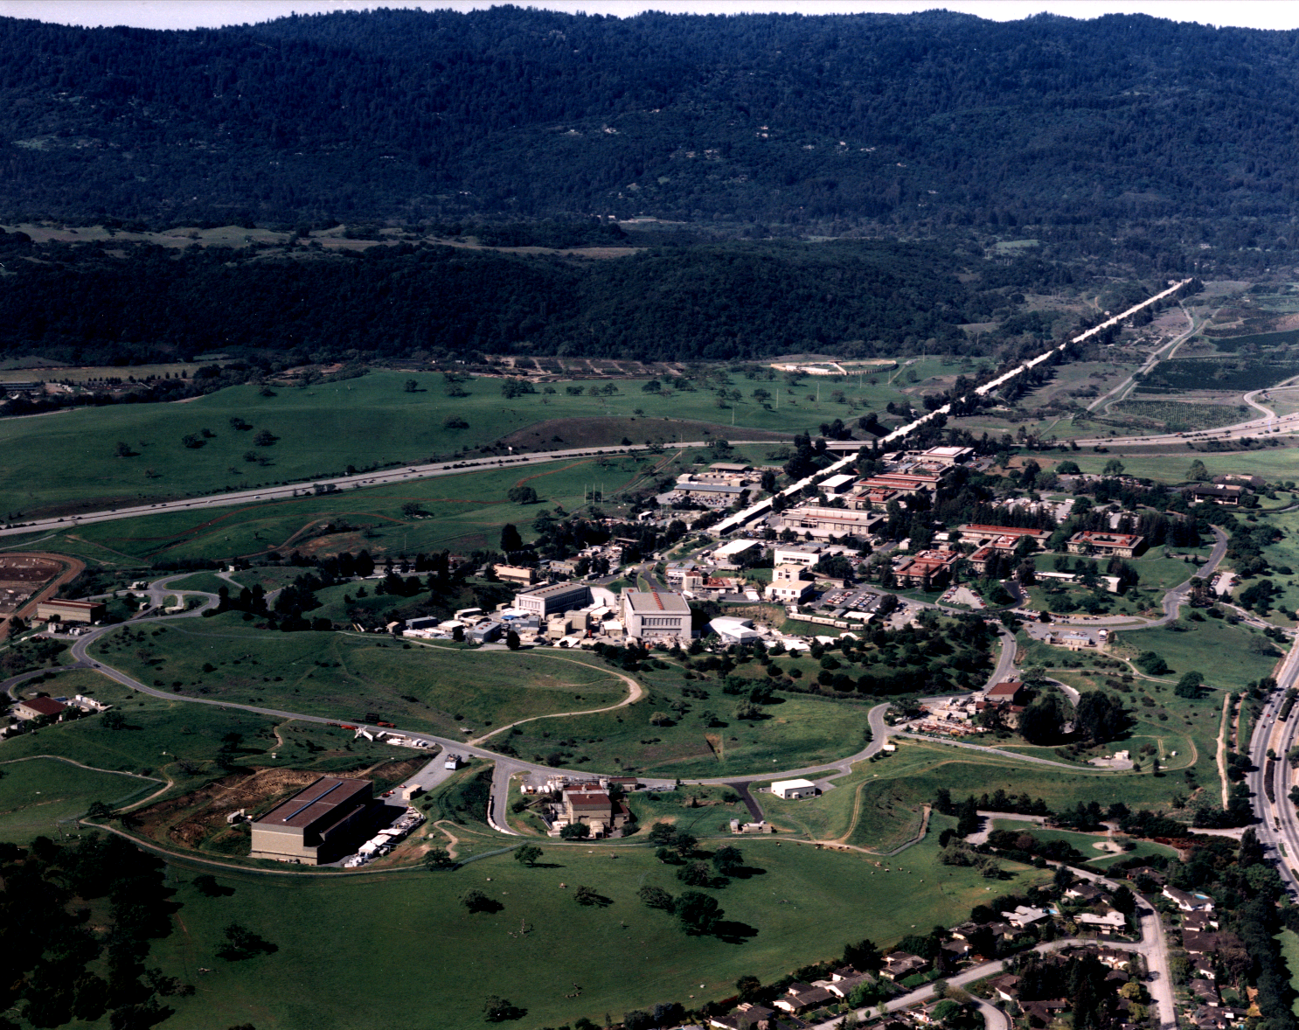
Stanford Linear Accelerator
42

Slide 43


Collider
What matters in physics is the Center-of-Mass energy
Fixed target
Collider
Energy of each beam can be lower in colliding scheme for given E_{CM}
Colliding scheme much better in relativistic regime
  e.g., for electrons, collision of 1GeV electrons is equivalent to 1TeV electron on sitting electron
43

Slide 44
How to Collide
Can be done in one ring for same energy beams and opposite charge (e.g., e+e-, proton-antiproton)
More freedom with two rings
.... PETRA, TRISTAN, LEP,
..... Spps, Tevatron
PEPII, KEKB, LHC, ...
44

Slide 45
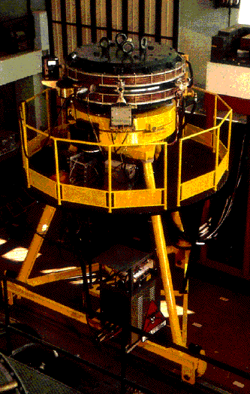
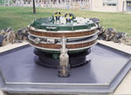
The First Electron-Positron Collider: AdA
First beam in 1961 in Italy
Moved to Orsay, France
The first beam collision in 1964
Orbit radius 65cm, collision energy 0.5GeV
Now in the garden
45

Slide 46
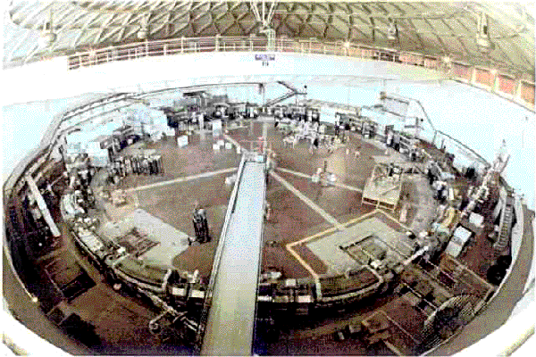
The Second one : Adone
First beam in 1967
Circumference 105m
Collision energy < 3GeV
(Unlucky, did not reach J/ψ at 3.1GeV !!)
Luminosity
3x10²⁹ /cm²/s
46

Slide 47
Ring Collider
cv
cv
♥ 高い重心系エネルギー（∵コライダー）
♥ ビームが高い繰り返しで衝突、高ルミノシティ
♥ ビームが周回するので、電力を節約
💔 シンクトロン放射によるエネルギー損失

Slide 48
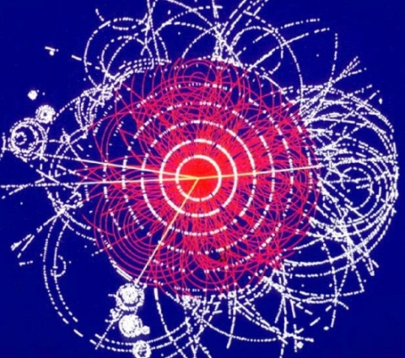
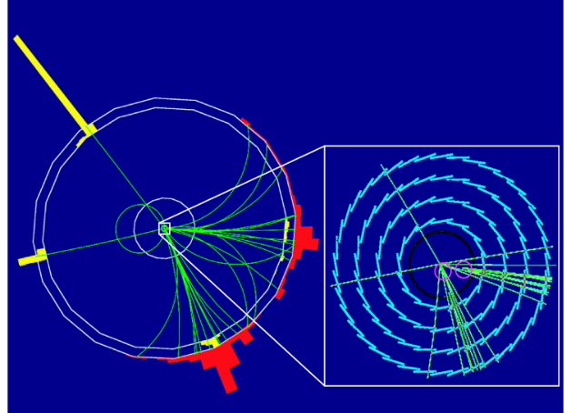
Hadron collider and Lepton Collider
Hadron Collider
u
u
u
d
u
d
Collision between composite particles (protons).
Initial state is not defined.
Extremely high energy, high event rate, large noise.
Lepton Colliders
e-
e+
Collision between elementary particles (leptons).
The initial state is well defined.
Full reconstruction of events.
A powerful tool for new particle and phenomena.
It can be discovered even if it is invisible.
48
Notes:
48

Slide 49
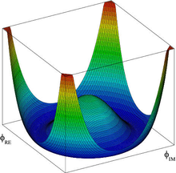
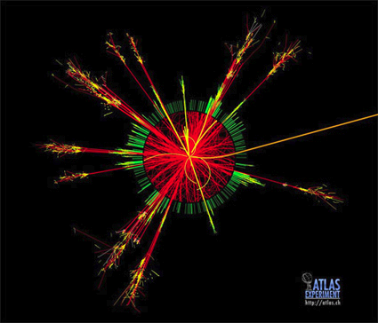
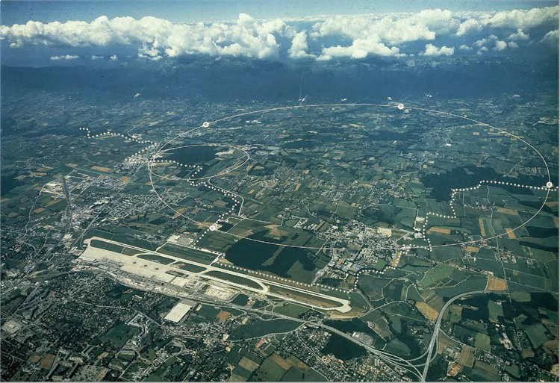
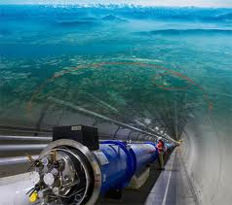
Large Hadron Collider
13 TeV proton-proton collider.
At CERN(Geneva, Swiss), 26km circumference.
Higgs boson (125 GeV) was discovered in 2012.
Energy is limited by radius and magnetic field.
Running !
Notes:
49
49

Slide 50


消費電力比較
Ring Collider
$$P_{wall}=η\left(\frac{2IE}{τ}+2\frac{4πe^{2}}{3}\frac{β^{4}γ^{4}}{ρ}\right)$$
Linear Collider
$$P_{wall}=η2IE$$

Slide 51
Large Electron Positron collider
周長およそ27km. スイスジュネーブ近郊のCERN(欧州原子核物理研究機構)に設置.
1989年運転開始。45 GeV x 45 GeV at Z0.
2000年運転終了。最高エネルギー104 GeV x 104 GeV.
現在はトンネルをLHC加速器として利用。

Slide 52
Higgs Hunting at LEP
LEP加速器はCME 209GeVで止めてしまった.
（Z₀H threshold energy 215 GeV)
LEP 104 GeVビームが一周する間に、エネルギーは2GeV程度低下。LEPの加速空洞の限界。
周長数十kmのリングコライダーでは、SRによるエネルギー損失が支配的となり、これ以上のエネルギー増大は困難。
リニアコライダーの時代へ！

Slide 53



ILC (International Linear Collider)
Electron-positron collider with CME 250GeV – 1000 GeV.
Detail study for Higgs particle, hunting SUSY particles, and any new physic beyond Standard Model.
This is the only possible way to realize e+e- collision beyond 300 GeV CME.
Coming Soon!
(I hope)
Notes:
53
53

Slide 54




The Biggest cosmological revolution since Copernicus
New dimension
Extra dimension
Super-symmetry
Grand Unified Theory
with gravity
New Principle
Multi-Universe
Human principle
New particles
Multi-Higgs
New interactions
International
Linear
Collider

Slide 55


Higgs, the last pierce of Standard Model
By the Higgs discovery, all of
particles in Standard model are
discovered.
We are now in a new epoch, post
Higgs discovery.
If we find any inconsistency
among particles, it is an evidence of new physics, beyond Standard model.
By measuring Higgs property as
precise as possible, we will see an
evidence of BSM with high
probability.
ILC is now starting as Higgs factory.

Slide 56



Synchrotron Radiation Science
Electron bent by magnetic field emits photon (Synchrotron Radiation, SR)
Bright, high directivity, polarized, wide band, and pulse.
Good for material study.
electron
Momentum
Synchrotron
Radiation
Centrifugal force
SR from undulator magnet
SR from bending magnet

Slide 57

Storage Ring Light Source
The 3rd Generation
Components
  Injector Linac：Generates electron beam and accelerate it up to 100 MeV, typically.
  Electron Synchrotron：Boost up the electron beam from 100 MeV to 3 GeV, typically.
  Ring：Store 3GeV electron beam and emit SR light continuously.
  Beam lines.
Special magnets called as
undulator for bright light.
Storage ring is optimized for
SR light.

Slide 58
Free Electron Laser
The 4th generation
Advanced light source beyond the 3rd generation light source.
Keywords are coherence and short pulse.
FEL(Free Electron Laser) and ERL(Energy Recovery Linac) are representative.
 | 3rd Generation | 4th Generation
Coherence | None (partly) | Full coherence
Pulse length | 3.0x10⁻¹¹ sec | 1.0x10⁻¹³ sec

Slide 59


What is Coherence
Coherence : a state of aligned phase of light.
Spatial coherence：wave front is defined as where light phase is same.
Temporal coherence：phase is aligned along longitudinal direction.

Slide 60



Coherence of SR
Coherence of SR is determined by bunch length of beam (beam size in longitudinal direction), σ_{z}.
If σ_{z} >λ , SR is incoherent.
If σ_{z} <λ , SR is coherent.
Coherent radiation : high power, phase information.
$$P∝N$$
$$P∝N^{2}$$

Slide 61

FEL(Free Electron Laser)
Laser by free electron.
Energy modulation by undulator radiation.
The energy modulation is converted to intensity modulation.
Coherent radiation by the beam with the modulation : FEL

Slide 62




European XFEL @ DESY, Hamburg
Schenefeld
Osdorfer Born
DESY-Bahrenfeld
Experiment hall
Laboratories
Offices
Electron beam to photon beamlines
Undulator systems begin
Electron source
Linear accelerator begins
DESY
Campus
  FEL Parameters
  Baseline photon energy
  0.4–20 keV
  Pulse duration < 100 fs
  Pulse energy a few mJ
  Superconducting linac
  14 – 17 GeV
3400 m
Technology spin off of ILC

Slide 63



Key Science Goals
Science of condensed matter & materials
Understand the cause of out-standing materials properties, in particular in dynamic behaviour
Develop new & better materials
Ultrafast photochemistry & energy research
‚Look‘ and understand how chemistry works on the atomic level
Develop better chemistry
Structure of large biomolecules, complexes & cells
  Determine function of biological systems through solving their 3D spatial structure
  Develop new treatments & drugs
Notes:
The scientific goals cover a broad range of different fields.
One of the main pillars is condensed matter and material science and in this context understanding material properties and the dynamic behavior of matter under various environmental conditions.
The second pillar will shed light onto chemistry on the atomic level. One prominent example in this field is understanding of how photosynthesis works. A question which goes back on the understanding of the chemistry of chlorophyll.
Last but not least, a large fraction of experiments will be devoted on determining of the 3D structure of biological systems viruses, bacteria or proteins
These and other questions will be studied at the 6 scientific instruments of the European XFEL, which are

Slide 64




Heavy Ion Factory where elements come from?
Study for element synthesis
Starting from hydrogen.
Light elements are synthesized in
QGP phase.
Heavy elements are synthesized by
nuclear interactions in super-nova,
etc.

Slide 65




Spallation Neutron Source

Slide 66



SNS Experimental Hall
2MW proton beam on Hg (Mercury) target for pulse neutron beam.
Experimental beam lines surround the target.

Slide 67





Medical Application
Cancer Therapy
X-ray : Compact, absorption dose is flat.
Proton : Huge, absorption dose is concentrated
(Bragg peak).
Carbon : Huge, absorption dose is concentrated (Bragg peak), biological effects are not well known.
X-ray
Proton/Carbon
Notes:
67
67

Slide 68



Positron Emission Tomography
Medical Diagnosis

Slide 69


Boron Neutron Capture Therapy
Neutron beam
Neutron generator

Slide 70




Humanities
Non-destructive inspection
X-ray imaging
Neutron radiography
THz imaging
AMS for dating
¹⁴C is generated by cosmic ray in air.
When we lived, fraction of ¹⁴C
and ¹²C is constant.
When we stop respiration, ¹⁴C
decays (half life 5000 years).
The fraction can be measured precisely
with Accelerator Mass Spectrometer.

Slide 71
Technology Big Ban by Accelerator
Accelerator
Health
Material
Agricul-
ture
Security
Humani-
ties
Environ-ment
PET CT scan
tire
Breeding
inspection
inspection
RI treatment
Radiation
therapy
Material
synthesis
Pest cont.
Security ins.
dating
photosynthesis

Slide 72
Summary
Accelerator has been a driving force for scientific studies.
Starting from nuclear/particle physics, the fields are now expanded to many scientific subjects , industrial, and medical applications.

