Slide 1
Foundation of RF Accelerator
Masao KURIKI
Graduate School of Advanced Sciences of Matter,
Hiroshima University

Slide 2
Contents
The greatest Invention in Accelerator science, RF accelerator.
Foundation of RF acceleration.
Accelerator Structures.
Beam loading control.

Slide 3
The greatest Invention
in Accelerator science,
RF accelerator

Slide 4
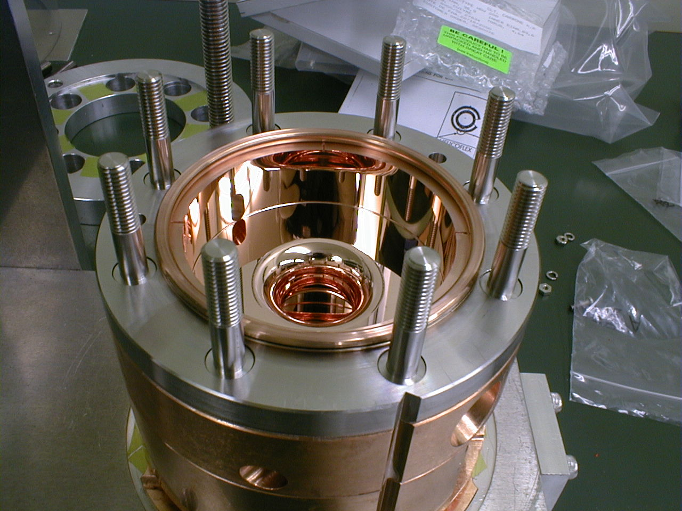
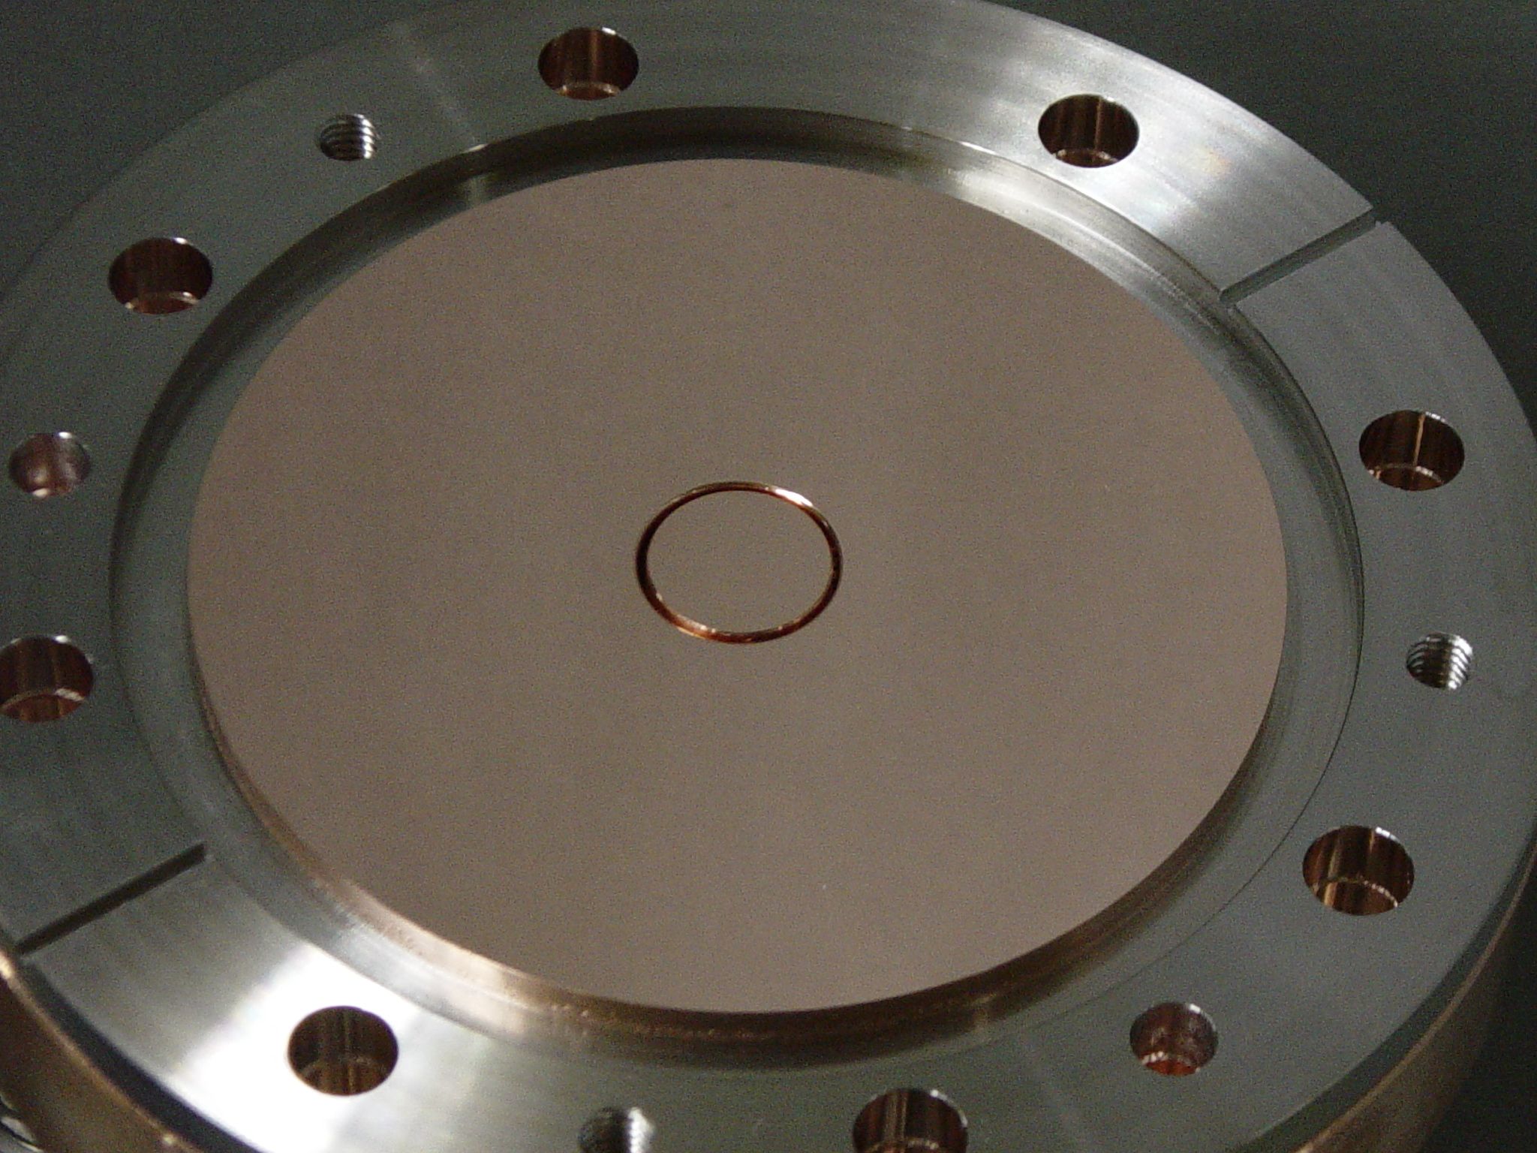
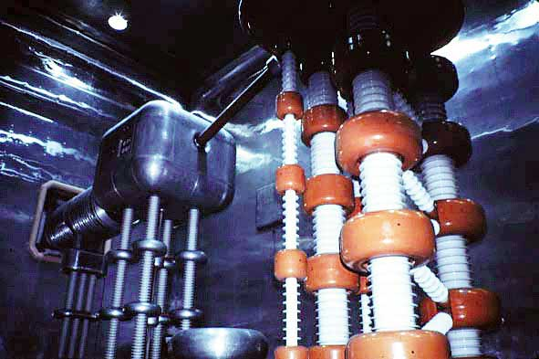
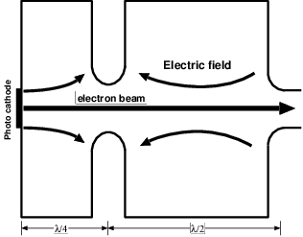
Static and RF fields
Cockcrof Walton（KEK-PS Injector）：
700kV/15 x 15 x 15 (m³) = 2.1e+2 V/m³.
RF electron gun：4MV/0.2x0.2x0.2 (m³)=5.0e+8 V/m³.
84mm
~10m

Slide 5
Toward RF acceleration
The 1st idea by G. Ising
Drift tubes connected to a spark gap.
The pulse reaches to each tube with delay.
Continuous acceleration.
Lack of technology.

Slide 6
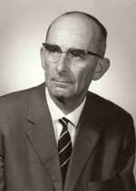
The greatest Invention
R. Wideroe PhD. Thesis : Develop the first RF accelerator based on Ising’s idea.
25kV, 1MHz AC voltage to the drift tube. Na and K beams to 50 keV.
Repeatable.
“The drift tube was the first accelerating system which had earthed potential on both sides“– Rolf Wideroe
R. Wideroe

Slide 7
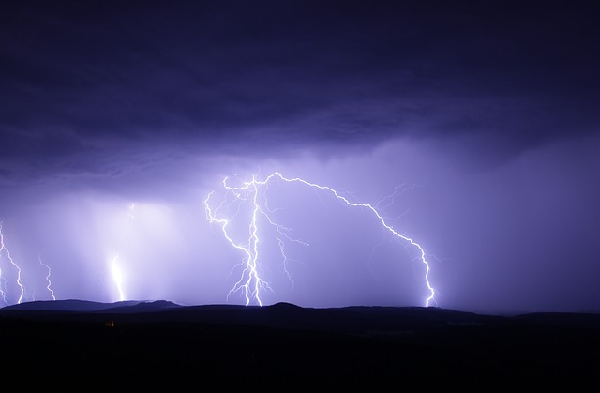
AC and DC
+V
Gnd
q
DC : Limited by discharge
AC : No fundamental limit on Energy

Slide 8
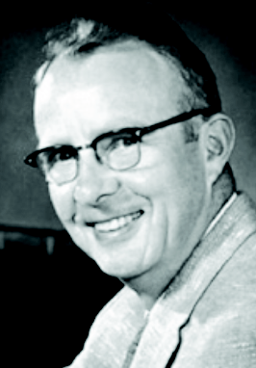
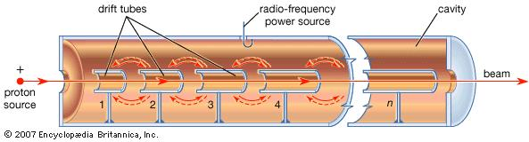
Alvarez-Linac:The first resonant cavity.
Resonant structure surrounded by metal wall.
No limitation on the acceleration frequency.
Alvarez type, DTL(Drift Tube Linac) is still used in the hadron accelerator.
Alvarez

Slide 9
Foundation of
RF Acceleration

Slide 10
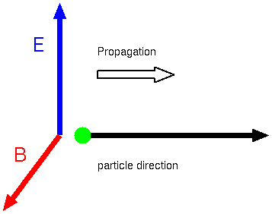
Question
All of modern high energy accelerator is based on RF acceleration.
Radio Frequency field is composed from plane wave.
Plane wave propagation direction is perpendicular to Electric field.
Question: How to realize a
continuous acceleration?

Slide 11
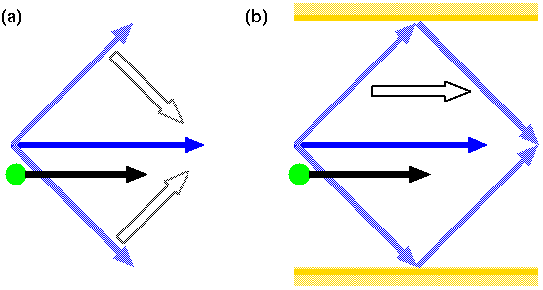
Answer
Superposition of plane waves + reflection : E-field and propagation becomes same direction.
Reflection is by metal wall -> cavity structure.

Slide 12
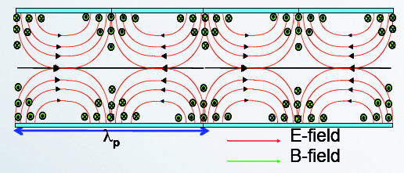
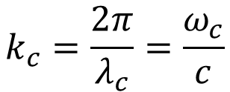


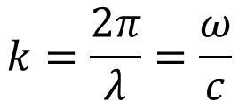
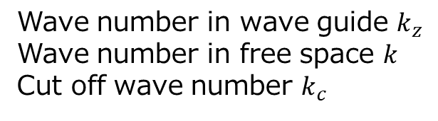
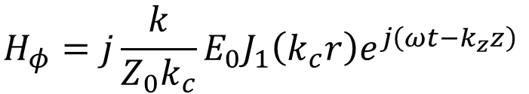
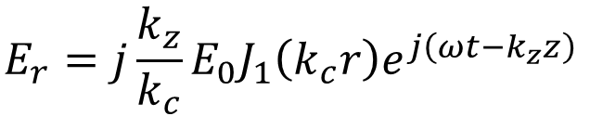

EM field in a cylinder
TM₀₁ solution
2a
$$E_{z}=E_{0}J_{0}\left(k_{c}r\right)e^{j\left(ωt{−k}_{z}z\right)}$$
$$E_{r}=j{\frac{k_{z}}{k_{c}}E}_{0}J_{1}\left(k_{c}r\right)e^{j\left(ωt{−k}_{z}z\right)}$$
$$H_{φ}=j{\frac{k}{{Z_{0}k}_{c}}E}_{0}J_{1}\left(k_{c}r\right)e^{j\left(ωt{−k}_{z}z\right)}$$
Wave number in wave guide $k_{z}$
Wave number in free space $k$
Cut off wave number $k_{c}$
$$k=\frac{2π}{λ}=\frac{ω}{c}$$
$${k_{z}}^{2}=k^{2}−{k_{c}}^{2}$$
$$k_{c}=\frac{2π}{λ_{c}}=\frac{ω_{c}}{c}$$
$$λ_{c}=2.61a$$

Slide 13

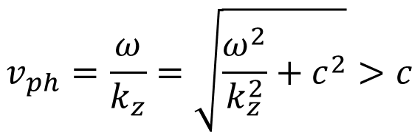
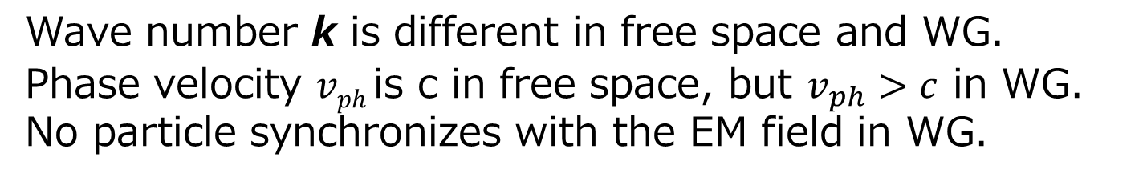
Dispersion Relation
$$ω^{2}=ω_{c}^{2}+{c^{2}k}_{z}^{2}$$
$$v_{ph}=\frac{ω}{k_{z}}=\sqrt{\frac{ω^{2}}{k_{z}^{2}}+c^{2}}>c$$
Wave number k is different in free space and WG.
Phase velocity $vph$is c in free space, but $v_{ph}>c$ in WG.
No particle synchronizes with the EM field in WG.

Slide 14
Periodic Structure
Periodic boundary condition by disks.
Dispersion relation is modified by reflected wave.
Synchronization of RF wave and particle is possible.
2b
2a

Slide 15
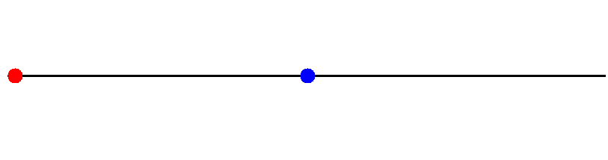
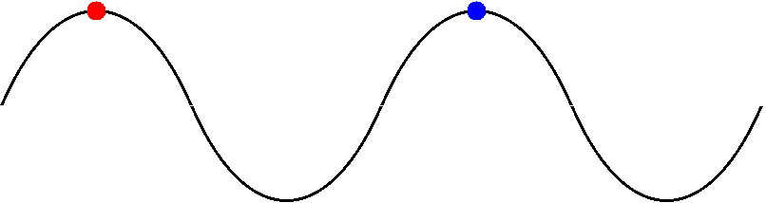
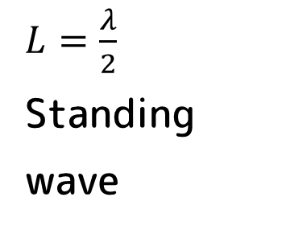
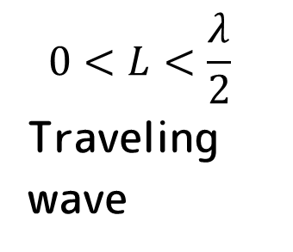
Standing Wave and Traveling Wave
$L=\frac{λ}{2}$
Standing
wave
$$0<L<\frac{λ}{2}$$
Traveling
wave

Slide 16
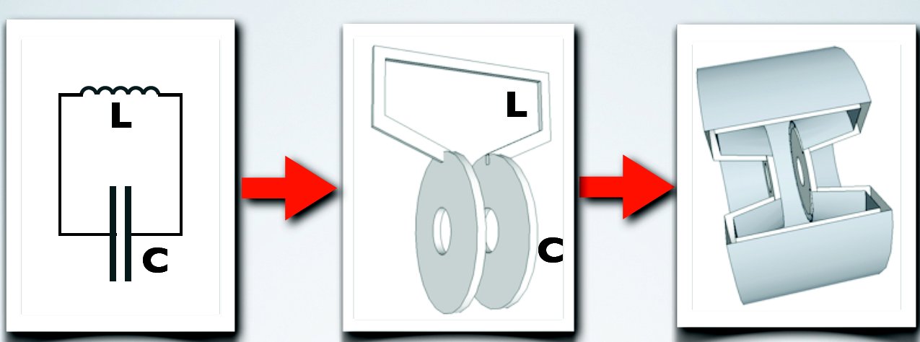
Pill Box Cavity
The simplest accelerator structure.
It is equivalent with a LC circuit.
SW cavity.

Slide 17
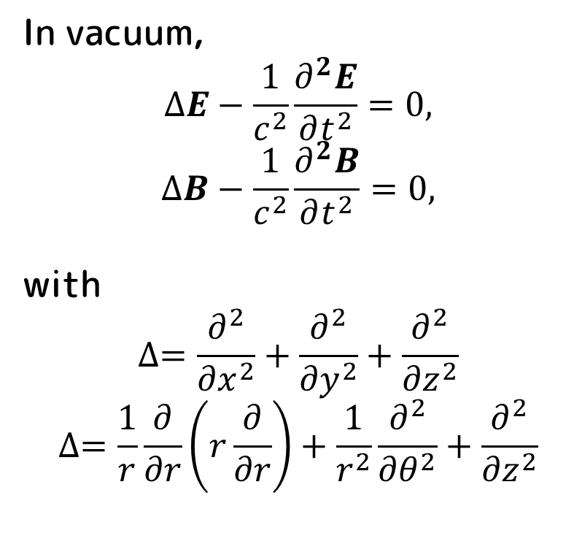


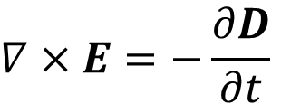
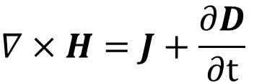
Starting from Maxwell Equation
In vacuum,
$$ΔE−\frac{1}{c^{2}}\frac{∂^{2}E}{∂t^{2}}=0,$$
$$ΔB−\frac{1}{c^{2}}\frac{∂^{2}B}{∂t^{2}}=0,$$
with
$$∆=\frac{∂^{2}}{{∂x}^{2}}+\frac{∂^{2}}{{∂y}^{2}}+\frac{∂^{2}}{{∂z}^{2}}$$
$$∆=\frac{1}{r}\frac{∂}{∂r}\left(r\frac{∂}{∂r}\right)+\frac{1}{r^{2}}\frac{∂^{2}}{{∂θ}^{2}}+\frac{∂^{2}}{{∂z}^{2}}$$
$$∇×H=J+\frac{∂D}{∂t}$$
$$∇×E=−\frac{∂D}{∂t}$$
$$∇∙D=ρ$$
$$∇∙B=0$$

Slide 18
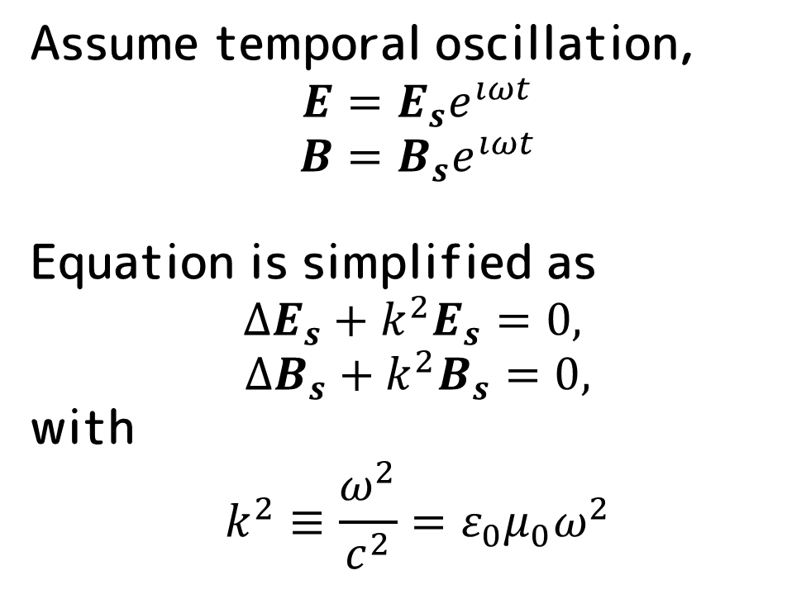
Helmholz Equation
Assume temporal oscillation,
$$E=E_{s}e^{ıωt}$$
$$B=B_{s}e^{ıωt}$$
Equation is simplified as
$$∆E_{s}+k^{2}E_{s}=0,$$
$$∆B_{s}+k^{2}B_{s}=0,$$
with
$$k^{2}≡\frac{ω^{2}}{c^{2}}=ε_{0}μ_{0}ω^{2}$$

Slide 19
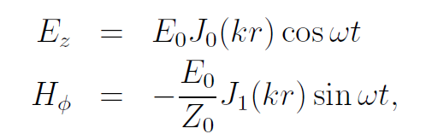
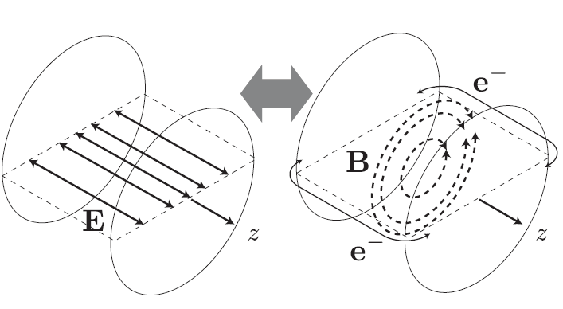
Solving Helmholz Equation
Assuming TM mode
(Only transverse B field)
Other components are zero.

Slide 20
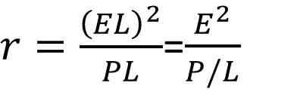
How much gain?
Shunt impedance r (Ω/m) gives the gain,
  E: field
  P: dissipated power
  L: length
$r=\frac{{\left(EL\right)}^{2}}{PL}$=$\frac{E^{2}}{P/L}$
Length L
Input power
P
Field E

Slide 21
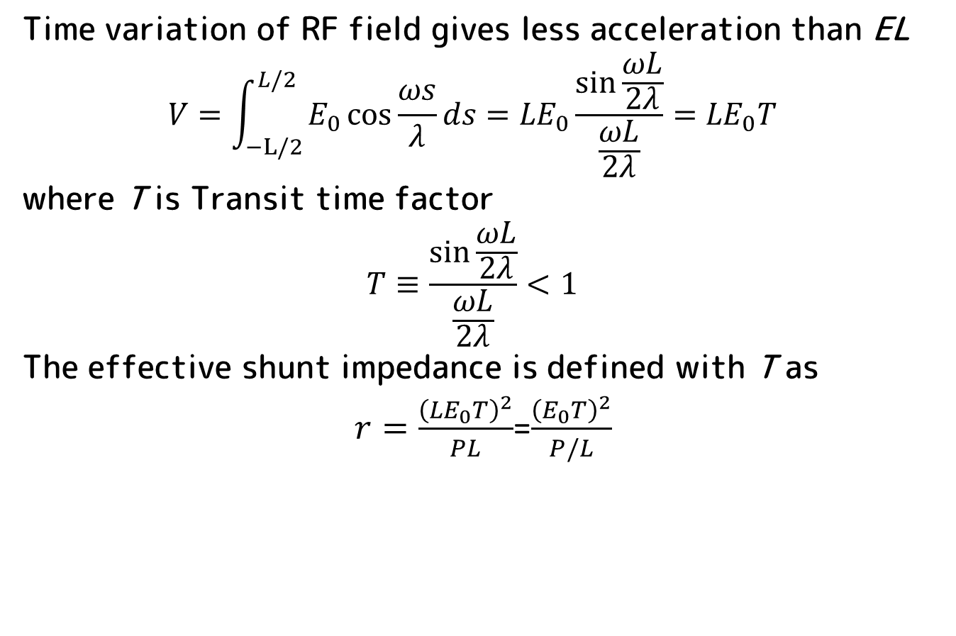
Transit Time Factor
Time variation of RF field gives less acceleration than EL
$$V=\int_{−L/2}^{L/2}{E_{0}\cos{\frac{ωs}{λ}}ds={LE}_{0}\frac{\sin{\frac{ωL}{2λ}}}{\frac{ωL}{2λ}}}={LE}_{0}T$$
where T is Transit time factor
$$T≡\frac{\sin{\frac{ωL}{2λ}}}{\frac{ωL}{2λ}}<1$$
The effective shunt impedance is defined with T as
$r=\frac{{\left({LE}_{0}T\right)}^{2}}{PL}$=$\frac{{\left(E_{0}T\right)}^{2}}{P/L}$

Slide 22
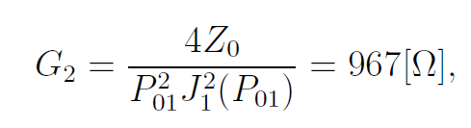
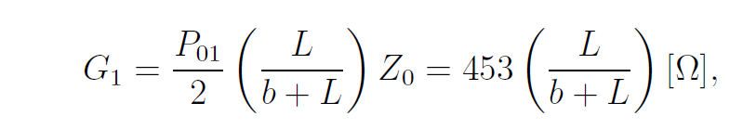
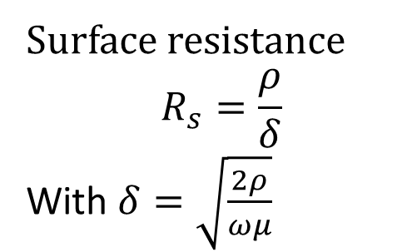
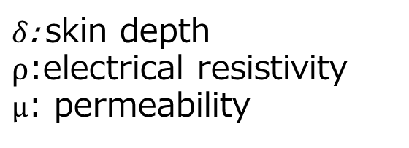
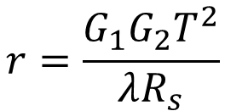
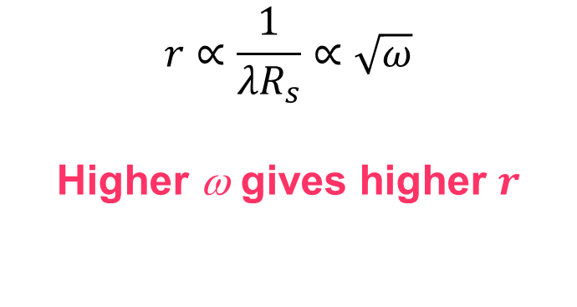
Shunt Impedance of Pill Box Cavity
$$r=\frac{G_{1}G_{2}T^{2}}{λR_{s}}$$
Surface resistance
$$R_{s}=\frac{ρ}{δ}$$
With $δ=\sqrt{\frac{2ρ}{ωμ}}$
$$r∝\frac{1}{{λR}_{s}}∝\sqrt{ω}$$
Higher ω gives higher $r$
$δ$: skin depth
$ρ$:electrical resistivity
$μ$: permeability

Slide 23
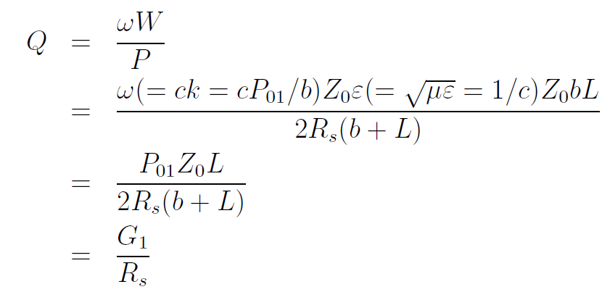
Q value
Q-value :numbers of oscillation to damp the stored energy W.
P
W
A geometrical
factor
P
Surface
resistance

Slide 24


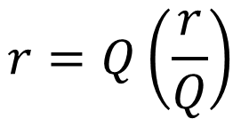
What is r/Q ?
r/Q is the ratio of the shunt impedance and Q value.
The shunt impedance is product of r/Q and Q. So what???
$$\left(\frac{r}{Q}\right)=\frac{r}{Q}$$
$$r=Q\left(\frac{r}{Q}\right)$$

Slide 25
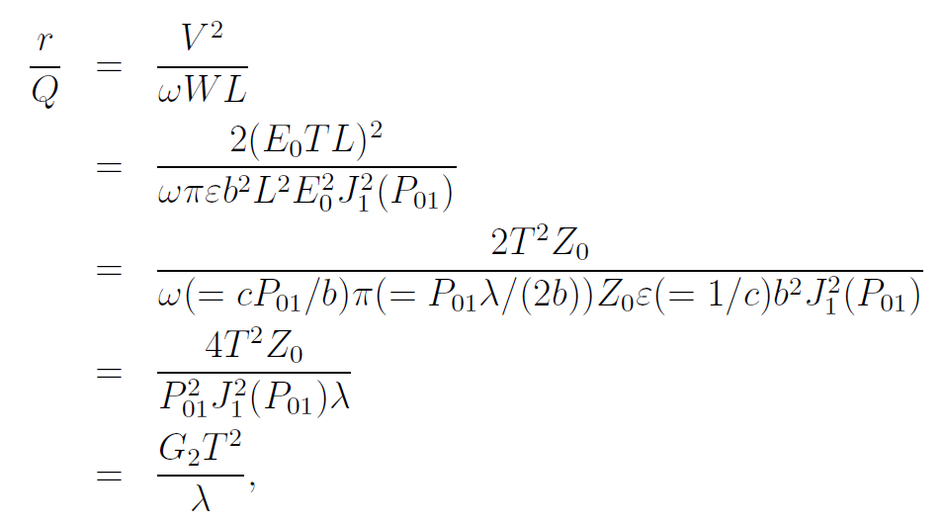
This is r/Q.
(r/Q) is determined
by the geometry.
A Constant
Transit time
factor
Wave length

Slide 26
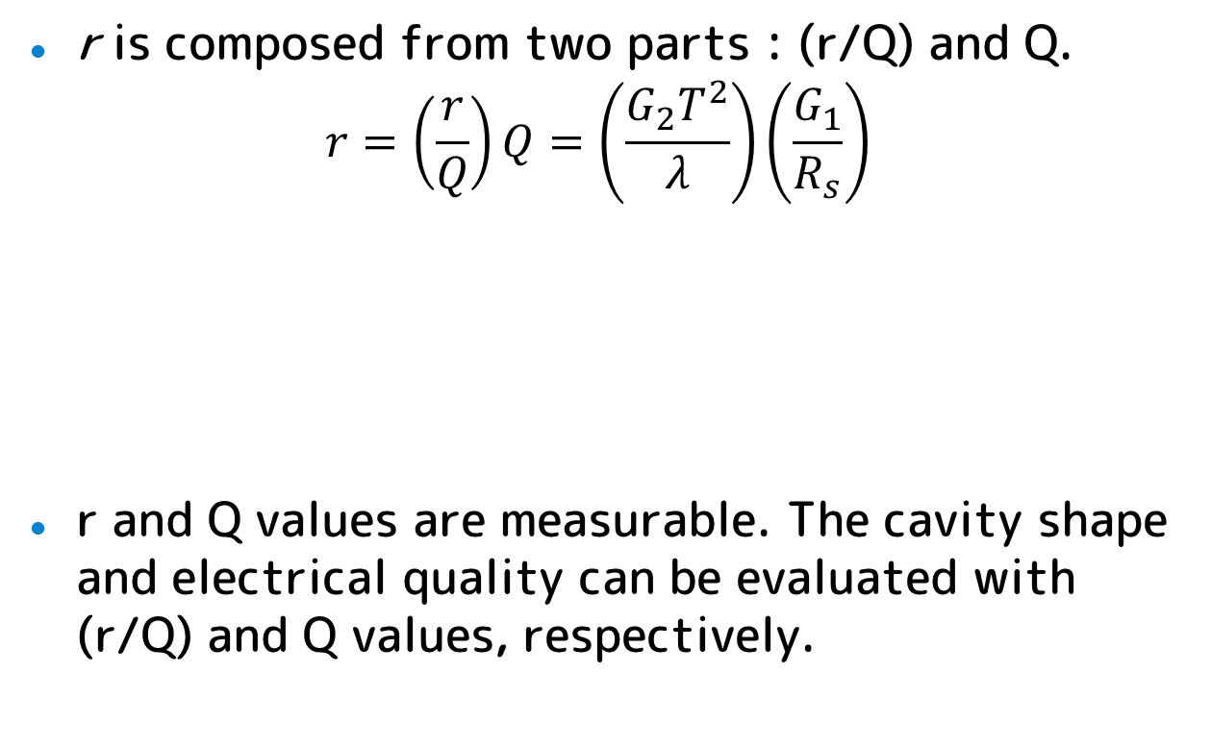
Shunt impedance again
r is composed from two parts : (r/Q) and Q.
$$r=\left(\frac{r}{Q}\right)Q=\left(\frac{G_{2}T^{2}}{λ}\right)\left(\frac{G_{1}}{R_{s}}\right)$$
r and Q values are measurable. The cavity shape and electrical quality can be evaluated with (r/Q) and Q values, respectively.
Geometry
Material
property

Slide 27
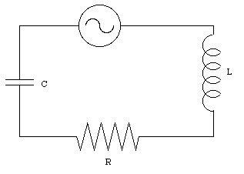
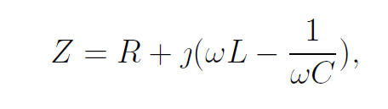
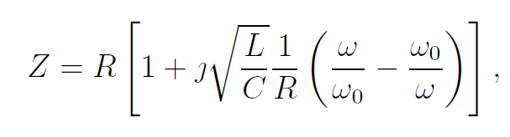
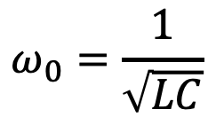
Equivalent Circuit :Pillbox
Let us start with a simple L, C, R circuit. Note that R is not the shunt impedance.
Impedance is
It can be rewritten as
$$ω_{0}=\frac{1}{\sqrt{LC}}$$

Slide 28
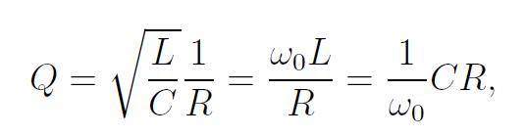

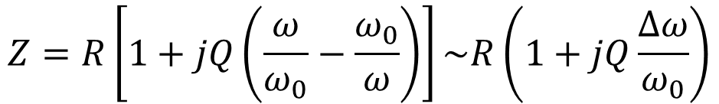
We define Q as
$$Z=R\left[1+jQ\left(\frac{ω}{ω_{0}}−\frac{ω_{0}}{ω}\right)\right]\sim R\left(1+jQ\frac{∆ω}{ω_{0}}\right)$$
$$∆ω≡ω−ω_{0}$$
Q is coefficient of giving increase of cavity
impedance by detuning.

Slide 29
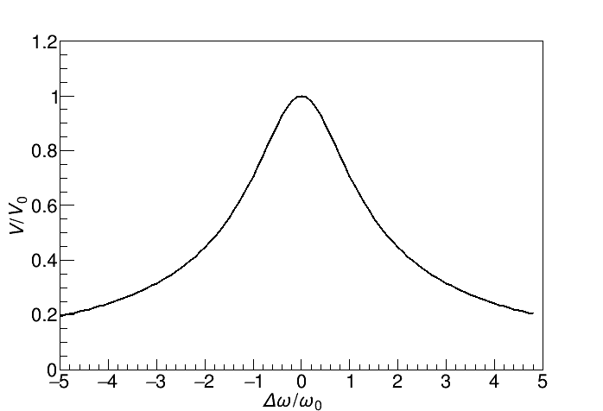
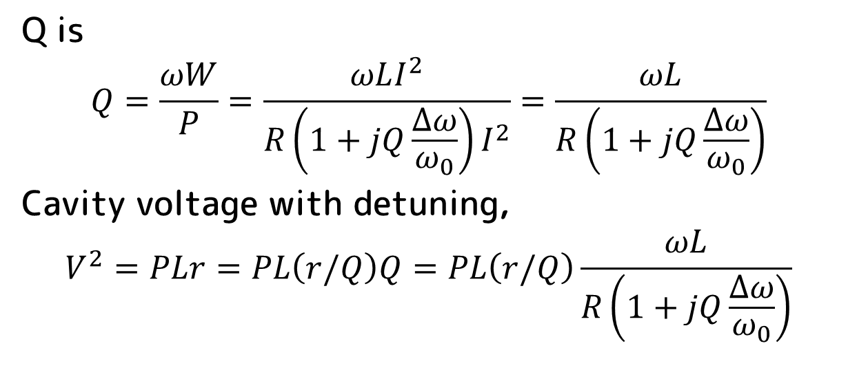
Q is
$$Q=\frac{ωW}{P}=\frac{ωLI^{2}}{R\left(1+jQ\frac{∆ω}{ω_{0}}\right)I^{2}}=\frac{ωL}{R\left(1+jQ\frac{∆ω}{ω_{0}}\right)}$$
Cavity voltage with detuning,
$$V^{2}=PLr=PL\left(r/Q\right)Q=PL\left(r/Q\right)\frac{ωL}{R\left(1+jQ\frac{∆ω}{ω_{0}}\right)}$$

Slide 30



Other Definition of Q-value

Slide 31


The last definition of Q-value
Q is a time constant of decay curve of W.
$\frac{dW}{dt}=−P=−\frac{ω_{0}}{Q}W$
because $Q=ω_{0}\frac{W}{P}$. It leads
$W(t)=W_{0}e^{−\frac{ω_{0}}{Q}t}$

Slide 32



Multi-cell cavity
The multi-cell cavity is LCR circuits with mutual inductance L_{c}
nth cell
we assume a solution in a form of
which gives

Slide 33




Dispersion Relation

Slide 34

Standing Wave Linac
$$v_{g}=\frac{∂ω}{∂k_{z}}=0$$

Slide 35


Standing Wave Linac
Operated in Standing Wave.
Phase advance per cell is

Slide 36



SW Cavity Power Balance
Pi
Pr
Matching
Pr
$$E_{i}+E_{r}=E_{cav}$$
$$P_{i}−P_{r}=P_{cav}$$
Pi
Pi
Stored

Slide 37

Traveling Wave Cavity
$$v_{g}=\frac{∂ω}{∂k_{z}}≠0$$

Slide 38

TW Cavity Power Balance
Input
Output
No reflection.
Power flows through cavities with $v_{g}$.
Rest of power is extracted and dumped.

Slide 39



Traveling Wave Linac
Power Source
(Klystron)
RF load
$$L_{c}=\frac{βλφ}{2π}$$
L_{c}

Slide 40
Property of TW structure

Slide 41


Disk-Loaded TW Linac
By inserting disks periodically to the cylindrical wave guide, the phase velocity can be decreased.
Synchronous frequency is determined from the dispersion relation.

Slide 42



Disk-Loaded TW Linac
By operating it with the synchronous frequency, the particle sits always on a same phase along the structure.
$$d=\frac{φ}{2π}λ$$

Slide 43
Disk-Loaded TW Linac
The structure can be parametrized with a similar way to the pill box.
The biggest difference from the SW cavity is that the power flows through the TW structure.
Input
Output

Slide 44

Parameters
Shunt Impedance $r=−\frac{E^{2}}{dP/dz}$
Q vaule $=−\frac{ωW}{dP/dz}$
r/Q = $\frac{E^{2}}{ωW}$
Group velocity $v_{g}=\frac{P}{W}=\frac{ωP}{QdP/dz}$
Attenuation parameter $α=−\frac{1}{2P}\frac{dP}{dz}$
Filling time $t_{f}=\int_{0}^{L}{\frac{dz}{v_{g}}}$

Slide 45

Attenuation constant
$$\frac{dP}{dz}=−2αP$$
P(z) is
$$P\left(z\right)=P_{0}e^{\left(−2\int_{0}^{z}{α(z^{′}})dz′\right)}$$
Output power
$$P\left(L\right)=P_{0}e^{\left(−2\int_{0}^{L}{α(z^{′}})dz′\right)}=P_{0}e^{\left(−2τ\right)}$$
With attenuation constant τ as
$$τ=\int_{0}^{L}{α(z^{′}})dz′$$
Which can be measured as
$$τ=−\frac{1}{2}ln\left(\frac{P_{L}}{P_{0}}\right)$$
P0
PL

Slide 46

Constant Impedance Structure
Constant vg and r along the structure.
$$τ=αL$$
$$E\left(z\right)=E_{0}e^{−αz}$$
$$P\left(z\right)=P_{0}e^{−2αz}$$
Field is not constant along z. Because the maximum field is higher than the average, frequent discharge.
break
down
E
E

Slide 47

Constant Gradient
In the CG structure, $α$ is determined to give a constant field along the structure.
$α$ is adjusted by changing the iris size (aperture, a).
  $r$ depends not strongly on $a$.
  $dP(z)/dz$should be constant.
  $$P\left(z\right)=P_{0}−\frac{P_{0}−P_{L}}{L}z=P_{0}\left(1−\frac{1−e^{−2τt}}{L}z\right)$$
  $$\frac{dP}{dz}=−\frac{P_{0}−P_{L}}{L}=−P_{0}\frac{1−e^{−2τt}}{L}$$

Slide 48

The gradient of CG structure is a constant as expected.
$E^{2}=−r\frac{dP}{dz}=rP_{0}\frac{1−e^{−2τt}}{L}$
$vg$and $tf$ are
$$v_{g}=\frac{ω}{Q}\frac{L−\left(1−e^{−2τt}\right)}{1−e^{−2τt}}z$$
$$t_{f}=\frac{2Qτ}{ω}$$
Because the maximum field is same as the average, discharge rate is much suppressed.
E
E

Slide 49
Transient Property and
Beam Loading Compensation

Slide 50



Standing Wave Accelerator
P_{in}
P_{r}
Power balance
$$\frac{dW_{0}}{dt}=P_{in}−P_{r}−P_{0}$$
V₀
Express in V₀
W₀
P₀
$$\frac{dW_{0}}{dt}=\frac{Q_{0}}{ω}\frac{dP_{0}}{dt}=\frac{Q_{0}}{ω}2G_{0}V_{0}\frac{dV_{0}}{dt}$$
Admittance G₀
$$P_{0}=G_{0}{V_{0}}^{2}$$

Slide 51








Admittance of wage guide (definition of coupling $β$)
$$G_{wg}={βG}_{0}$$
$$P_{in}={βG}_{0}{V_{in}}^{2}$$
$$P_{r}={βG}_{0}{V_{r}}^{2}$$
Matching condition at the coupling window
$$V_{r}$$
$$V_{in}+V_{r}=V_{0}$$
$$V_{in}$$
$$V_{0}$$
$$\frac{Q_{0}}{ω}2G_{0}V_{0}\frac{dV_{0}}{dt}=P_{in}−P_{r}−P_{0}=−βG_{0}{V_{0}}^{2}+2βG_{0}V_{0}V_{in}−G_{0}{V_{0}}^{2}$$
The equation is summarized with $Q_{0}=\left(1+β\right)Q_{L}$
$$\frac{{2Q}_{L}}{ω}\frac{dV_{0}}{dt}=−V_{0}+\frac{2β}{1+β}V_{in}$$

Slide 52





Differential equation of SW accelerator
$$τ\frac{dV_{0}}{dt}=−V_{0}+αV_{in}$$
$$α≡ \frac{2β}{1+β}$$
$$τ≡\frac{{2Q}_{L}}{ω}$$
Solution with
V₀=0 at t=0
$$V_{0}\left(t\right)=\frac{2β}{1+β}\sqrt{\frac{P_{in}}{βG_{0}}}\left(1−e^{−\frac{t}{τ}}\right)$$

Slide 53

Introduce Beam
Cavity voltage is determined by not only Input power, but also beam current.
Beam consume the cavity stored energy as
$$P_{beam}=\frac{1}{T}\int_{0}^{T}{dt}IV_{0}\cos\left(ωt\right)$$
If the beam is delta function on crest,
$$P_{beam}=IV_{0}$$
Power balance is
$$\frac{dW_{0}}{dt}=P_{in}−P_{r}−P_{0}−IV_{0}$$

Slide 54



Differential equation of SW accelerator with Beam
$$τ\frac{dV_{0}}{dt}=−V_{0}+αV_{in}−\frac{I}{\left(1+β\right)G_{0}}$$
Voltage reduction by beam
Solution with
V₀=0 at t=0,
Beam start at t=t_{b}
$$V_{0}\left(t\right)=\frac{2β}{1+β}\sqrt{\frac{P_{in}}{βG_{0}}}\left(1−e^{−\frac{t}{τ}}\right) \\ −\frac{I}{\left(1+β\right)G_{0}}\left(1−e^{−\frac{t−t_{b}}{τ}}\right)$$

Slide 55



Beam Loading Compensation
Since RF and Beam term have the same time constant τ, V₀ can be constant by adjusting amplitude and timing.
$$V_{0}\left(t\right)=\frac{2β}{1+β}\sqrt{\frac{P_{in}}{βG_{0}}}\left(1−e^{−\frac{t}{τ}}\right) \\ −\frac{I}{\left(1+β\right)G_{0}}\left(1−e^{−\frac{t−t_{b}}{τ}}\right)$$
$$t_{b}=−τln\left(\frac{I}{2}\sqrt{\frac{rL}{βP_{in}}}\right)$$

Slide 56

Beam Loading By Bunched Beam
Beam current by a single bunch (delta function),
$$I=qβcδ\left(z\right)$$
The differential equation (no RF input) is
$$τ\frac{dV}{dt}=−V−\frac{I}{\left(1+β\right)G_{0}}=−V−\frac{qβcδ\left(z\right)}{\left(1+β\right)G_{0}}$$
Integrating on $−ε<t<+ε$ and taking $ε→0$
$$\int_{−ε}^{+ε }{\frac{dV}{dt}dt}=V\left(+ε \right)−V\left(−ε \right)=2εV−\frac{q}{τ\left(1+β\right)G_{0}}$$
$$∆V=−\frac{ωq}{{2Q}_{L}G_{0}}=−ζq, ζ≡\frac{ω}{{2Q}_{L}G_{0}}$$

Slide 57


The differential equation for t>0 is
$$τ\frac{dV}{dt}=−V$$
We solve the equation with $V\left(+0\right)=−ζq$
$$V=−ζqu(t)e^{−\frac{t}{τ}}$$
$u(t)$ is step function. With many bunches and RF input,
$$V\left(t\right)=\frac{2}{1+β}\sqrt{\frac{βP_{in}}{G_{0}}}\left(1−e^{−\frac{t}{τ}}\right)+−ζ\sum{q_{i}u\left(t_{i}\right)e^{−\frac{t−t_{i}}{τ}}}$$

Slide 58

Traveling Wave Accelerator
Accelerator with a finite group velocity.
The power flows through the accelerator.
The beam loading can be suppressed with an active method.

Slide 59

Power Balance
  Assume quasi-constant power flow in TW accelerator.
  $$\frac{dP}{dz}={\left(\frac{dP}{dz}\right)}_{wall}+{\left(\frac{dP}{dz}\right)}_{beam}=−2α\left(z\right)P\left(z,t\right)−IE(z,t)$$
  Expansion with partial derivative
  $$\frac{dP}{dz}=\frac{∂P}{∂z}+\frac{∂P}{∂t}\frac{dt}{dz}=\frac{∂P}{∂z}+\frac{1}{v_{g}}\frac{∂P}{∂t}$$
  $$\frac{∂P}{∂z}+\frac{1}{v_{g}}\frac{∂P}{∂t}−2α\left(z\right)P\left(z,t\right)−IE\left(z,t\right)=0$$

Slide 60



Expression in field,
$$\frac{∂E}{∂z}−\frac{E}{2α}\frac{dα}{dz}+\frac{1}{v_{g}}\frac{∂E}{∂t}+α\left(z\right)E\left(z,t\right)+Iαr=0$$
$$P=\frac{E^{2}}{2αr}$$
r: shunt impedance
Constant Gradient condition $\frac{dα}{dz}=−2α$
$$\frac{∂E(z,t)}{∂z}+\frac{1}{v_{g}}\frac{∂E(z,t)}{∂t}+I(t)αr=0$$

Slide 61

Laplace Transformation
$$ℒ\left[f\left(t\right)\right]≡F\left(s\right)=\int_{0}^{∞}{dtf(t)e^{−st}}$$
In s-domain, differential and integral operation becomes algebraic operation.
$$ℒ\left[\frac{df}{dt}\right]=sF\left(s\right)−f\left(0\right)$$
$$ℒ\left[\int_{0}^{t}{f\left(u\right)du}\right]=\frac{1}{s}F\left(s\right)$$
Differential
Equation f(t)
Differential
Equation F(s)
Laplace transformation
Algebra
Inverse
Laplace transformation
Solution
f(t)
Solution
F(s)

Slide 62


$$\frac{∂E(z,t)}{∂z}+\frac{1}{v_{g}}\frac{∂E(z,t)}{∂t}+I(t)αr=0$$
Laplace transformation
$$\frac{∂E(z,s)}{∂z}+\frac{s}{v_{g}}\frac{∂E(z,s)}{∂t}+I(s)αr=0$$
By integrating with z,
$$E\left(z,s\right)−E\left(0,s\right)e^{st_{z}}+ I(s)r\int_{0}^{z}{αdz}=0$$
By integrating with z again,
$$V\left(s\right)=\frac{ωL}{Q\left(1−e^{−2τ}\right)}\frac{1}{s+\frac{ω}{Q}}E\left(s\right)\left[1−e^{−\left(s+\frac{ω}{Q}\right)t_{f}}\right]$$
$$−\frac{ωrLI(s)}{2Q\left(1−e^{−2τ}\right)s}\left[1−e^{−\frac{ω}{Q}t_{f}}−\frac{ω\left(1−e^{−st_{f}−2τ}\right)}{Q(s+ω/Q)}\right]$$

Slide 63

Input RF E(t) and Beam current,
$$E\left(t\right)=E_{0}u\left(t\right), I\left(t\right)=I_{0}u(t−t_{f})$$
Giving
$$E\left(s\right)=\frac{E_{0}}{s} , I\left(s\right)=\frac{I_{0}}{s}e^{−st_{f}}$$
$$V\left(s\right)=\frac{ωL}{Q\left(1−e^{−2τ}\right)}\frac{1}{s+\frac{ω}{Q}}\frac{E_{0}}{s}\left[1−e^{−\left(s+\frac{ω}{Q}\right)t_{f}}\right]$$
$$−\frac{ωrLI(s)}{2Q\left(1−e^{−2τ}\right)}\frac{I_{0}e^{−st_{f}}}{s^{2}}\left[1−e^{−\frac{ω}{Q}t_{f}}−\frac{ω\left(1−e^{−st_{f}−2τ}\right)}{Q(s+ω/Q)}\right]$$
In t-domain,
$$V\left(t\right)=\frac{LE_{0}}{1−e^{−2τ}}\left[\left(1−e^{−\frac{ω}{Q}t}\right)u\left(t\right)−e^{−2τ}\left(1−e^{−\frac{ω}{Q}\left(t−t_{f}\right)}\right)u(t−t_{f})\right]$$
$$−\frac{rLI_{0}}{2}\left[−\frac{ω}{Q}\frac{e^{−2τ}}{{1−e}^{−2τ}}\left(t−t_{f}\right)+\frac{1−e^{−\frac{ω}{Q}\left(t−t_{f}\right)}}{{1−e}^{−2τ}}\right]u(t−t_{f})$$

Slide 64



$$0<t<t_{f}$$
$$V\left(t\right)=\frac{LE_{0}}{1−e^{−2τ}}\left(1−e^{−\frac{ω}{Q}t}\right)$$
$$t>t_{f} and I_{0}=0,$$
$$V\left(t\right)=\frac{LE_{0}}{1−e^{−2τ}}\left(1−e^{−\frac{ω}{Q}t_{f}}\right)=LE_{0}$$
$$t_{f}$$

Slide 65


$$t>t_{f} and I=I_{0}u(t−t_{f}),$$
$$V\left(t\right)=LE_{0}−\frac{rLI_{0}}{2}\left[−\frac{ω}{Q}\frac{e^{−2τ}}{{1−e}^{−2τ}}\left(t−t_{f}\right)+\frac{1−e^{−\frac{ω}{Q}\left(t−t_{f}\right)}}{{1−e}^{−2τ}}\right],$$

Slide 66
Beam Loading Compensation
Acceleration field is varied when we start the beam acceleration. Beam on first t_{f} is useless.
We consider its compensation for uniform acceleration.
Useless beam
Beam

Slide 67





Amplitude Modulation
Amplitude modulation on E(t) for compensation,
$$E\left(t\right)=E_{0}u(t)+E_{1}u(t−t_{f})$$
$$E\left(s\right)=\frac{E_{0}}{s}+\frac{E_{1}}{s}e^{−st_{f}}$$

Slide 68

The variation is much compensated, but not perfect.

Slide 69



Two components AM
The beam loading term has two components.
AM should have also two components for a perfect compensation.
$$E\left(t\right)=E_{0}u\left(t\right)+E_{1}u\left(t−t_{f}\right)$$
$$+E_{2}\left(t−t_{f}\right)u\left(t−t_{f}\right)$$
$−E_{2}\left(t−t_{f}\right)u(t−2t_{f})$

Slide 70





Slide 71
Summary
RF acceleration is a great invention realizing high energy acceleration beyond the vacuum discharge.
For acceleration, appropriate boundary condition and synchronization are essential.
Two types of accelerator: Standing wave and Travelling wave.
Beam loading compensation is mandatory for multi-bunch acceleration.

Slide 72

Stored Energy

Slide 73

Dissipated Power

