Slide 1

Foundation of FELs
(Slides made by T. Tanaka)
Masao KURIKI
Graduate School of Advanced Sciences of Matter,
Hiroshima University
(material is taken from Lecture by T. Tanaka, Sp8)
ALLPPT.com _ Free PowerPoint Templates, Diagrams and Charts

Slide 2
Introduction
Coherent radiation & FELs
Amplification mechanism in FELs
FEL equation
Characteristics of FEL radiation
ERL: what’s it?

Slide 3
Introduction
Coherent radiation & FELs
Amplification mechanism in FELs
FEL equation
Characteristics of FEL radiation
ERL: what’s it?

Slide 4
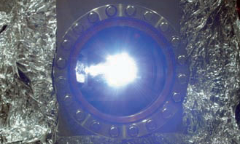
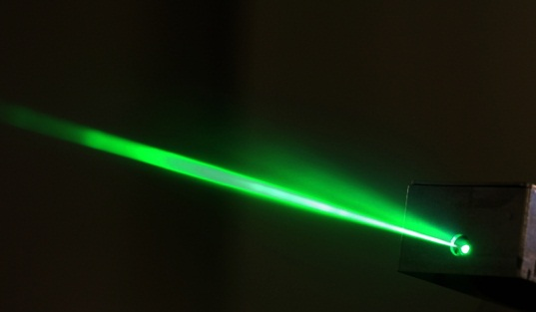
Synchrotron Radiation & Laser
Photon Science
SR
Laser
first observed in 1947
radiation by a relativistic electron beam
work as laser-like sources, where conventional lasers are not available
first realized in 1960
fully coherent source by stimulated emission
applicable in spectral regions where reflective mirrors are available

Slide 5
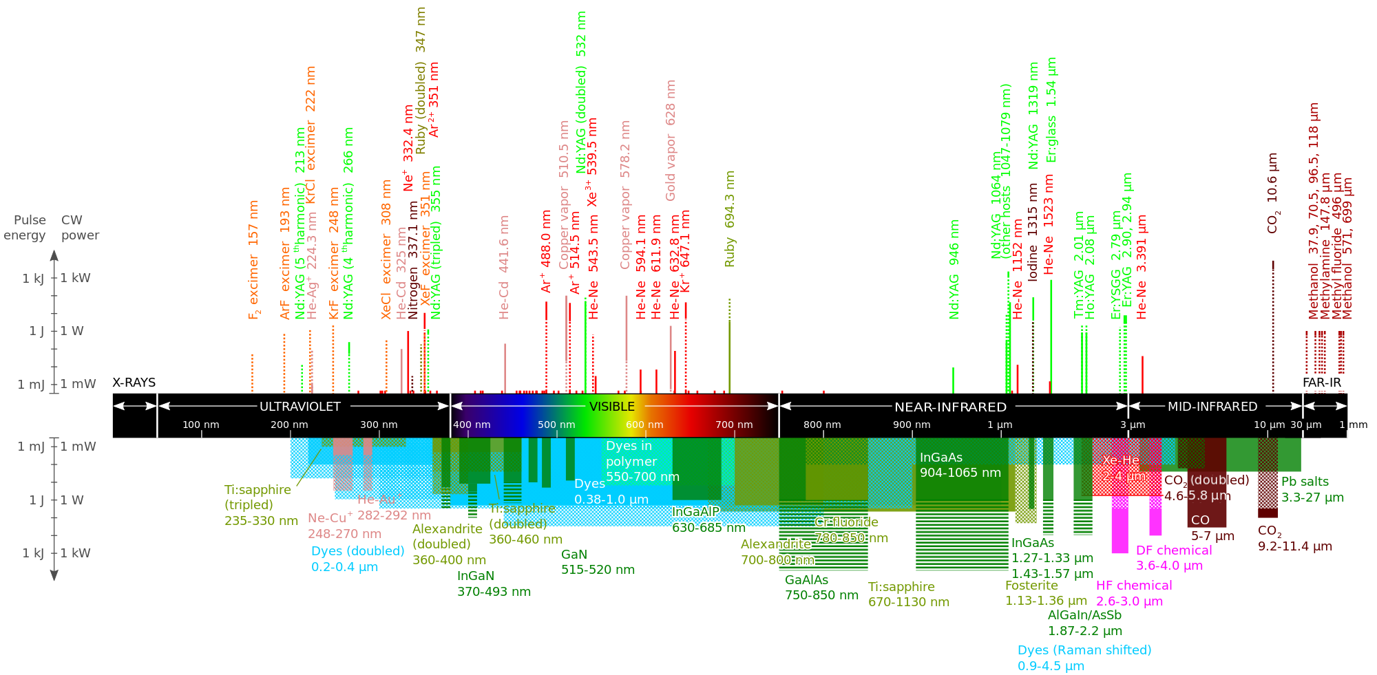
No Practical Lasers in X-ray Region
until recently
Lasers and their wavelengths currently available
SR has been a good alternative to “X-ray” lasers!

Slide 6
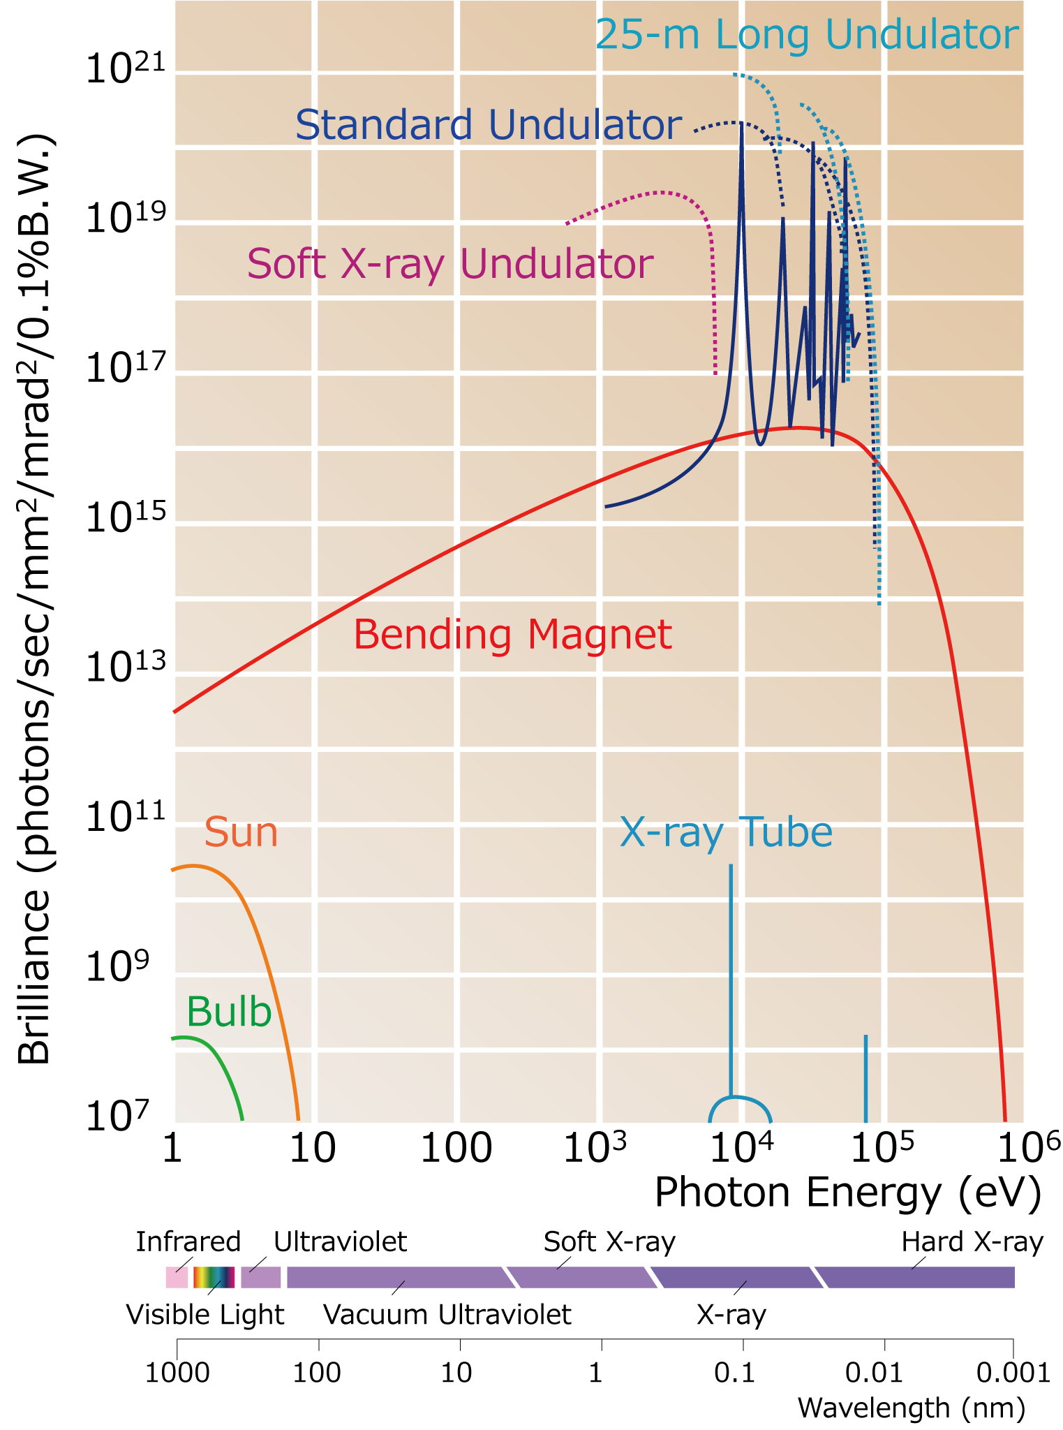
SR & Various Sources
SR provides much higher brilliance in x-ray regions.

Slide 7
However,……
Four parameters to characterize the laser source performance
  Temporal & Spatial coherence, Brilliance, Bose degeneracy
Item | Laser (800nm) | SR (0.1nm)
Temp. Coherence | ~100% | ~10⁻⁵%
Spat. Coherence | ~100% | ~0.1%
Peak Brilliance | ~10²⁸ | ~10²³
Bose Degeneracy* | 10¹³ | ~10⁻⁴
*Number of photons (=Boson) occupying a single mode (state)
Source performances of SR are far from the laser source!

Slide 8
What We Learn in This Lecture?
Free Electron Laser (FEL) as an advanced form of SR sources
How FEL Works?
  Coherent radiation
  Microbunching
  Characteristics of FEL radiation
  Numerical examples
ERL: another direction of SR sources evolution

Slide 9
Introduction
Coherent radiation & FELs
Amplification mechanism in FELs
Characteristics of FEL radiation
ERL: what’s it?

Slide 10
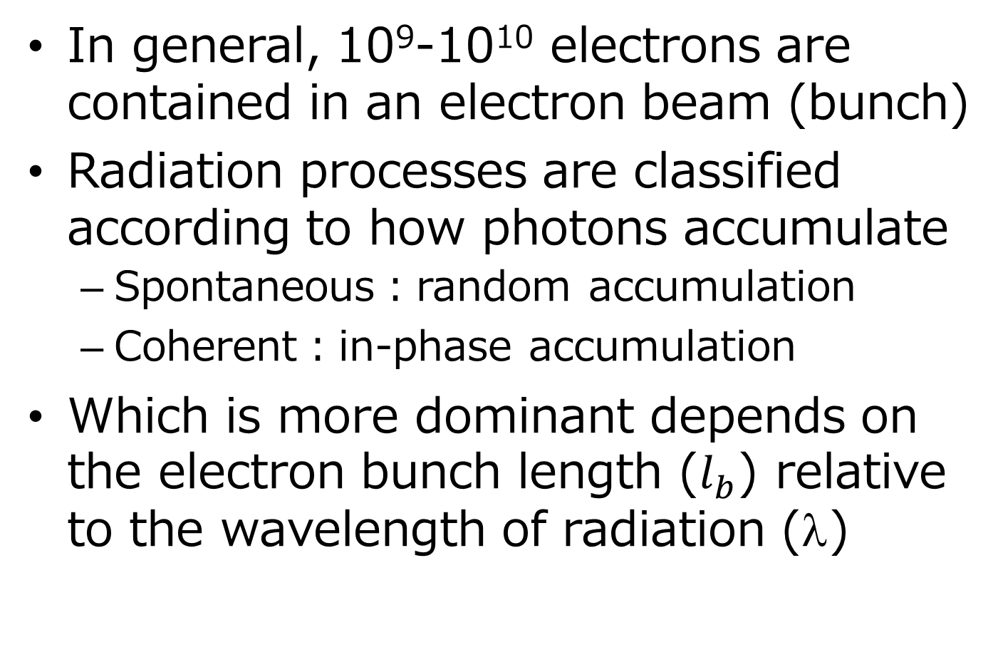
Spontaneous & Coherent Radiation (1)
In general, 10⁹-10¹⁰ electrons are contained in an electron beam (bunch)
Radiation processes are classified according to how photons accumulate
  Spontaneous：random accumulation
  Coherent：in-phase accumulation
Which is more dominant depends on the electron bunch length ($l_{b}$) relative to the wavelength of radiation (λ)

Slide 11


Spontaneous & Coherent Radiation (2)
λ
Spontaneous
$$l_{b}$$
Coherent
$$l_{b}$$

Slide 12
Spontaneous & Coherent Radiation (3)
Spontaneous Radiation
  Bunch Length > Wavelength
  Summation as photons: # photons enhanced by N (=# electrons)
Coherent Radiation
  Bunch Length < Wavelength
  Summation as waves: amplitude enhanced by N
  # photons (∝|amplitude|²) by N²
Intensity of coherent radiation is N (=10⁹~10¹⁰) times the spontaneous.

Slide 13
Example of Coherent Radiation
E=8GeV
B=1T
Δt=100fs
λ=30μm

Slide 14


Coherent Radiation by Microbunches
λ
$$l_{b}$$
Microbunch
λ
Coherent at the wavelength of λ
$$l_{b}$$
FEL is coherent radiation emitted by an electron beam with microbunches

Slide 15
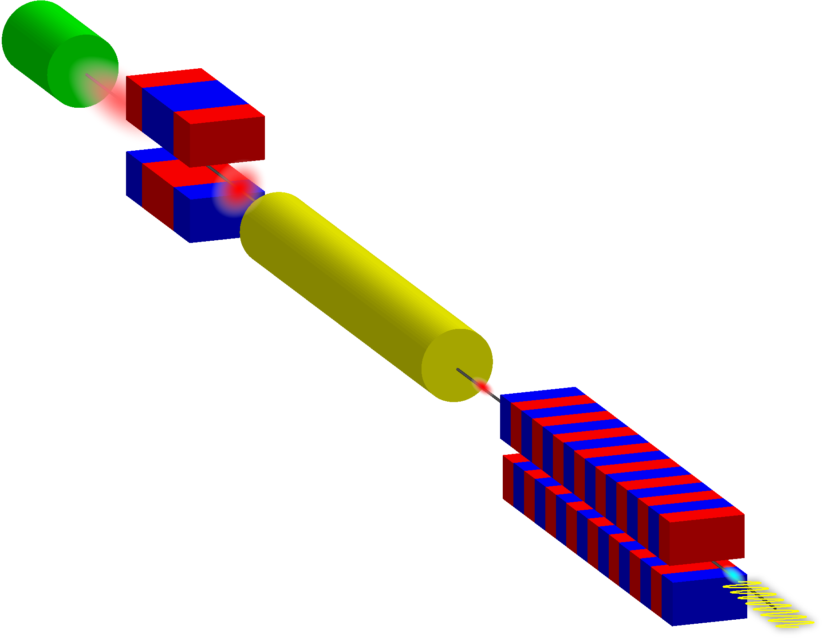
General Layout of FELs
Injector
Bunch
Compressor
Highly-brilliant Electron Beam
Main
Accelerator
Undulator
FEL
Pulse
FEL amplification takes place here!

Slide 16
Introduction
Coherent radiation & FELs
Amplification mechanism in FELs
FEL equation
Characteristics of FEL radiation
ERL: what’s it?

Slide 17


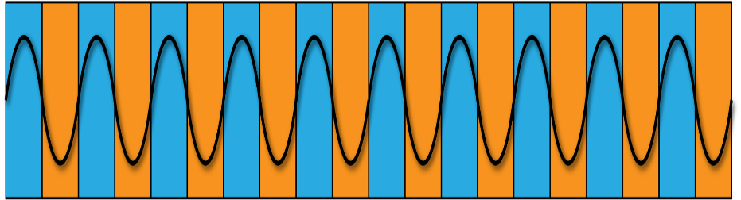
Basic Concept of FELs
Electron Beam
Microbunches
x
Undulator
z
Seed Light
Amplified Light
What’s the laser medium in FELs?
Free electrons?
Free electrons moving in the undulator field!

Slide 18
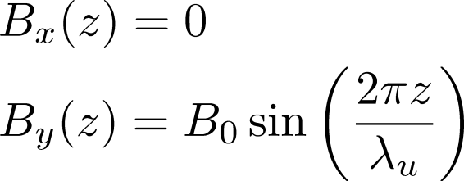
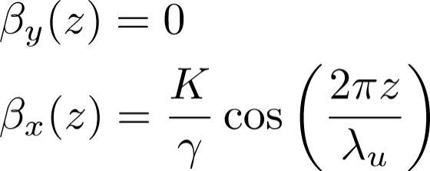
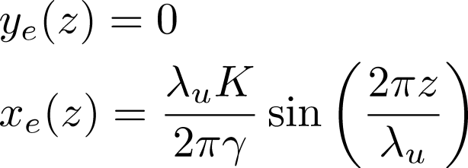
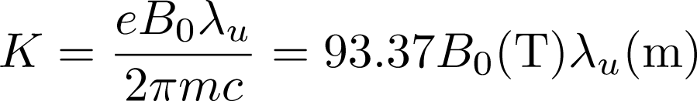




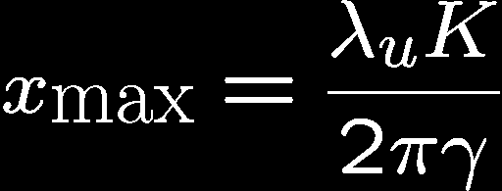
Electron Trajectory in an Undulator
Undulator field with period λ_{u}
Transverse
Velocity
Trajectory
K Value
Deflection Parameter
E=8GeV,K=1,λ_{u}=5cm：β_{xmax}=64μrad, x_{max}=0.5μm

Slide 19
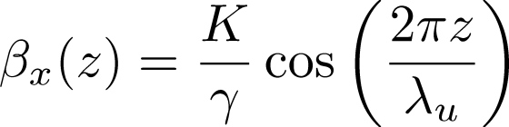
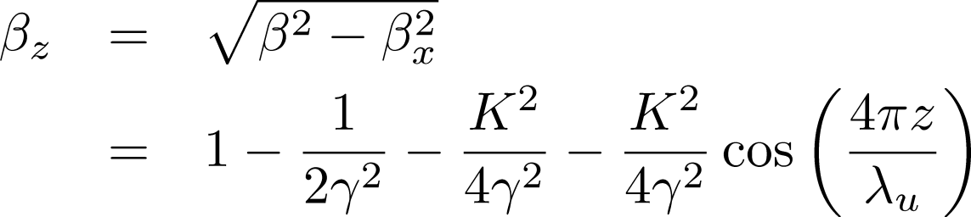
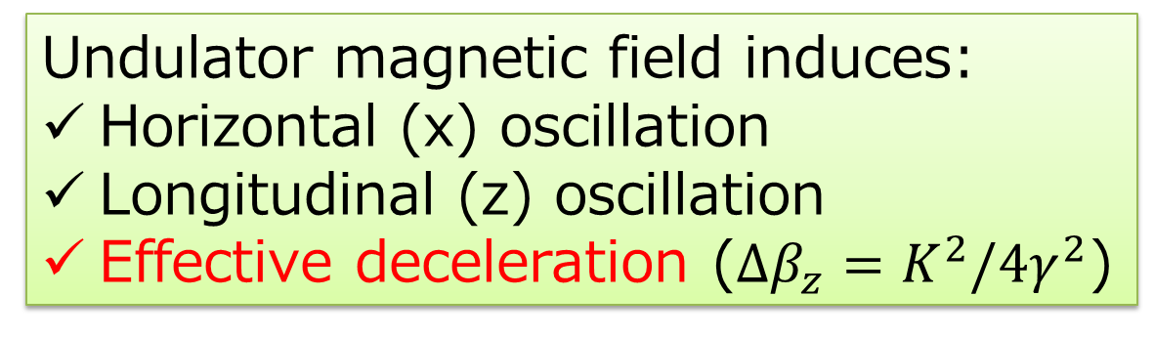
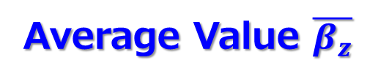
Velocity Modulations
transverse velocity
Oscillating Term
longitudinal velocity
Original value
Average Value $\overline{β_{z}}$
Undulator magnetic field induces:
  Horizontal (x) oscillation
  Longitudinal (z) oscillation
  Effective deceleration ($Δβ_{z}=K^{2}/4γ^{2}$)

Slide 20



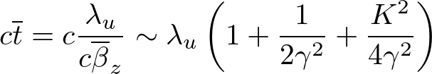
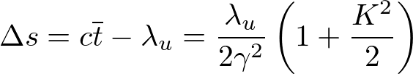
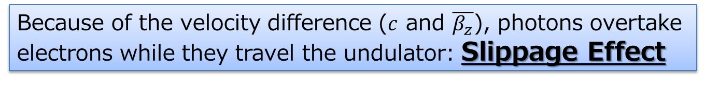
Slippage
x
e⁻
z
photon
: slippage length over λ_{u}
= fundamental wavelength λ₁
Because of the velocity difference ($c$ and $\overline{β_{z}}$), photons overtake electrons while they travel the undulator: Slippage Effect

Slide 21


What’s Fundamental Wavelength?
x
z
Radiation with λ₁ is in phase with e⁻
  Intense spont. radiation at λ₁
  Continuous interaction between radiation and e⁻ (next slide)

Slide 22
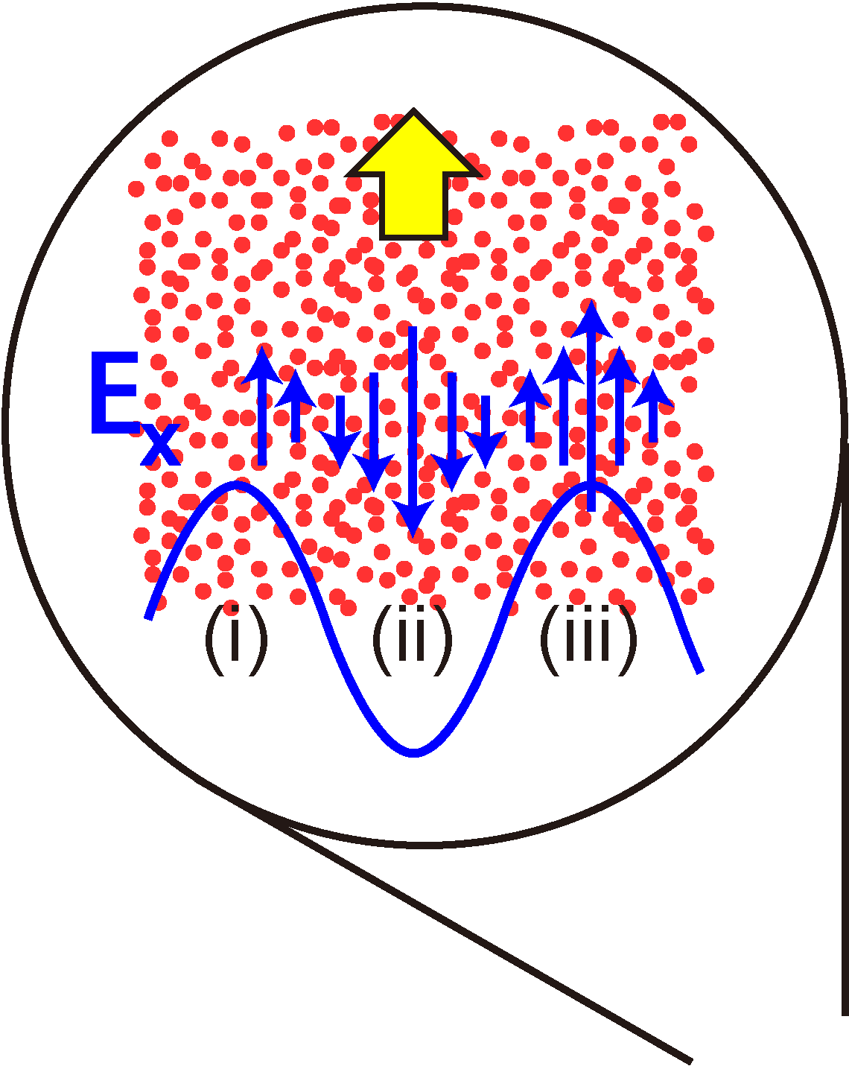
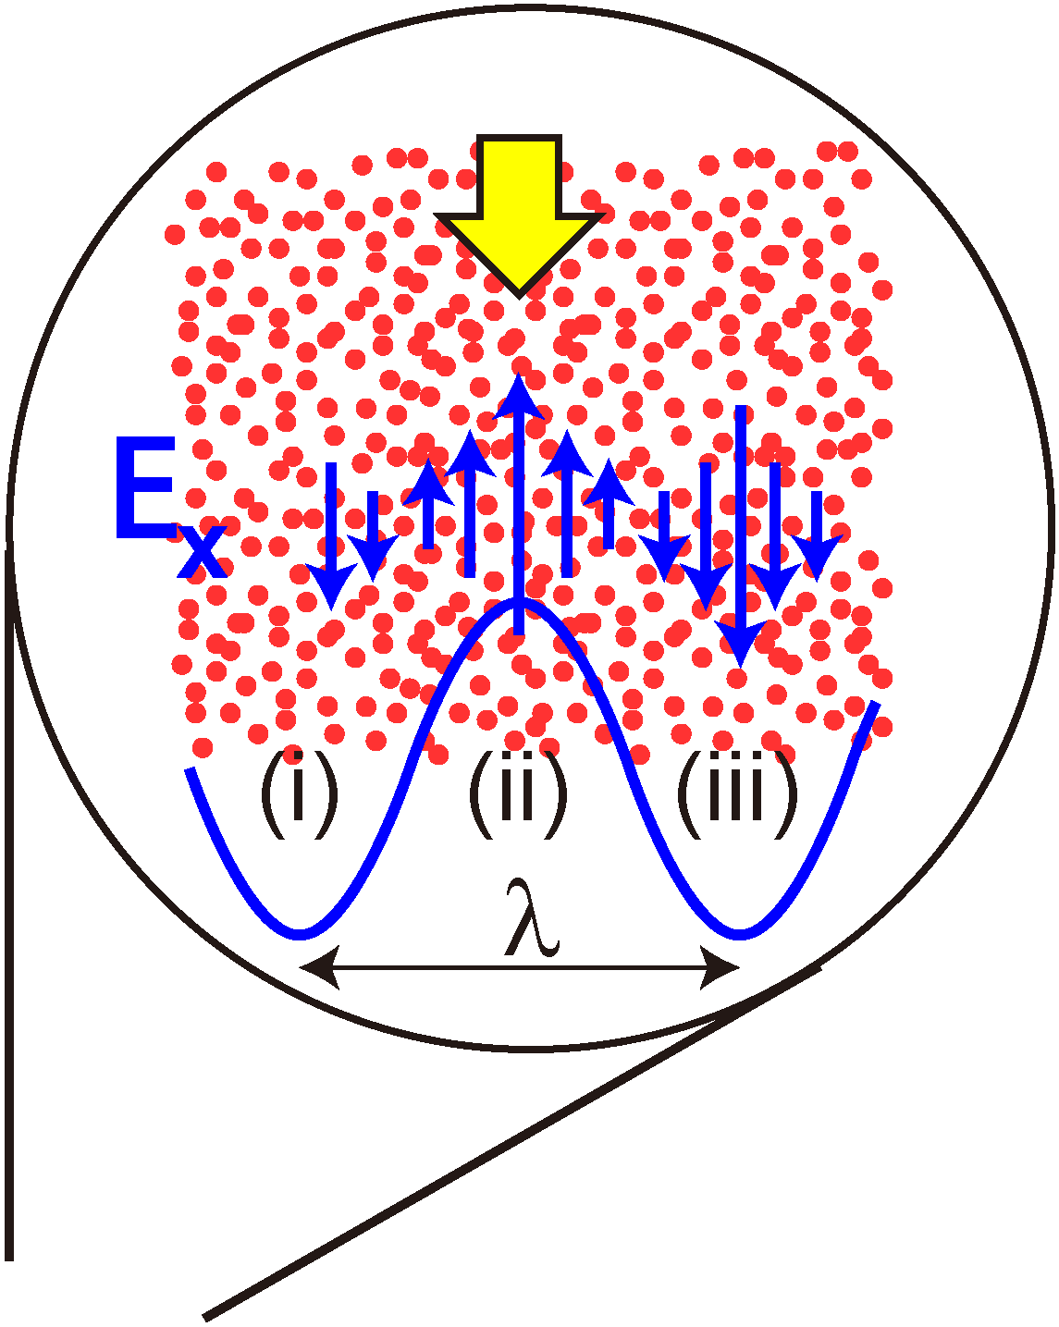
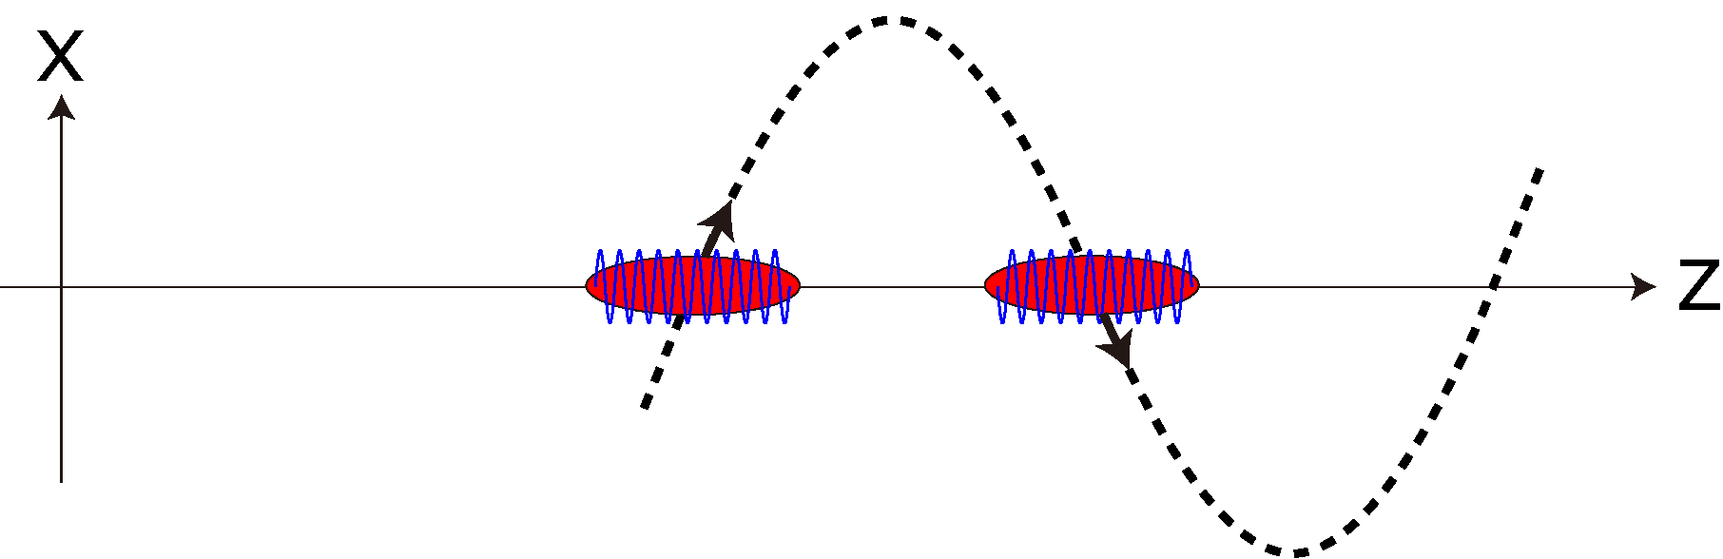
Interaction with Radiation
Continuous interaction with radiation
Δγ > 0 in (ii), (iv,…)
Δγ < 0 in (i), (iii), (v,…)
Periodic energy modulation with λ₁

Slide 23


Longitudinal Dispersion
x
e⁻(γ)
z
e⁻(γ’<γ)
Lower-energy electrons are left behind the higher-energy ones

Slide 24
Mechanism of Microbunch Formation
Sinusoidal Magnetic Field
Horizontal Oscillation
Effective Deceleration
Radiation with λ₁
Slippage
Continuous Interaction
Longitudinal Dispersion
Energy Modulation
Density Modulation
(Microbunch)

Slide 25
Microbunch Formation in Phase Space
λ₁
Interaction with Radiation
Longitudinal Dispersion

Slide 26
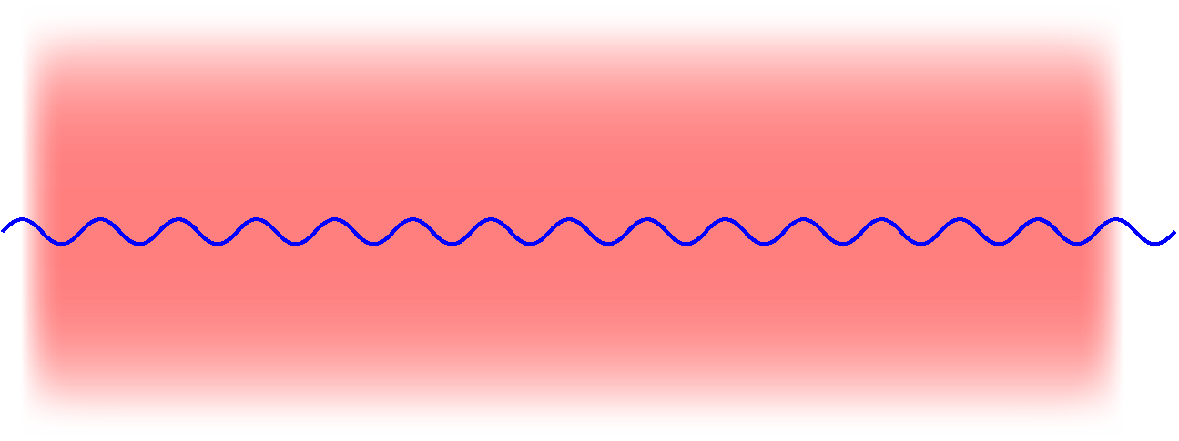
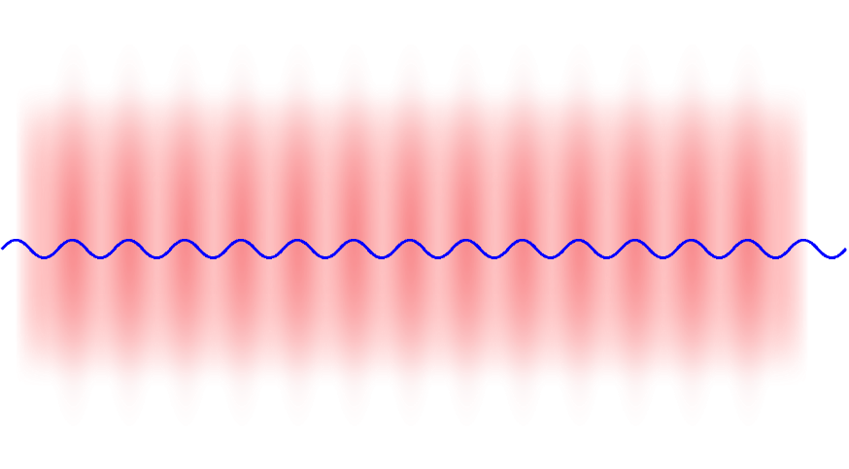
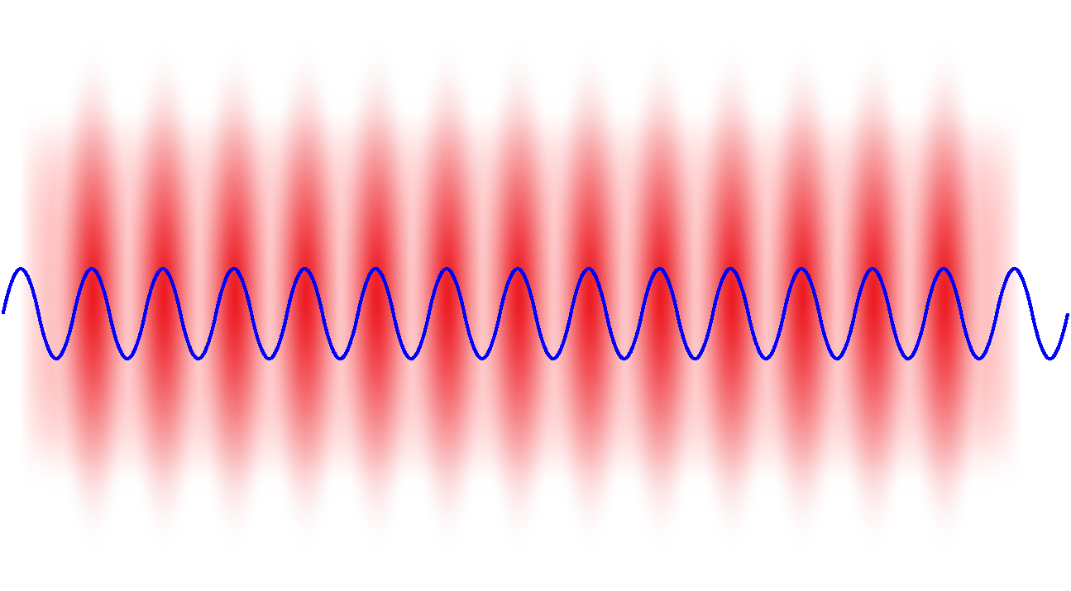
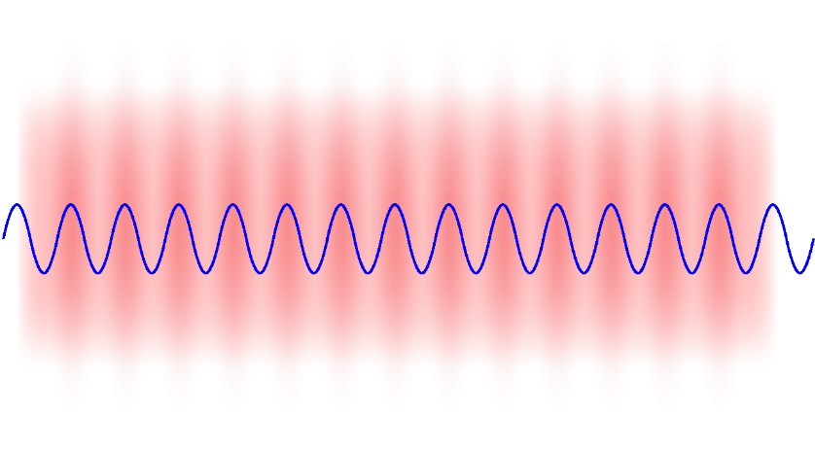
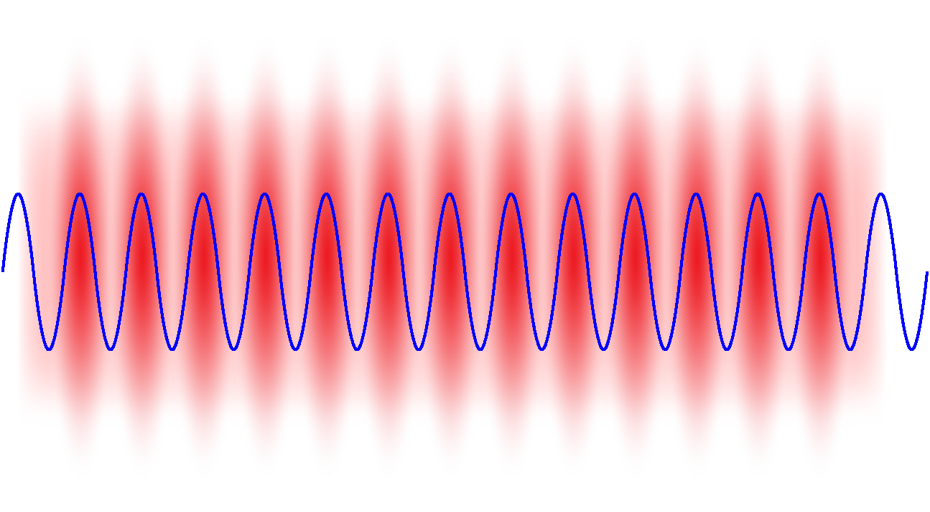
FEL Amplification
FEL Amplification =
Positive Feedback Loop of
Microbunching through interaction with radiation
Intensify radiation by coherent radiation
Microbunching
Coherent Radiation
Microbunching
Coherent Radiation

Slide 27
Introduction
Coherent radiation & FELs
Amplification mechanism in FELs
FEL equation
Characteristics of FEL radiation
ERL: what’s it?

Slide 28
FEL Equation
To describe the FEL amplification, we need to consider:
  Electron dynamics in 6D phase space
  Interaction between e⁻ and radiation
  Amplification by coherent radiation
  Diffraction of radiation
Rigorous solution needed For quantitative estimation
For qualitative understanding, simplified form with some approx. is enough!
FEL Equation

Slide 29
1-D & SS Approximation
1-Dimensional and Steady State Approximation:
Initial distribution functions (at z=0) do not depend on x,y,t
Radiation amplitude and microbunch grows as z, but does not depend on x,y,t
amplitude
of radiation
constant
current
microbunching

Slide 30
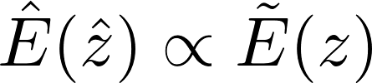


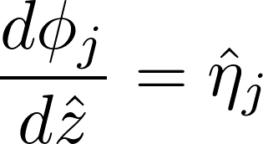
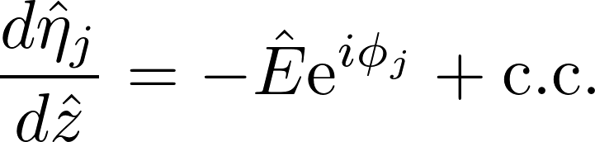
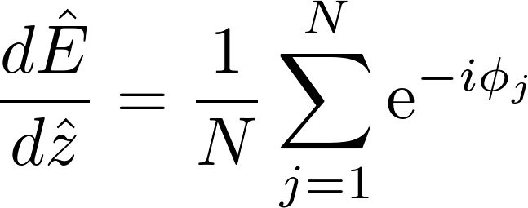
FEL Equation under 1D & SS
Under 1D & SS approximations, the FEL amplification is described by normalized variables as a function of normalized coordinate as follows:
Complex amplitude of radiation
Energy and position of j-th electron, relative to a reference electron
Longitudinal dispersion
Energy variation by interaction with radiation
Growth of radiation by coherent radiation

Slide 31
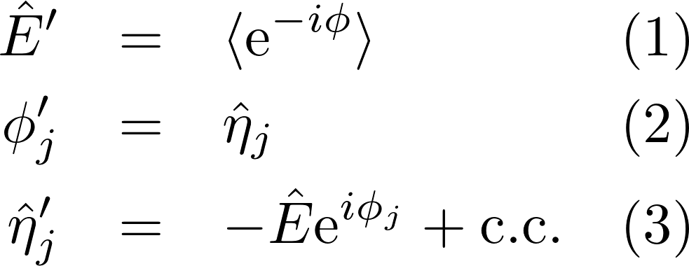
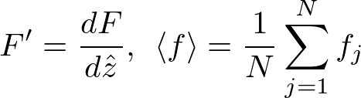
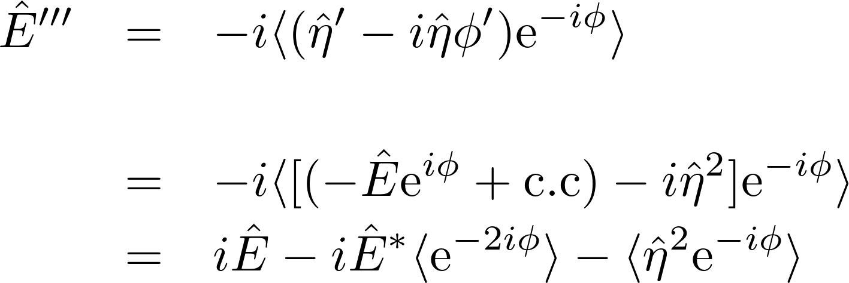

Solving the 1D FEL Eq. (Analytical)
(2)
(1)’
(2)
(3)
uniform distribution
small energy deviation
0
Radiation growth equation under 1D & SS

Slide 32
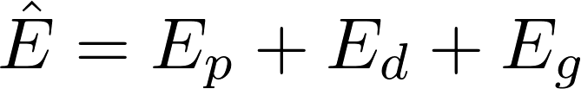
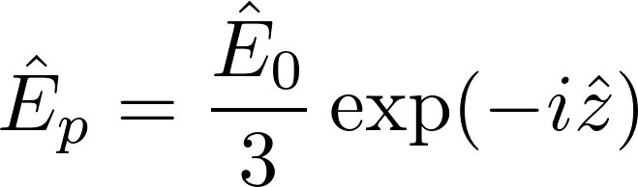
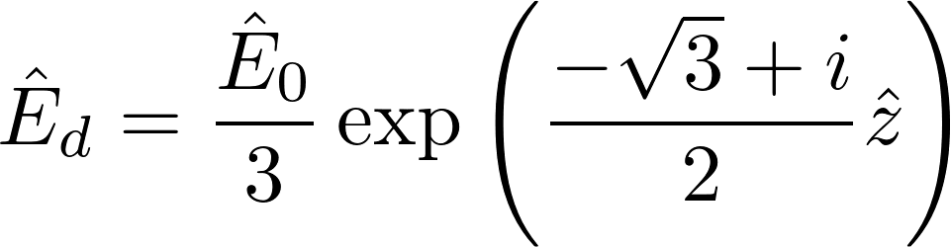
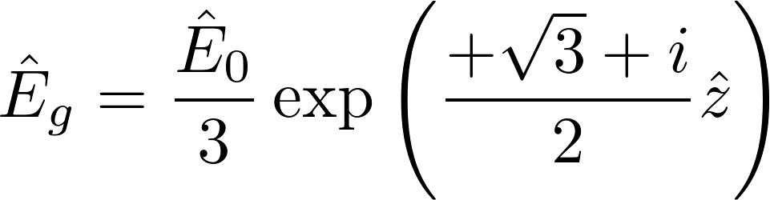

Solving the 1D FEL Eq. (cont.)
Simple propagation
Decaying field
Growing field
For large $\hat{z}$, only the growing field ${\hat{E}}_{g}$ survives

Slide 33
Solving the 1D FEL Eq. (Numerical)
The analytical results are valid only in the “exponential amplification” regime.
In practice, the radiation power “saturates” because of
  Growth of the energy spread
  Decrease of the central energy
The FEL eqs. should be numerically solved to describe the amplification near saturation.

Slide 34
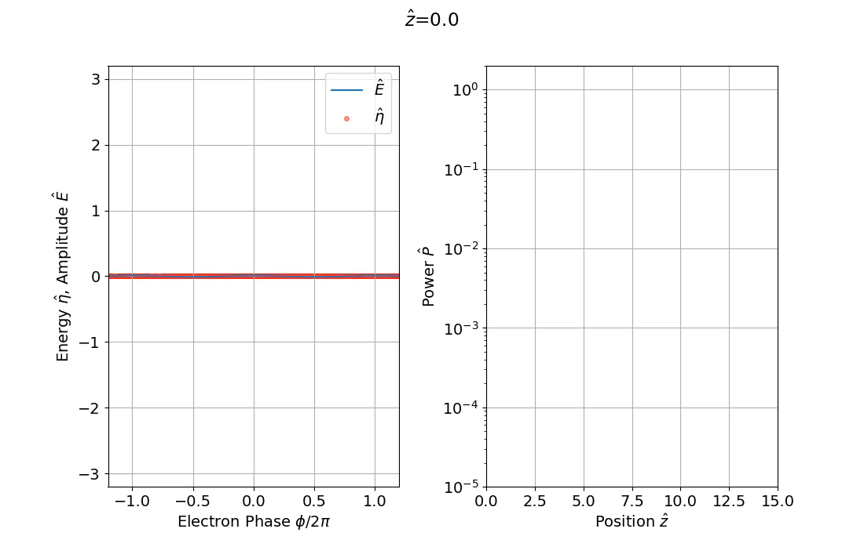
Results of Simulation

Slide 35
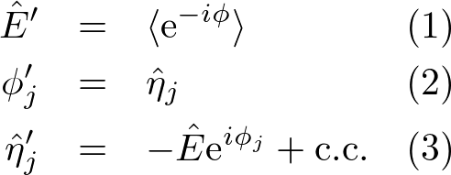
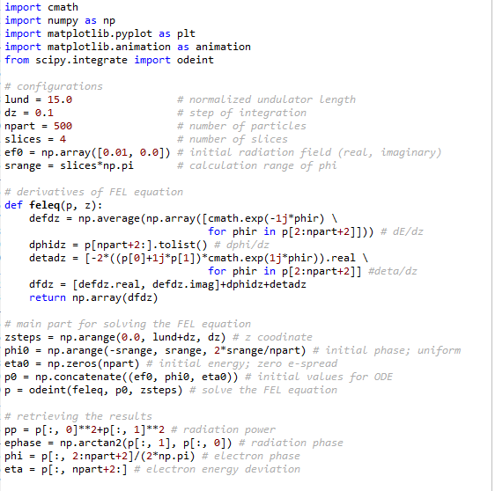
Example of the Python Code
Main part to solve the 2N+1 equations.
Can be solved easily under 1D and SS condition. Why not try on your own?

Slide 36
Introduction
Coherent radiation & FELs
Amplification mechanism in FELs
FEL equation
Characteristics of FEL radiation
ERL: what’s it?

Slide 37
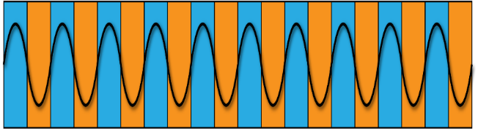


Classification of FELs
The e- beam moving in the undulator works to “amplify” light
To achieve lasing in FEL, we need
  High gain in total
  Seed light to be amplified
The FELs can be classified according to how to arrange the above condition
Microbunches
Electron Beam
x
Undulator
z
Seed Light
Amplified Light

Slide 38
Oscillator FELs
Oscillator FEL: original concept
Undulator
Mirror(Optical Cavity)
Amplified many times by different electrons Mode selection by the optical cavity
    single mode laser is possible
    not applicable in shorter-λ (x-ray) regions

Slide 39
Single Pass FELs
Difficulty in oscillator FELs can be overcome by enhancing the gain/pass
  Long undulator
  Higher electron density (lower emittance, higher peak current)
Seed light is amplified by many orders of magnitude even with a single pass
  No cavity is necessary
Further classified into two types according to how to prepare seed light

Slide 40
Introduction
Coherent radiation & FELs
Amplification mechanism in FELs
Characteristics of FEL radiation
  General description of single-pass FELs
ERL: what’s it?

Slide 41
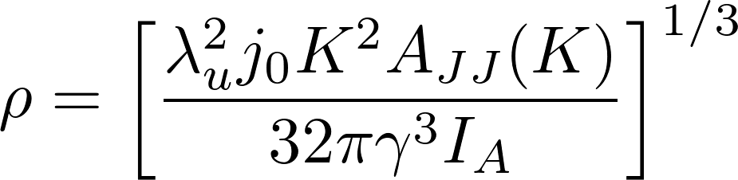
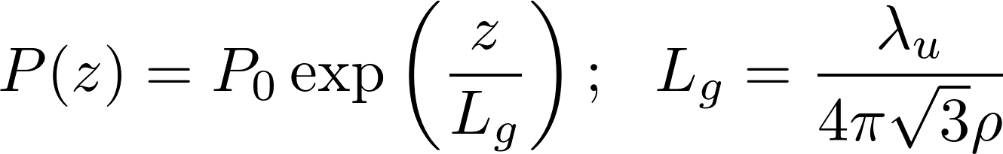
Important Parameters in SP-FEL(1)
主要パラメータ
FEL Paramerer ρ
  Dimensionless parameter related to the efficiency (10⁻²~10⁻⁴)
Gain Length L_{g}
  Undulator length needed to amplify the radiation power by e=2.718

Slide 42


Important Parameters in SP-FEL(2)
主要パラメータ
Saturation Power P_{sat}
  Maximum Power Reached in FEL
Saturation Length L_{sat}
  Undulator length to reach saturation
Conversion efficiency from e- to radiation is ρ
Number of undulator periods for saturation is ρ⁻¹

Slide 43
Gain Curve
Spont. Rad (SASE)
Exponential Amp.
Saturation
ρ

Slide 44
Introduction
Coherent radiation & FELs
Amplification mechanism in FELs
FEL equation
Characteristics of FEL radiation
  SASE FEL
ERL: what’s it?

Slide 45
SASE: Seeded by Spont. Radiation
SASE: Self Amplified Spontaneous Emission
  Spontaneous radiation emitted near the entrance works as the seed light
No special process is needed to prepare seed light
“Shot Noise” dominates the properties of radiation

Slide 46
Shot Noise
e- distribution contains sparse and dense areas
Radiation profile
temporal
spectral
spatial
angular

Slide 47
Parameters for Simulation
Electron Beam |  | Undulator
Energy | 9 GeV | Period | 20 mm
Bunch Charge | 80 pC | Peak Field | 1.12 T
Bunch Length (FWHM) | 20 fsec | K Value | 2.05
Peak Current | 3.7 kA | Length | 5 m x 10
Norm. Emittance | 0.4 μm | Source Parameter
Energy Spread | 10⁻⁴ | FEL Parameter | 5.0x10⁻⁴
Average Beta | 25 m | Gain Length | 2.1 m
Beam Size (σ) | 24 μm | Wavelength | 0.1 nm
Angular Div. (σ) | 0.95 μrad | Photon Energy | 12 keV

Slide 48
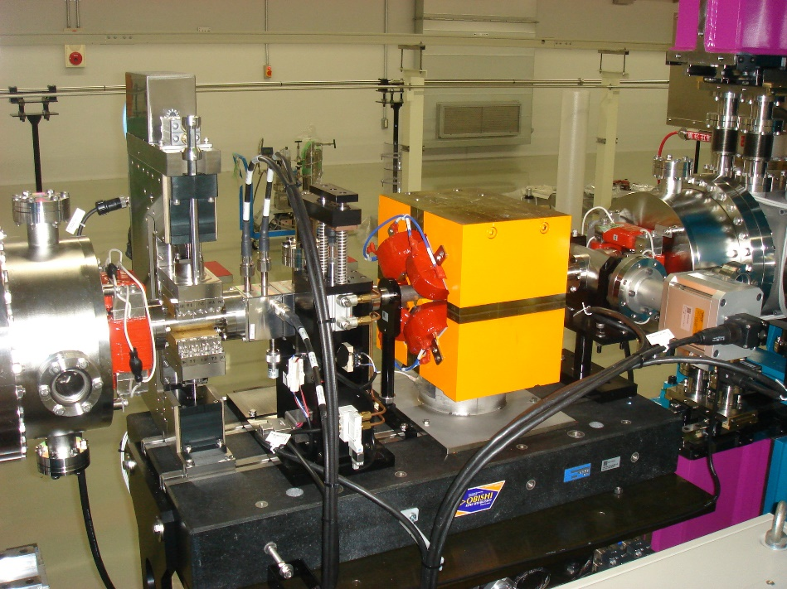
Gain Curve
1-m intersection (diagnostics, Q magnets, phase shifters)

Slide 49
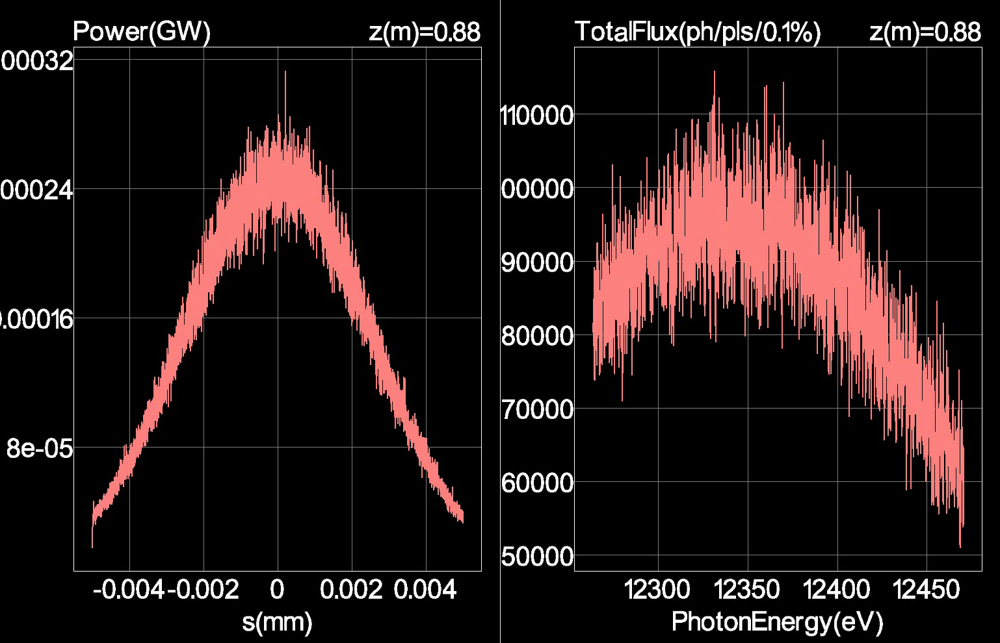
Spectral and Temporal Profiles
物理現象と光特性

Slide 50
Spiky Structure
物理現象と光特性
Fourier Limit imposes the widths of envelopes and spikes to be inversely proportional!
Time
Domain
Freq.
Domain
σ_{T}
σ_{ω}=ρω₁
Fourier
Transform
(ρω₁)⁻¹
σ_{T}⁻¹
t
ω
ω₁

Slide 51
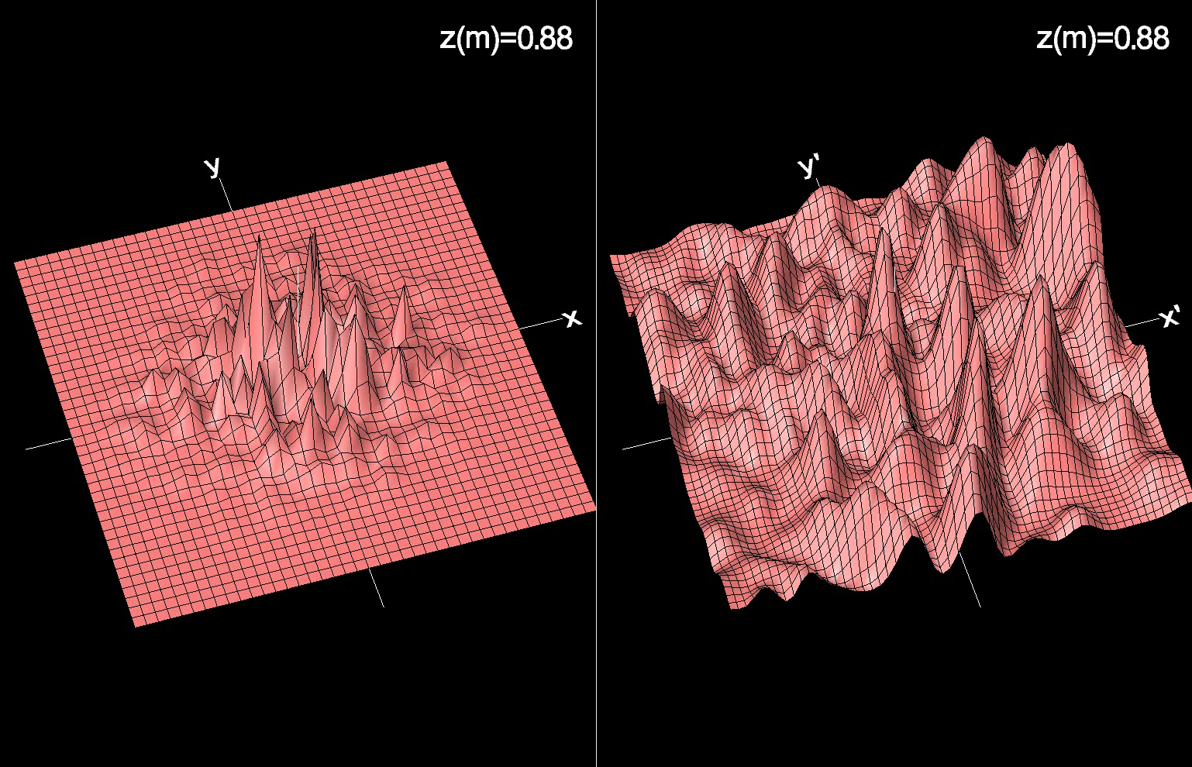
Spatial and Angular Profiles
物理現象と光特性

Slide 52
Coherence Improvement

Slide 53
Introduction
Coherent radiation & FELs
Amplification mechanism in FELs
FEL equation
Characteristics of FEL radiation
  Seeded FEL
ERL: what’s it?

Slide 54
Seeded Light in FELs
Oscillator FEL: Mode-selected light
  Single mode available
SASE FEL：Shot noise (Spont. Rad.)
  Spatially coherent (optical guiding)
  Temporally partially coherent (poor coherence)
Seeded FEL: Coherent light (seed laser)
  Perfect coherence in time and space (single mode)
  “Coherent-seed” FEL

Slide 55
How to Realize Short-λ Seeded FEL?
High Power Laser
HHG
Undulator
Gas Target
Dispersive
Section
HGHG
Modulator
Radiator
High Power Laser
Self Seed
Monochromator

Slide 56
Pros and Cons
HHG & HGHG
  External laser needed
  Shorter wavelength using high harmonics
    Interaction with gas (HHG)/
    HHs in microbunches (HGHG)
  Timing (& spatial overlap) is the key issue
  How to go toward shorter λ?
Self Seed
  Monochromatized SASE radiation as seed
  No limitations for timing and shorter λ
  Seed power fluctuates shot-by-shot

Slide 57
Parameters for HGHG Simulation
Electron Beam |  | Modulator |  | Radiator
Energy | 1.2 GeV | Period | 50 mm | Period | 28 mm
Bunch Charge | 100 pC | Peak Field | 0.72 T | Peak Field | 0.63 T
Bunch Length (FWHM) | 80 fsec | Length | 3.2 m x 2 | Length | 3.2 m x 4
Peak Current | 1.2 kA | K Value | 3.35 | K Value | 1.65
Emittance | 0.4 μm | Seed Parameter |  | Source Parameter
Energy Spread | 10⁻⁴ | Peak Power | 100 kW | FEL Parameter | 2.0x10⁻³
Average Beta | 10 m | Wavelength | 30 nm | Gain Length | 0.66 m
Beam Size (σ) | 41 μm | Pulse Length | 20 fs | Wavelength | 6 nm
Ang. Div. (σ) | 4.1 μrad | Beam Size | 0.35 mm | Photon Energy | 0.2 keV
Modulator
Radiator
30nm
6nm

Slide 58
Comparison with SASE: Gain Curve
Modulator (HGHG)

Slide 59
Comparison with SASE: Spectrum

Slide 60
Introduction
Coherent radiation & FELs
Amplification mechanism in FELs
FEL equation
Characteristics of FEL radiation
ERL: what’s it?

Slide 61
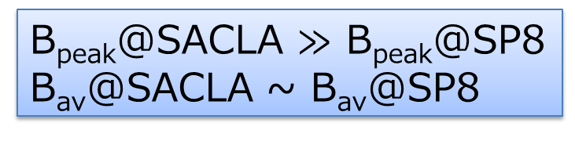
Low Rep. Rate in NC Linac
Low rep. rate: biggest drawback of FELs based on NC linac
SACLA
B_{peak}@SACLA $≫$ B_{peak}@SP8
B_{av}@SACLA ~ B_{av}@SP8

Slide 62
Increasing the Rep. Rate
Rep. rate in NC cavity is limited by the Ohmic loss: pulse operation mandatory (~100 Hz)
  I_{av}=100pC x 100Hz=10nA (cf. 100mA in storage ring)
SC cavity completely solves the problem; CW operation possible!
  I_{av} = 100 pC x 1 Gz = 100 mA
However, we have to generate and handle e- beam with huge (average) power
  100mA x 10GeV=1GW (average)
  Nuclear reactor typical power~1GW

Slide 63
ERL: Energy Recovery Linac
long undulator or canted undulator
undulator
beam dump
electron gun
superconducting accelerator
Electron beam is decelerated by the SC linac in the 2nd turn:
  return its energy to be used to accelerate the next electron beam
  safely discarded

Slide 64
Application of ERL as a Light Source
EUV-FEL for lithography
  High average power (>kW) light source is strongly desired for EUV litho.
Diffraction-limited synchrotron radiation source (cf. storage ring)
  Much lower emittance enhances the spatial coherence
  Much shorter bunch length may help the time-resolve experiments

Slide 65
Pros and Cons
 | Storage Ring | NC Linac | ERL
Emittance | △ | ◎ | ◎
Energy Spread | △ | ◎ | ◎
Peak Current | △ | ◎ | 〇
Bunch Length | × | ◎ | ◎
Rep. Rate | ◎ | × | ◎
Stability | ◎ | △ | ?
# Users | ◎ | × | ◎
ERL has many advantages over other competing machines; thus, R&D activities are ongoing toward realization.

