Slide 1

Medical Applications
Masao KURIKI
Graduate School of Advanced Sciences of Matter,
Hiroshima University
Lecture material is made from slides
by L.G. Sukhikh (Thomsk Tech. Univeristy)
ALLPPT.com _ Free PowerPoint Templates, Diagrams and Charts

Slide 2
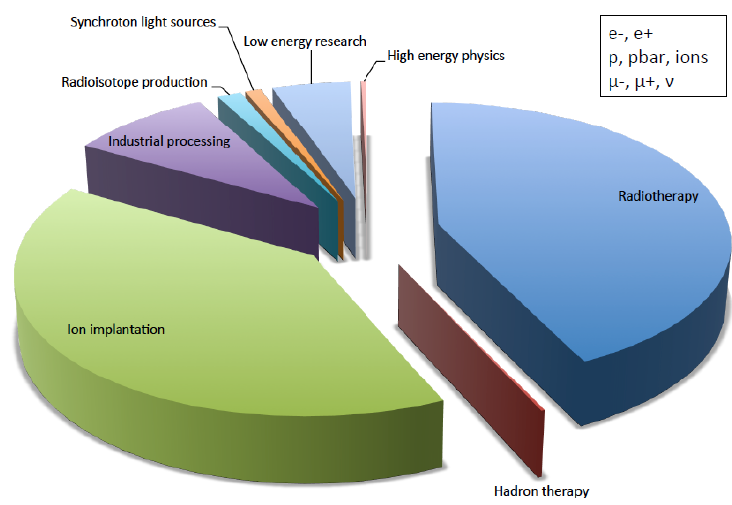

30000 Accelerators in the world
Courtesy R. Baily

Slide 3
Accelerators in medicine
Accelerators for treatment
Accelerators for radiopharmaceuticals production
Indirect use (e.g. sterilization)

Slide 4

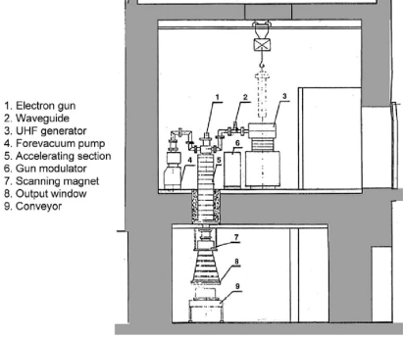
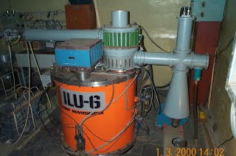
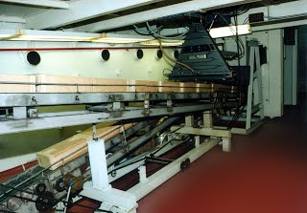
Radiation sterilization
E.g. syringes sterilization
BINP, Novosibirsk
Notes:
6 MeV power matters

Slide 5
Radiopharmaceutical production
Pharmaceuticals for nuclear diagnostics: gamma and positron emitters: F-18, N-15, Tc-99 etc.
Pharmaceuticals for nuclear treatment: beta emitters P-32, Sr-89, etc.
Notes:
General scheme

Slide 6
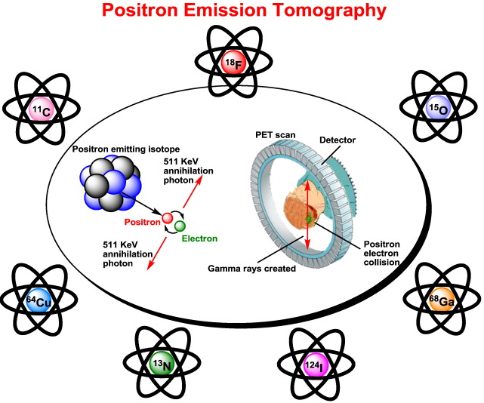
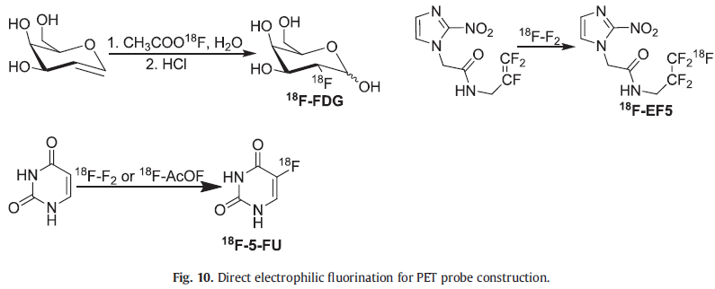
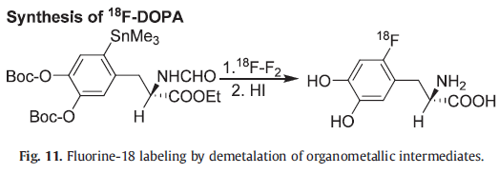
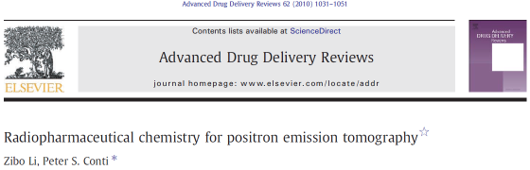
PET
Notes:
General scheme

Slide 7
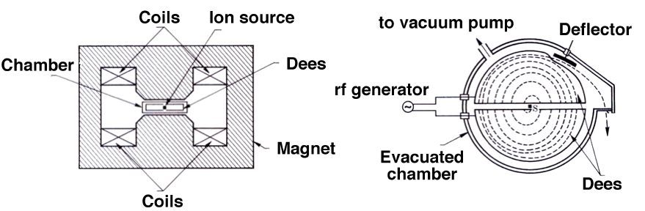
Particle accelerators: Cyclotron
In a cyclotron the heavy particles (protons, ions) are accelerated along a spiral trajectory guided inside two evacuated half-cylindrical electrodes (dees) by a uniform magnetic field produced between the pole pieces of a large magnet (1 T).
Notes:
General scheme

Slide 8
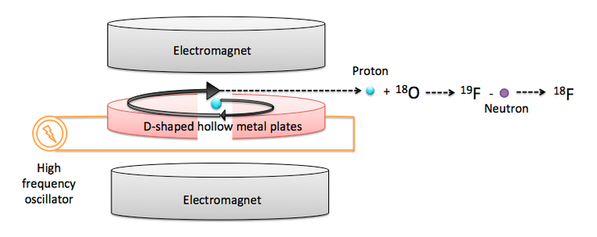
Fluorine-18 production
Notes:
General scheme

Slide 9
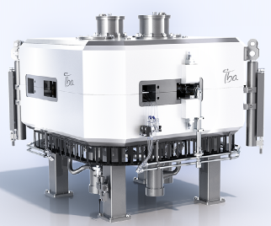
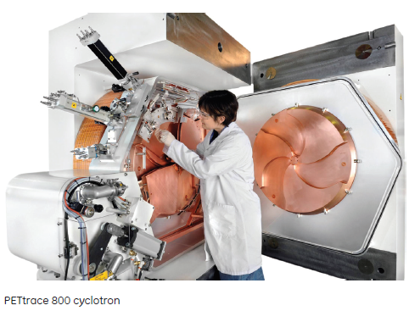
Fluorine-18 production
Proton energies 11-18 MeV
Currents 50-300 uA
Notes:
General scheme

Slide 10
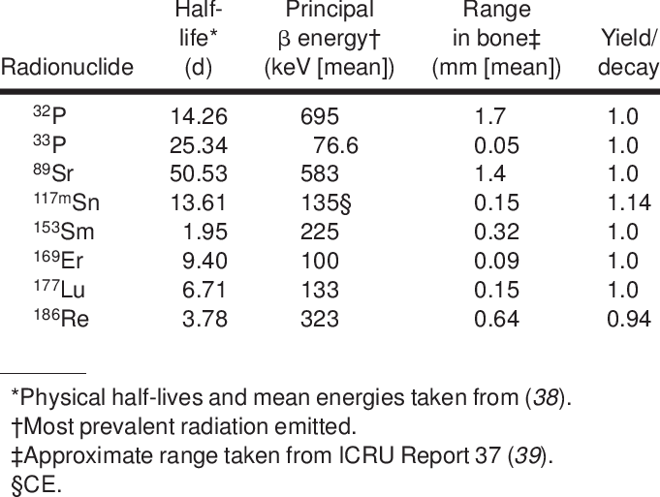
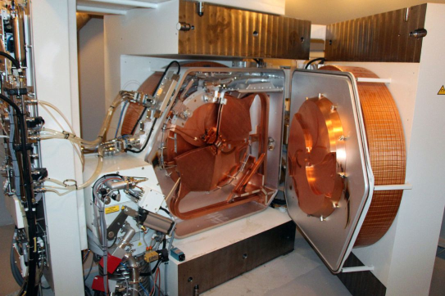
Radionuclides for nuclear therapy
Notes:
General scheme

Slide 11
Radiation therapy

Slide 12
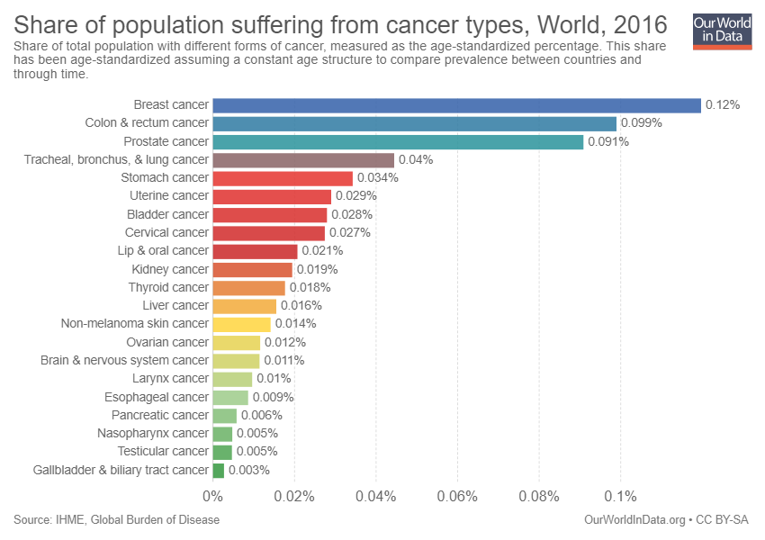
Radiation treatment - radiotherapy
>95% of radiation therapy is used for cancer treatment
Notes:
General scheme

Slide 13
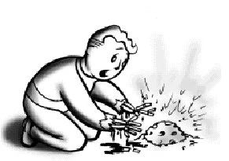
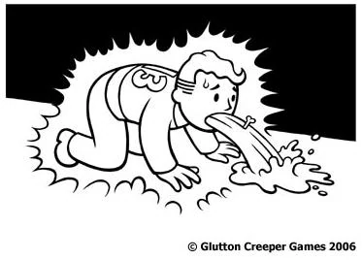
Radiation
Ionizing radiation is DANGEROUS!
1 Gy (J/kg) per whole body – radiation disease
7 Gy per whole body – 95% lethal result in a few weeks
20-25 Gy per whole body – lethal result in 30 min
Notes:
General scheme

Slide 14
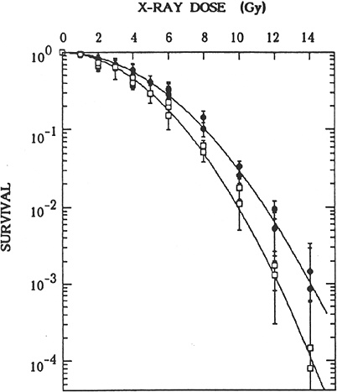
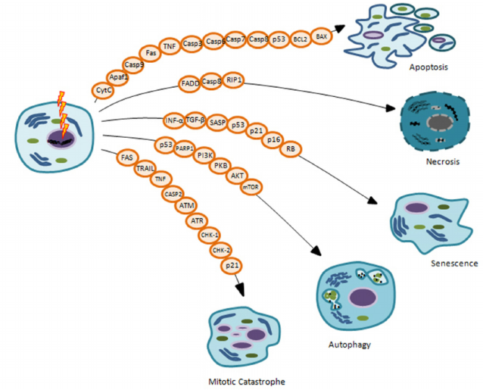
Radiobiology
Radiation kills cells mainly via DNA damage
Notes:
General scheme

Slide 15
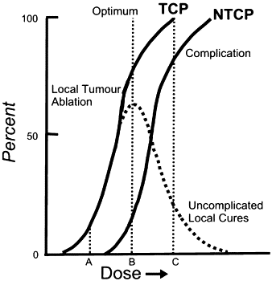
Tumor control probability
TCP and NTCP vs. dose
Minimal complications of normal tissues and organs are desired
B point – 35-70 Gy
Notes:
General scheme

Slide 16

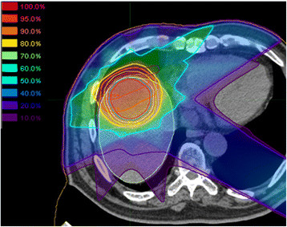
Typical medical accelerator
For a radiotherapist
Black box
Dose distribution
Notes:
General scheme

Slide 17
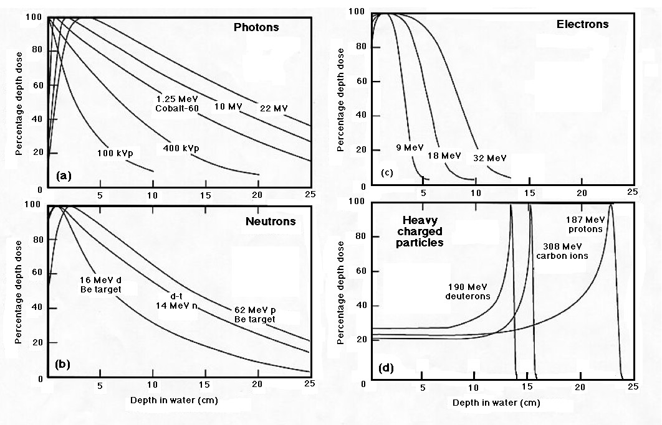
Dose in water
Notes:
General scheme

Slide 18
Electron machines

Slide 19
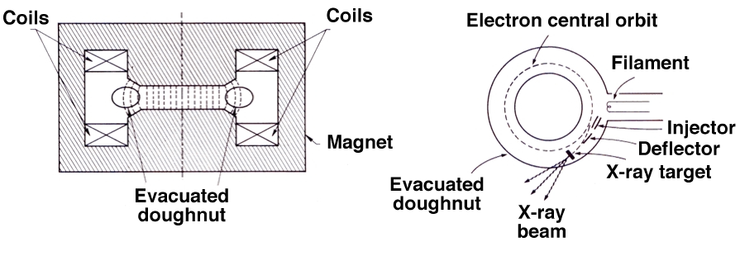
Particle accelerators: Betatron
Betatron is a cyclic induction accelerator in which the electrons are made to circulate in a toroidal vacuum chamber (doughnut) that is placed into a gap between two magnet poles.
Conceptually, the betatron may be considered an analog of a transformer:
  Primary current is the alternating current exciting the magnet.
  Secondary current is the electron current circulating in the doughnut.
Notes:
General scheme

Slide 20
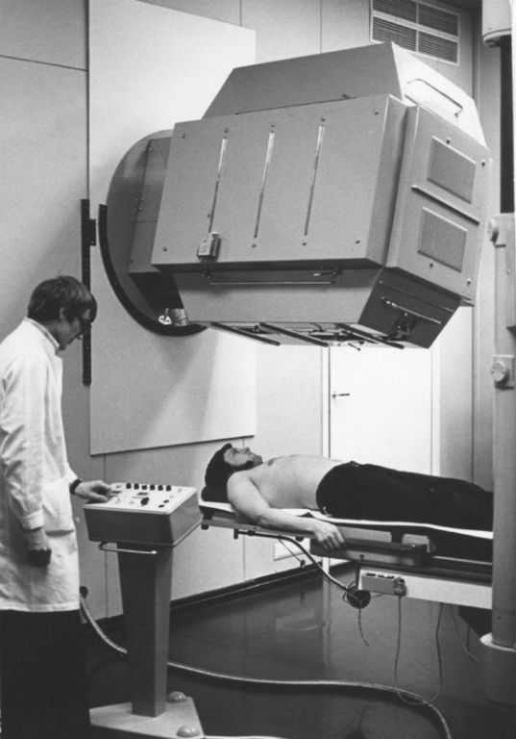
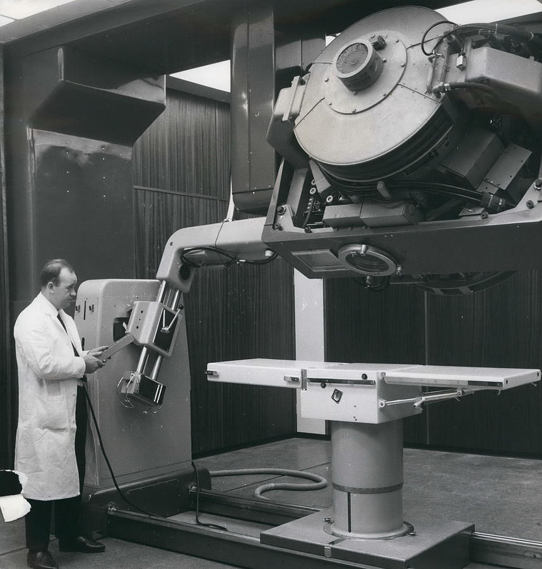
Particle accelerators: Betatron
Betatrons were used for external RT in 70-th, 80-th
Finland
Great Britain
Notes:
General scheme

Slide 21
LINACS
Medical linacs accelerate electrons to kinetic energies from 4 to 25 MeV using microwave radiofrequency fields:
  10³ MHz : L band
  2856 MHz: S band
  10⁴ MHz: X band
In a linac the electrons are accelerated following straight trajectories in special evacuated structures called accelerating waveguides.
Notes:
General scheme

Slide 22
LINACS
During the past 40 years medical linacs have gone through five distinct generations, each one increasingly more sophisticated:
  Low energy x rays (4-6 MV)
  Medium energy x rays (10-15 MV) and electrons
  High energy x rays (18-25 MV) and electrons
  Computer controlled dual energy linac with electrons
  Computer controlled dual energy linac with electrons combined with intensity modulation
Notes:
General scheme

Slide 23
LINACS
Linacs are usually mounted isocentrically and the operational systems are distributed over five major and distinct sections of the machine:
  Gantry
  Gantry stand and support
  Modulator
  Patient support assembly
  Control console
Notes:
General scheme

Slide 24
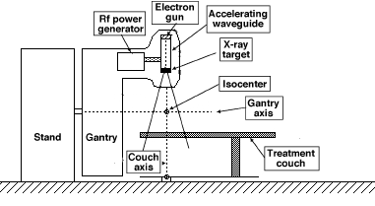
LINACS: configuration
In the simplest and most practical configuration:
  Electron source and the x-ray target form part of the accelerating waveguide and are aligned directly with the linac isocentre obviating the need for a beam transport system.
  Since the target is embedded into the waveguide, this linac type cannot produce electron beams.
Notes:
General scheme

Slide 25
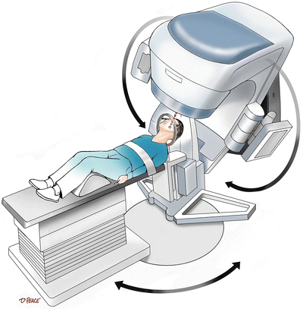
Configuration of modern linacs
Notes:
General scheme

Slide 26
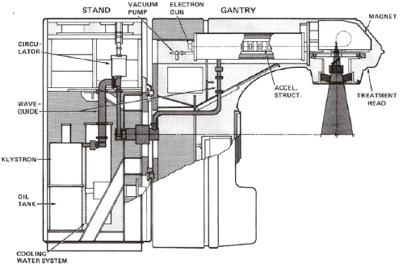
LINACS: configuration
For both electrons and photons (Varian):
Notes:
General scheme

Slide 27
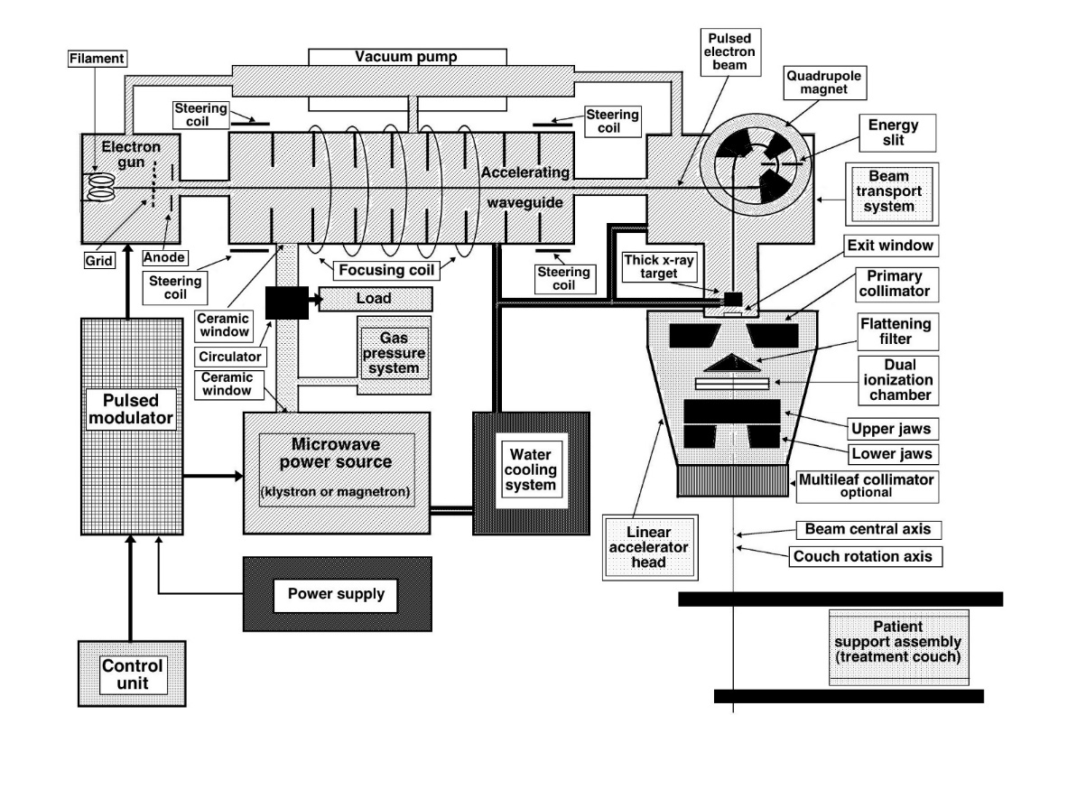
LINACS: configuration
Alpha
magnet
Notes:
General scheme

Slide 28
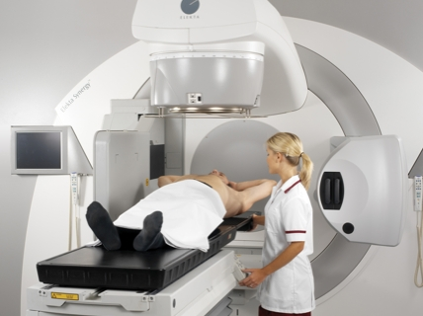
Configuration of modern linacs
Typical modern dual energy linac, incorporating imaging system and electronic portal imaging device (EPID),
Elekta,
Stockholm
Notes:
General scheme

Slide 29
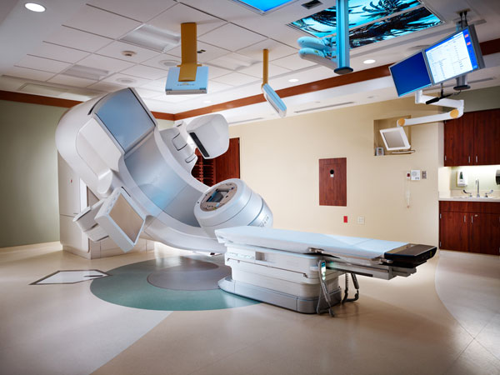
Configuration of modern linacs
Typical modern dual energy linac, with on board imaging system and an electronic portal imaging device (EPID),
Varian,
Palo Alto, CA, USA
Notes:
General scheme

Slide 30
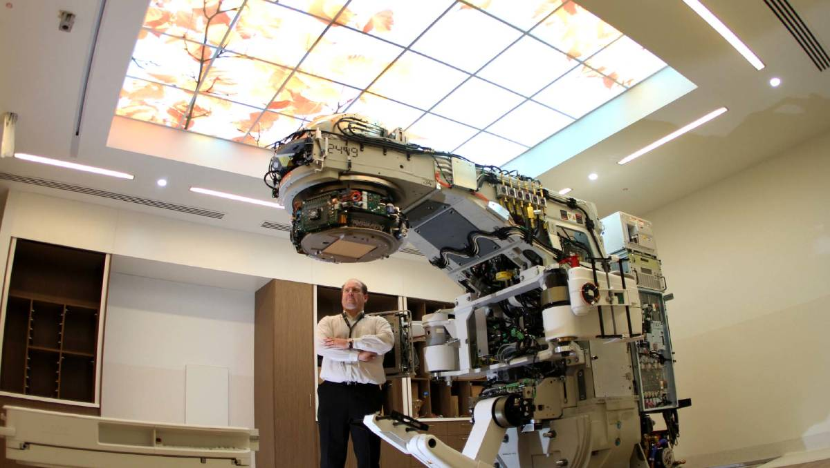
Configuration of modern linacs
Notes:
General scheme

Slide 31
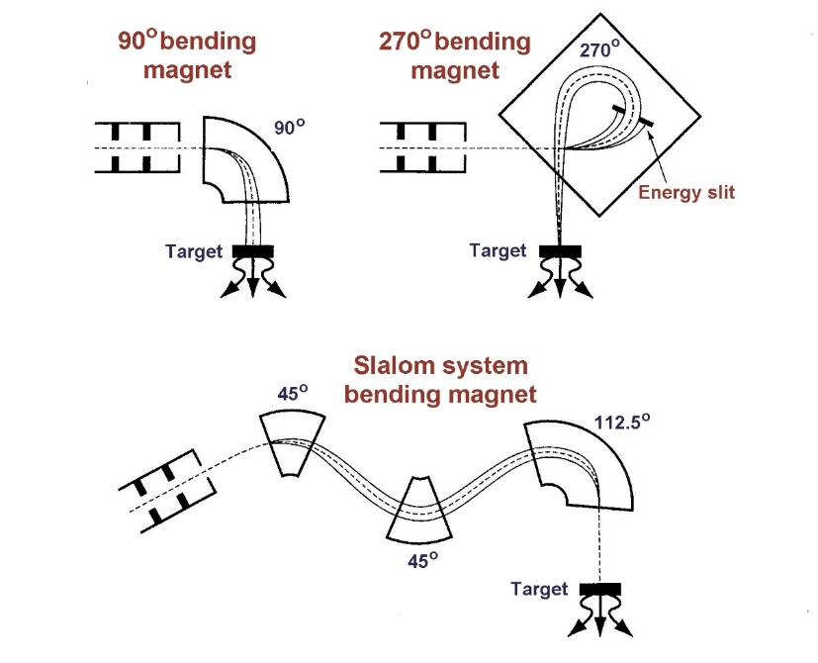
Electron beam transport
Three systems for electron beam bending have been developed:
90º bending
270º bending
112.5º (slalom) bending
Notes:
General scheme

Slide 32
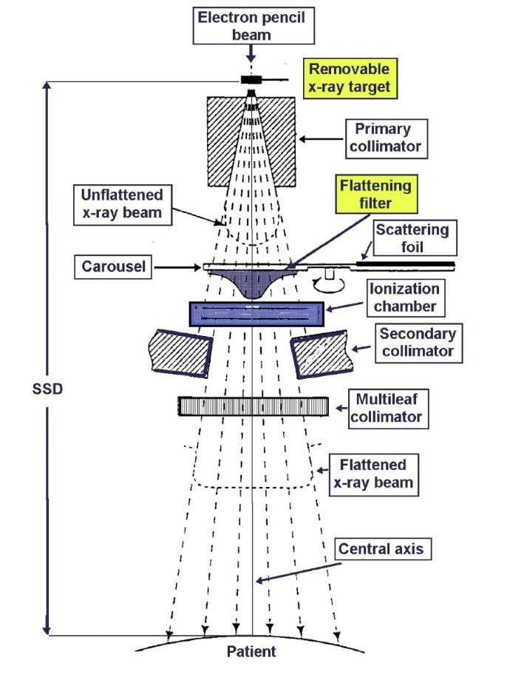
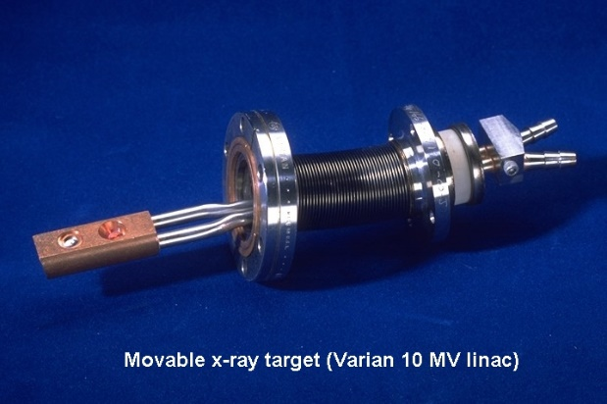
Clinical X-ray beam
Notes:
General scheme

Slide 33
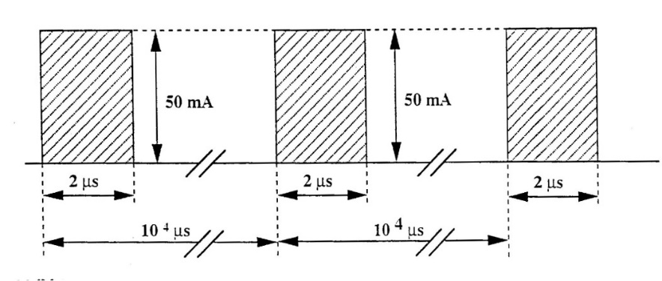
Clinical X-ray beam
Typical electron pulses arriving on the x-ray target of a linac.
The target is insulated from ground, acts as a Faraday cup, and allows measurement of the electron charge striking the target.
Typical values:
Pulse height: 50 mA
Pulse duration: 2 μs
Repetition rate: 100 Hz
Period: 10⁴ μs
Notes:
General scheme

Slide 34
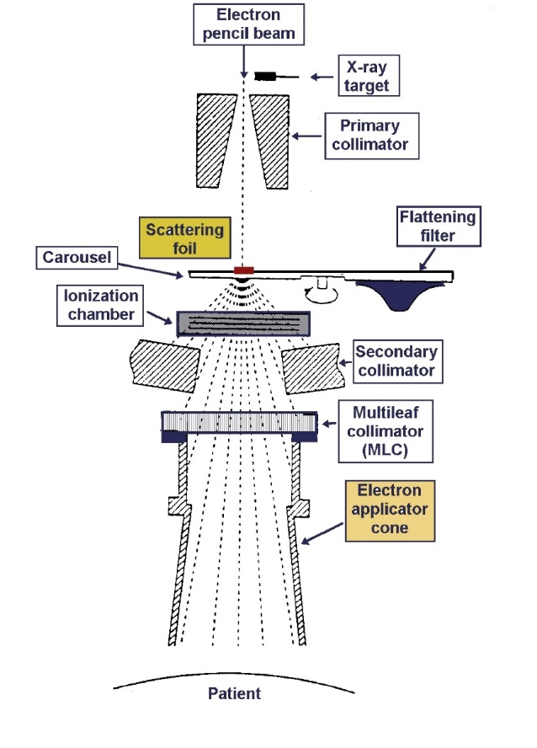
Clinical electron beam
Notes:
General scheme

Slide 35
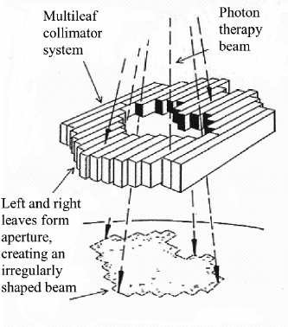
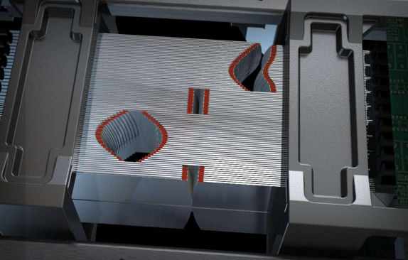
Multileaf collimator
Notes:
General scheme

Slide 36
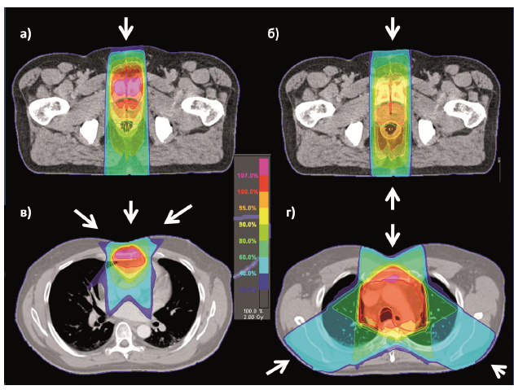
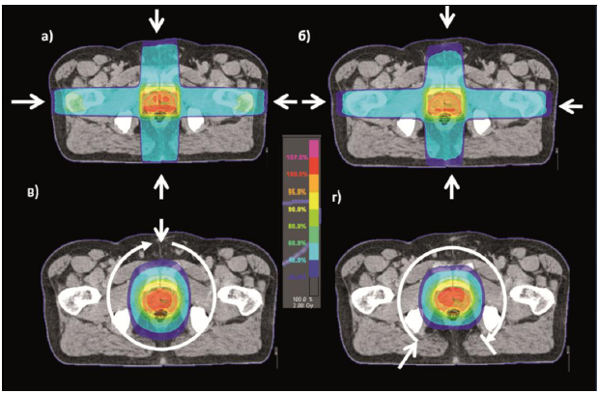
Conventional EBRT
Rectangular shape
Notes:
General scheme

Slide 37
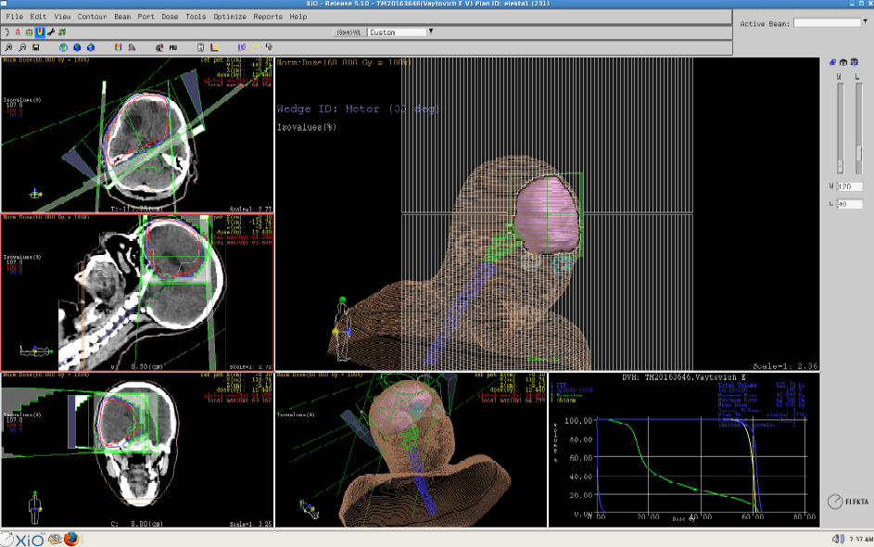
3D-CRT
Notes:
General scheme

Slide 38
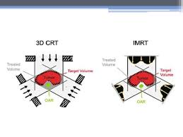
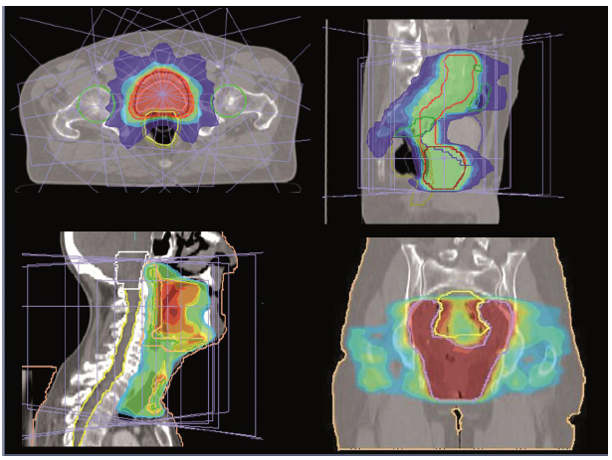
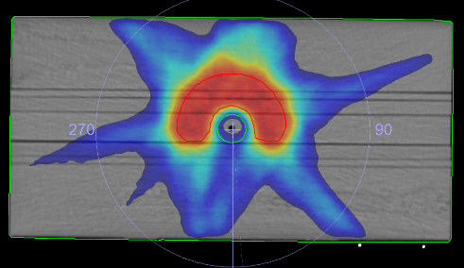
IMRT and VMAT
Notes:
General scheme

Slide 39
proton machines

Slide 40
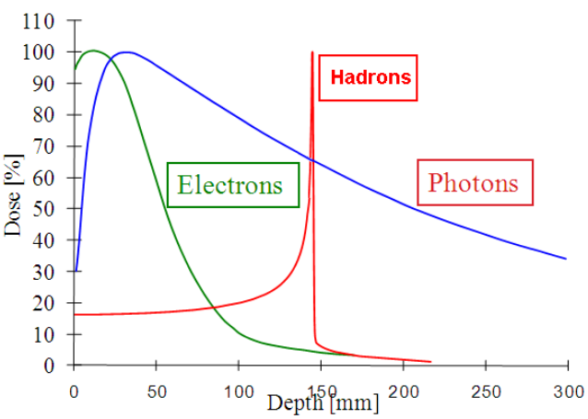
Dose depth distribution
Notes:
General scheme

Slide 41
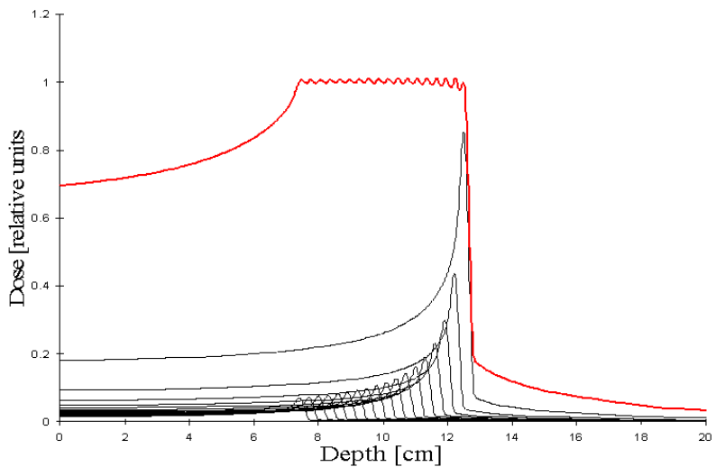
Spread of Bragg peak
Tumour
Proton energy
70-250 MeV
Notes:
General scheme

Slide 42
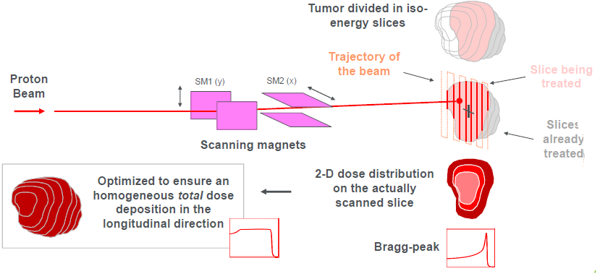
Pencil beam scanning
Notes:
General scheme

Slide 43
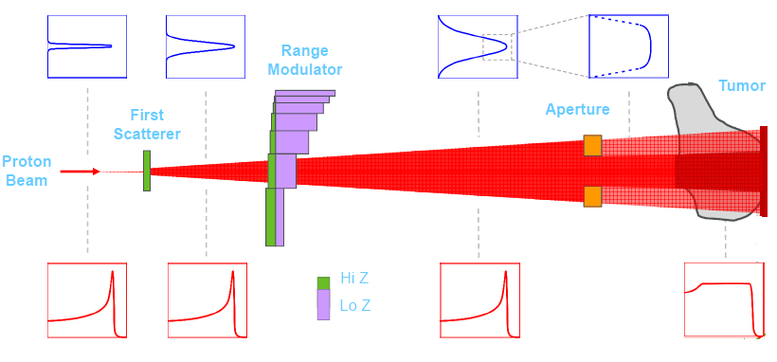
Single scattering
Notes:
General scheme

Slide 44
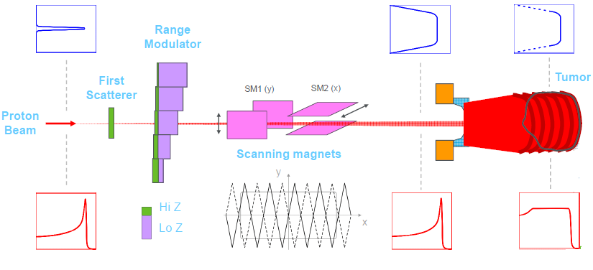
Uniform scanning (wobbling)
Notes:
General scheme

Slide 45

Intensity modulation pencil beam
Fast intensity modulation is needed (easier with CW isochronous cyclotrons)
Notes:
General scheme

Slide 46

Main blocks
Accelerator
Energy selection
Beam transport
Gantry
Courtesy M. Schippers
Notes:
General scheme

Slide 47

Building
Notes:
General scheme

Slide 48


Accelerator
Cyclotron: fixed energy, energy modulation is needed, CW
Synchrotron: variable energy, complexity
Notes:
General scheme

Slide 49

Energy degrader (PSI)
Notes:
General scheme

Slide 50

Gantry
Notes:
General scheme

Slide 51







Main manufactures
Germany (RP)
USA (PT)
GE, USA (RP)
USA (PT)
Japan (RP+PT)
Canada (RP)
C235
Canada (RP)
Belgium (RP+PT)
Notes:
General scheme

Slide 52
Conclusions
Roughly 35% of accelerator are used for medical purposes, mainly radiotherapy.
Electron linacs are the main “working horses” that are developed in the direction of precise dose delivery
Proton therapy is widely developed but still to expensive and complicated, mostly because of beam transport and delivery.
Notes:
General scheme

Slide 53
Thank you
for your Attention!

