Slide 1
Phase-space rotation technique and applications
Masao KURIKI
Graduate School of Advanced Sciences of Matter,
Hiroshima University
ALLPPT.com _ Free PowerPoint Templates, Diagrams and Charts

Slide 2
Contents
Introduction
Emittance Exchange
Applications.
Summary

Slide 3
Introduction
Area of the phase-space occupied by particles: emittance.
In principle, the emittance is the volume in 6D phase-space.
The 6D emittance is invariant (Loisville's theorem).
z
px
pz
py
ｘ
ｙ
ｘ
px

Slide 4
Louisville's theorem
6D emittance is invariant.
2D emittance (ex, ey, ez) can be conserved, but not invariant.
Can the partitioning of x, y, and z be modified as we want? (Phase-space rotation).
Emittance | ex | ey | ez | ex*ey*ez
No coupling | conserved | convserved | conserved | Invariant
With coupling | varied | varied | varied | Invarian

Slide 5
XY-Z Emittance Exchange TLEX (Transverse to Longitudinal Emittance eXchange)

Slide 6
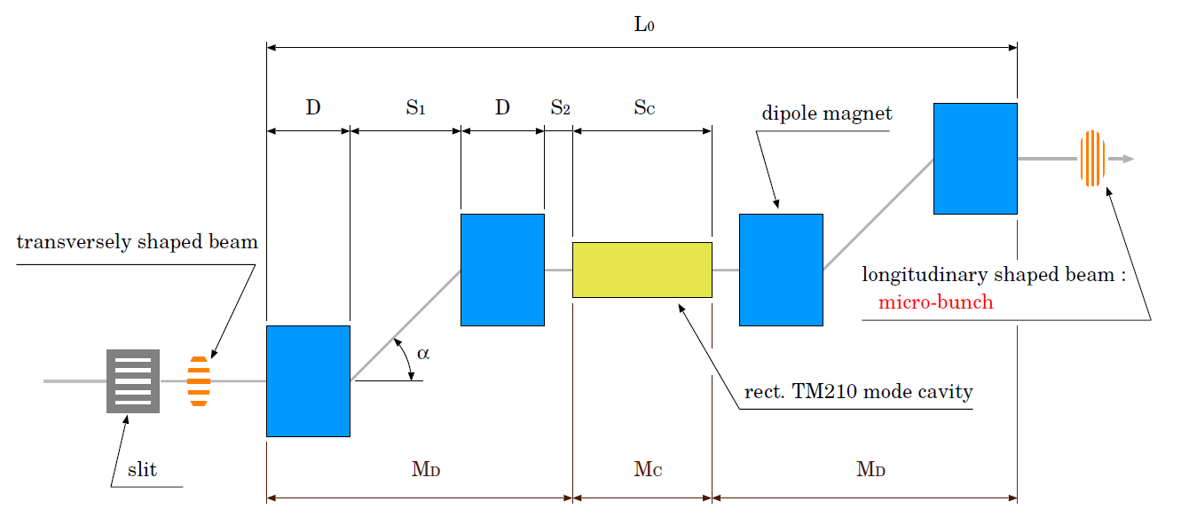
XY-Z Emittance Exchange TLEX
TLEX can be made with chicane or two doglegs and a dipole mode RF cavity.
The phase spaces of X(transverse direction in deflecting plane) and Z (longitudinal direction) are swapped.

Slide 7
Transfer Matrix
One dog-leg section
One dog-leg section
Dispersion
Momentum compaction
Effective length

Slide 8
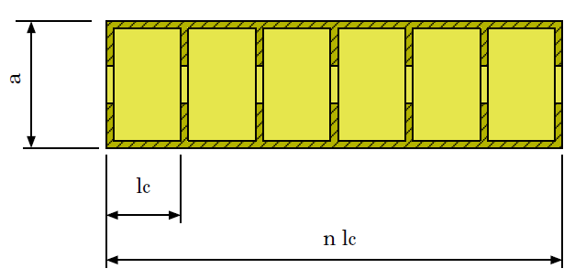
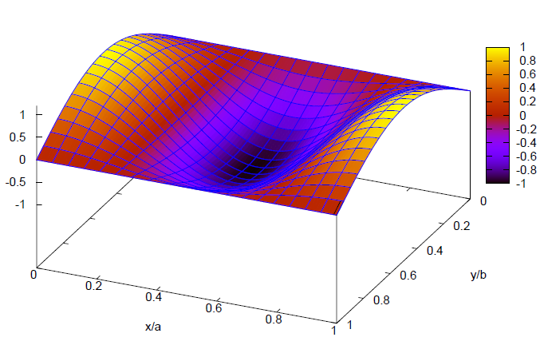
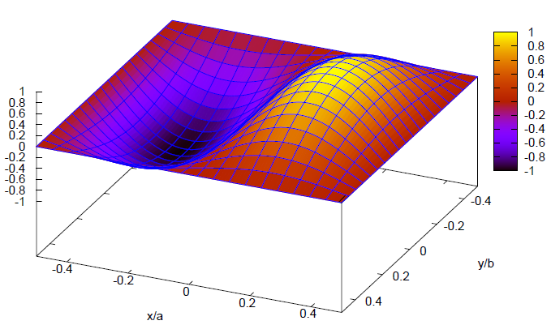
Transfer Matrix of Dipole RF
TM011cavity
By/B0
Ez/E0

Slide 9
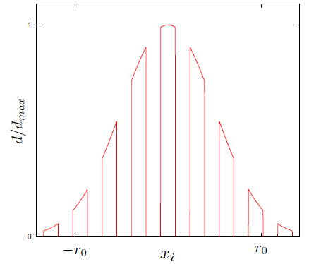
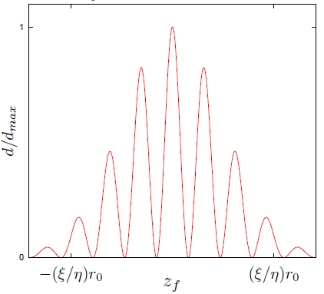
Matrices -EEX section-
x0
matching condition
z1
compression
factor
dilution
factor
x-z space exchange
by the 4D space rotation.
otsuki

Slide 10
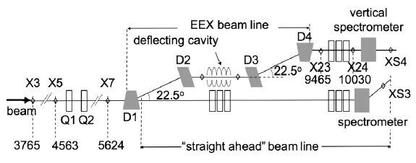
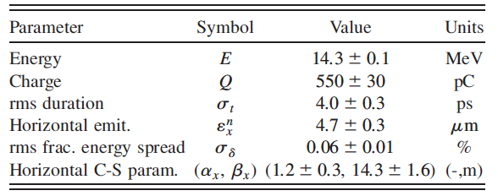
Tunable Subpicosecond Electron-Bunch-Train Generation Using a Transverse-To-Longitudinal Phase-Space Exchange Technique
Y.-E Sun, et al.,
PRL(105)2340801(2010)

Slide 11
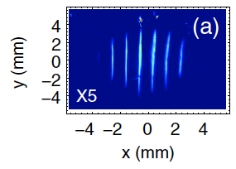
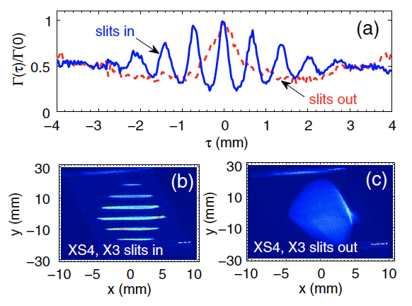
Primary modulation
(slits in x)
After Z-X rotation
(y corresponds to z)
RMS<300fs
(limited by resolution)

Slide 12
XY Emittance Exchange
RFTB(Round to Flat Beam Transformation)

Slide 13
Magnetized Beam
Beam Generation in solenoid field (B_{z})
Canonical momentum by Vector potential has the angular momentum.
By the fringe field, the canonical momentum becomes the kinetic momentum .
The x-py and y-px correlated beam is obtained.
Vector Potential
Magnetized Beam
In sigma matrix

Slide 14
Restoration Matrix
By ignoring the intrinsic emittance, the beam at the exit of the solenoid field is (x and y are correlated.)
Beam transfer with a matrix M is
If the condition is satisfied, Y1 is independent from X0. The correlation is restored.
E. Thrane, LINAC2002

Slide 15
How to restore?
Sigma matrix at the downstream of solenoid field.
M should vanish the non-diagonal component (LJ) of the sigma matrix.

Slide 16
M matrix
Let us assume three skew Qs
Assume
To satisfy

Slide 17
Restoration Matrix
E. Thrane, LINAC2002
After skew Q channel,

Slide 18
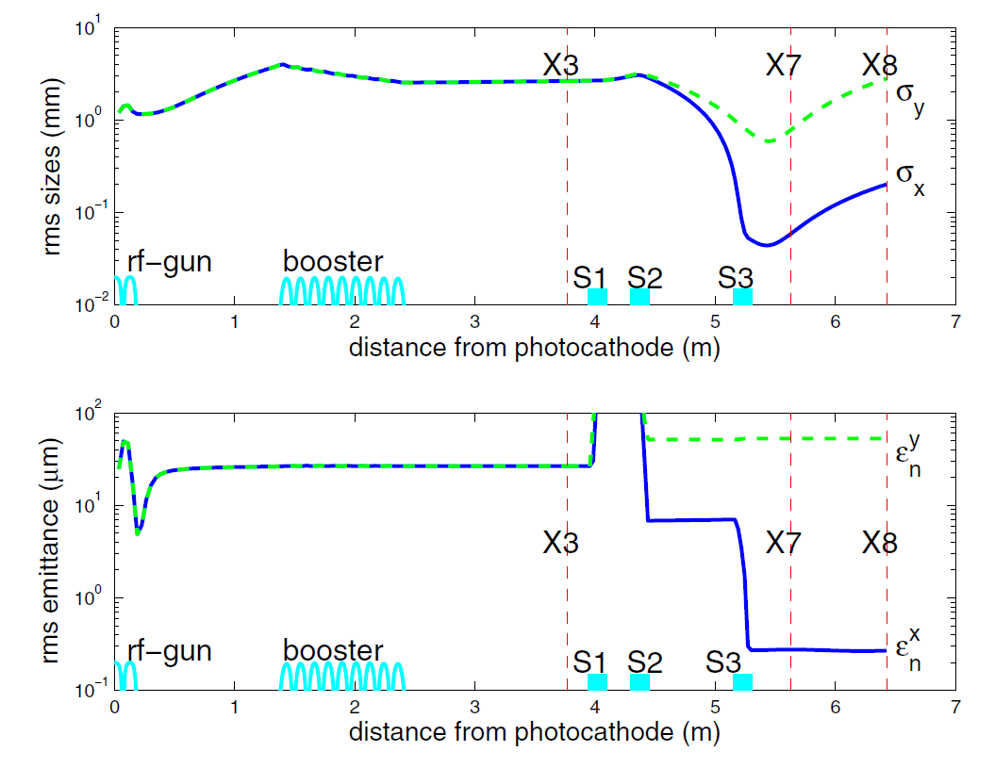
P.Piot, Y.-E Sun, K.-J. Kim
PRSTAB(9)031001(2006)
Emittance Ratio 100
was achieved.

Slide 19
Possible Applications
Emittance exchange is useful to optimize the phase-space distribution to applications.
Examples are
Pre-bunched FEL,
Coherent Smith-Parcels radiation,
Extremely short pulse generation,
High aspect ratio beam for linear colliders

Slide 20
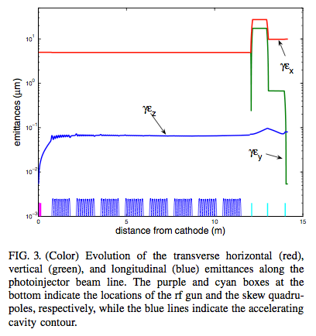
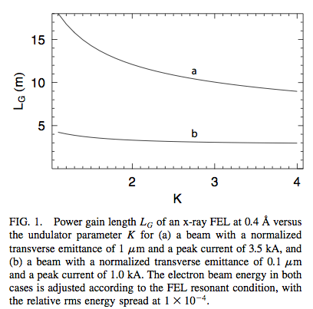
High Gain FEL
Neil Thompson., et al. "The 4GLS VUV-FEL." University of Strathclyde (2011).

Slide 21
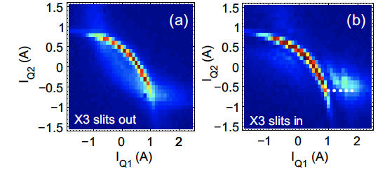
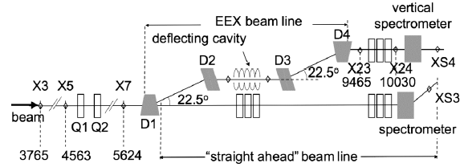
Coherent Radiation with Bunch Train
Y.-E Sun, et al.,
PRL(105)2340801(2010)
v

Slide 22
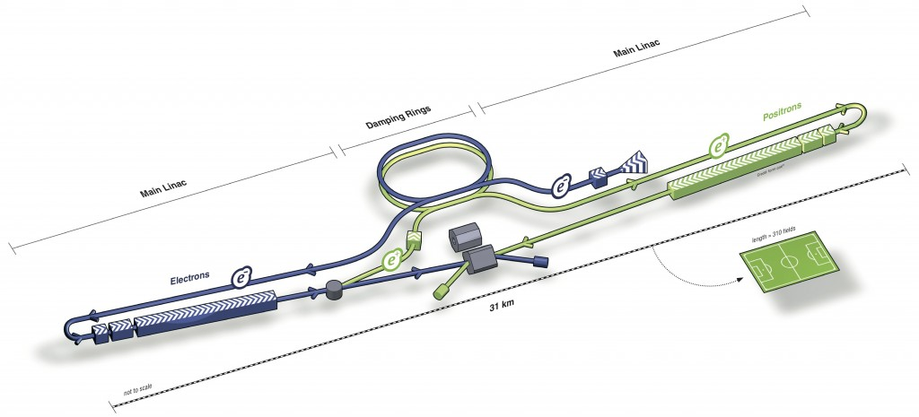
Asymmetric Beam for Linear Collider
Linear Collider is an only solution for e+e- collision beyond the limit of ring colliders by the huge energy loss by synchrotron radiation.
The beam is “one pass” and the beam current is very limited. In order of 10mA for linear colliders, and in order of A for a modern ring collider .
To obtain an enough luminosity, the beam is focused down to nm.

Slide 23
High Aspect Ratio Beam in LC
Event Rate
Luminosity
Beamstrahlung
Disruption
σy«σx
(Asymmetric Beam)
Parameter | Value
Horizontal size | 640 nm
Vertical size | 5.7 nm
Bunch length | 300 μm
Vertical Disruption | 19.4
RMS energy by BS | 2.4%
Horizontal emi. | 10 mm.mrad
Vertical emi. | 0.04 mm.mrad
Aspect ratio 250 is made
up with 3km DR
23
Notes:
23

Slide 24
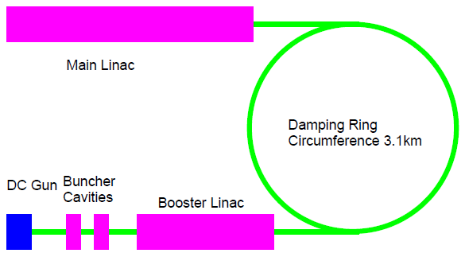
High Aspect Ratio Beam by EMIX
The high aspect ratio beam is generated by a 3km DR (Damping Ring) in the current design (ILC TDR)..
I the beam can be generated directly from the injector with EmiX technique, the design can be much simpler.

Slide 25
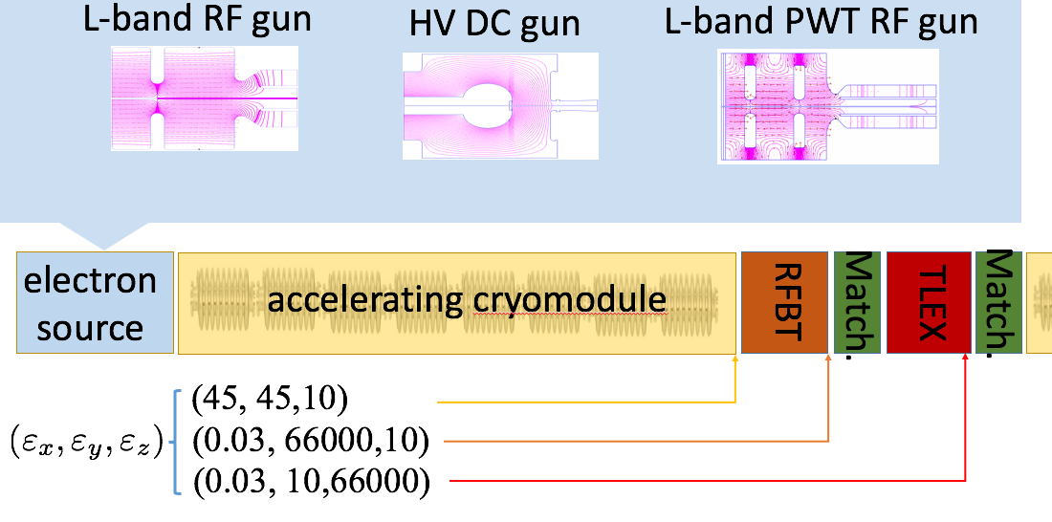
Flat Beam Generation for LC
The flat beam (ex=10um, ey=0.04um) can be generated with RFTB and TLEX.
The beam is generated in a large size to compensate the space charge non-linearity. ex=ey=45 um.
By RFTB, it can be ex=66000um and ey=0.03.
The ex is too large for LC. It should be exchanged with ez by TLEX.

Slide 26
High Aspect Ratio Beam Generation with EmiX
B field
Skew Quadrupoles
laser
Injector Linac
Polarized Beam
GaAs/GaAsP
Super-lattice
Dipole Mode
RF cavity
Dogleg
To booster
Dogleg

Slide 27
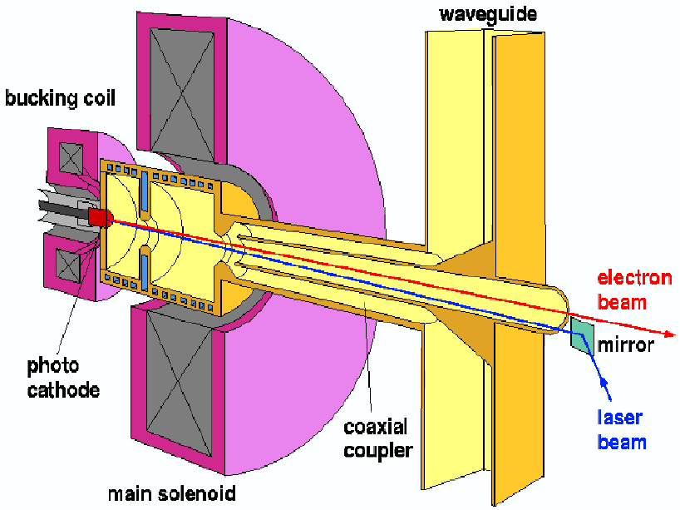
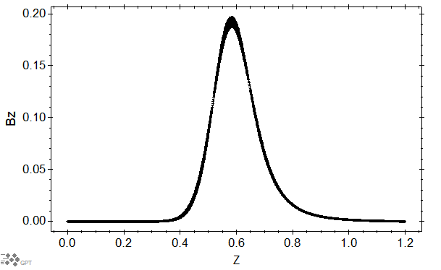
STF RF Gun
L-band (1.3 GHz) normal conducting RF gun developed for FLASH/XFEL at DESY.
By switching current of the bucking coil, solenoid field can be made on the cathode surface.
In the simulation, that was 0.1 Tesla.
Cathode Position

Slide 28
RFTB Section
The beam is generated in 0.1 Tesla selenoid field.
The canonical angular momentum is converted in the free-space.
The beam is accelerated and the correlation is restored by skew-Q channel.
B field
laser
Accelerator
Skew Quadrupoles
Polarized Beam
GaAs/GaAsP
Super-lattice

Slide 29
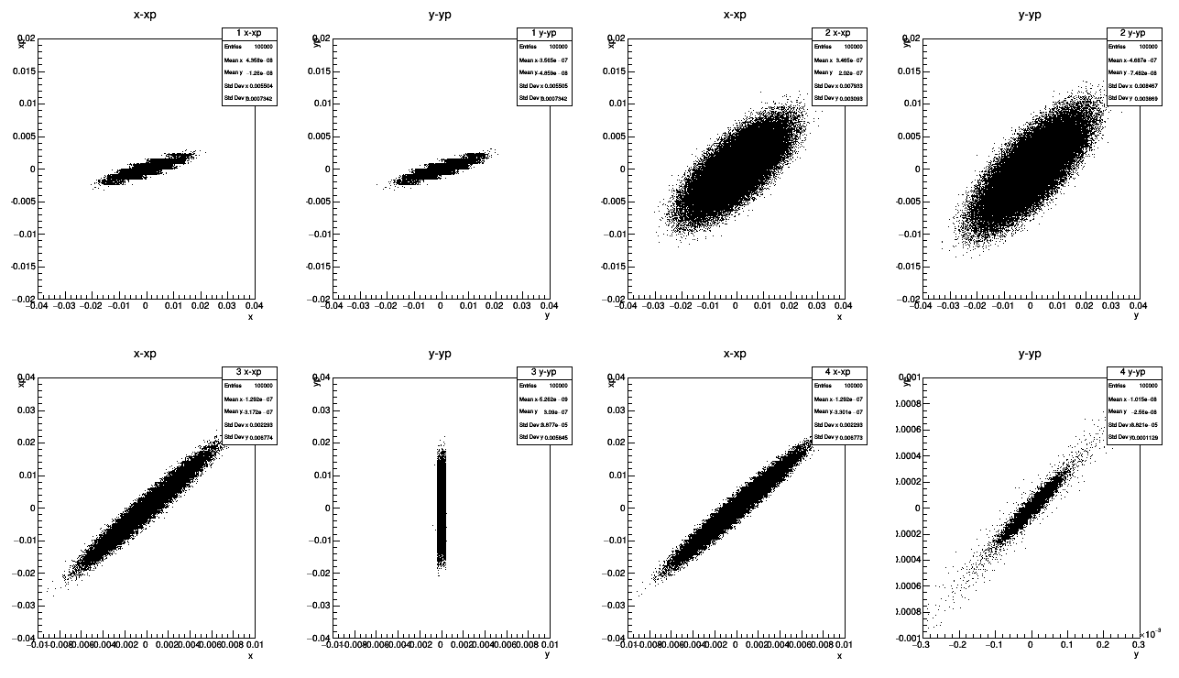
Phase-space in RFTB
Before 1st Skew
Before 2nd Skew
Before 3rd Skew
After 3rd Skew

Slide 30
TLEX Section
ex and ez are exchanged by TLEX beam line.
The large ex after RFTB is transferred to Z space after TLEX.
ex after TLEX section is same as ez before TLEX line.
Dipole Mode
RF cavity
Dogleg
To booster
Dogleg

Slide 31
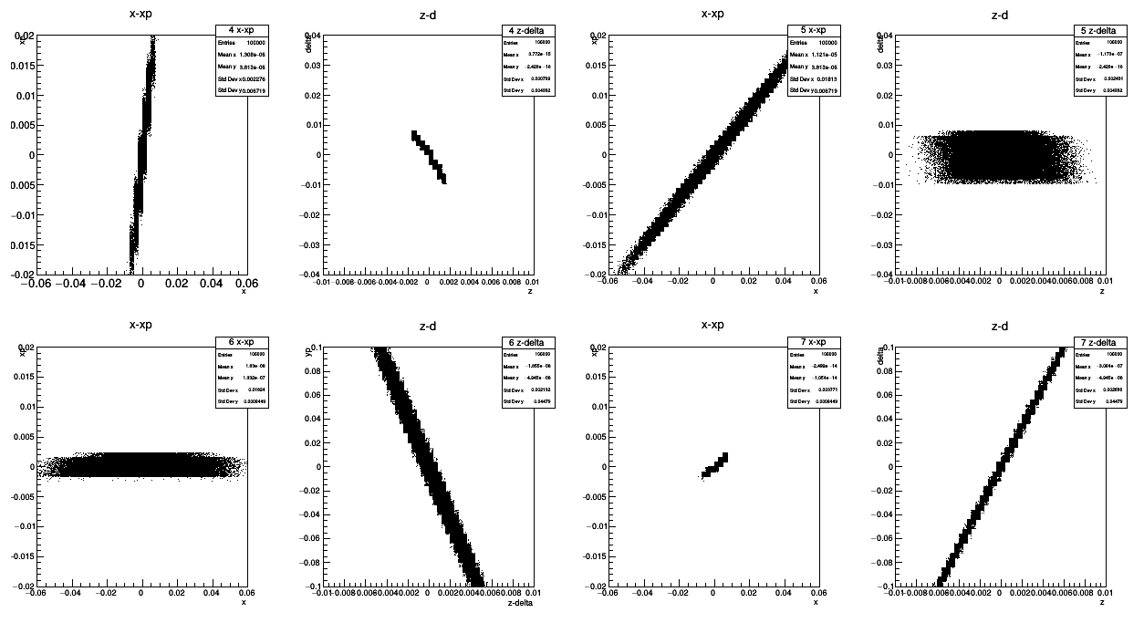
Phase-space in TLEX
Before 1st Dogleg
After 1st Dogleg
After dipole RF
After 2nd Dogleg

Slide 32
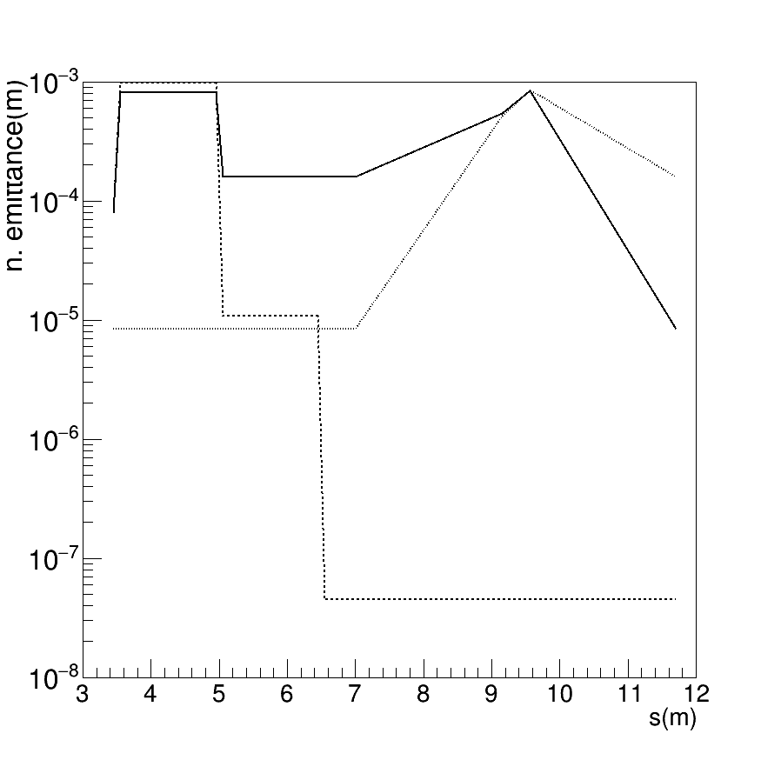
Emittance Evolution
(norm. in um)
εz
Position | εx | εy | εz
Cathode | 1.5 | 1.5 | 8.5
RFTB | 160 | 0.045 | 8.5
TLEX | 8.5 | 0.045 | 160
ILC design | 10 | 0.04 | 8.4e+5
εx
εy

Slide 33
Parameters
Parameter | Value | Unit
Bsol | 0.1 | T
Initial emittance | 1.5 | mm.mrad
Bunch length | 12 | ps (full width)
Beam size | 1.6 | mm (rms)
Gamma after acc. | 49
g1 | -0.503 | T/m
g2 | 0.926 | T/m
g3 | 2.058 | T/m
alpha | 0.3 | rad
η (δισπερσιον) | 0.355 | m
ξ(mom. compaction) | 0.106 | m
RF voltage | 1.29 | MV (at λ)

Slide 34
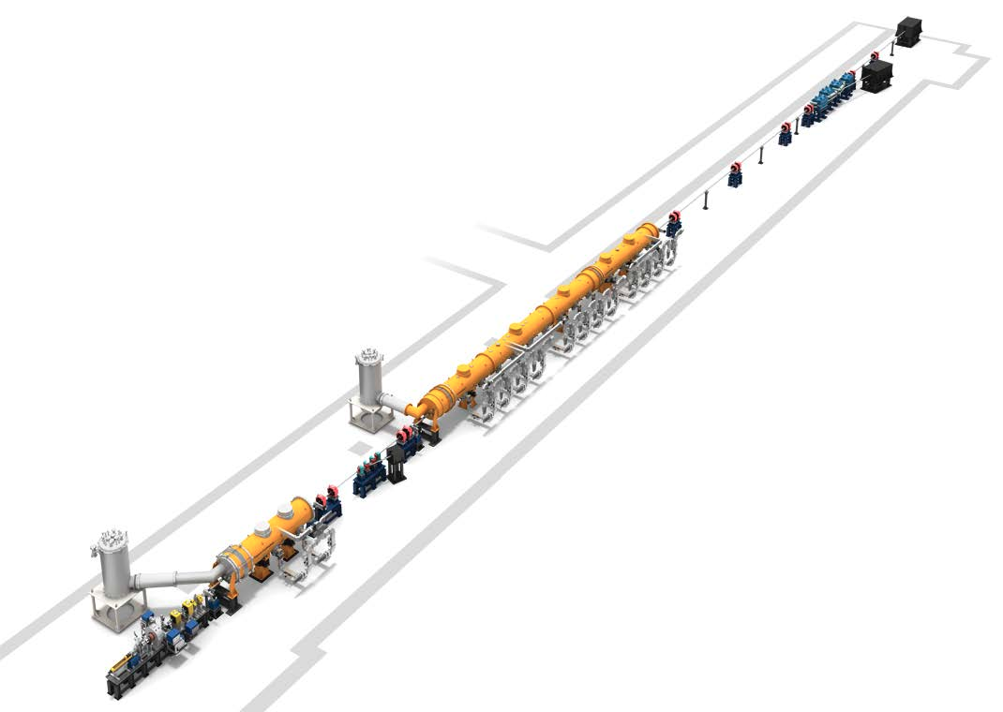
Flat Beam Generation at STF and WFA
RFBT experiment will be carried at KEK-STF.
TLEX experiment will be carried out at ANL WFA.
These works will be carried out in 2018 and 2019.
The flat beam compatible to LC will be demonstrated in STF by introducing the TLEX beam line as a future proposal.
RFTB + TLEX section
KEK-STF
ANL-WFA

Slide 35
Summary
Emittance exchange gives a freedom to optimize the emittance partitioning among degree of freedom.
Applications : High gain FEL, coherent radiation, extremely short bunch generation, flat beam for LC, etc.
ILC compatible beam can be made with these techniques.
Pilot experiments will be carried out at KEK-STF and ANL-WFA.
It can be a proposal for a future plan of STF.

Slide 36
Acknowledgement
P. Piot (Northrn Illinois University)
J. Power (ANL)
H. Hayano, N. Yamamoto, Y. Seimiya (KEK)
S. Kashiwagi (Tohoku University)
K. Sakaue, M. Wahio (Waseda University)
This work is partly supported by Japan-US
cooperativegrant for scientific studies,
Grant aid for scientific study by MEXT Japan (KAKENHI)

